Slide 1

Learner
Credential
Wallet
Brandon Muramatsu, MIT

Slide 2
Overview
Digital Credentials Consortium
Verifiable Credentials
Learner Credential Wallet
Demo

Slide 3
Digital
Credentials
Consortium

Slide 4
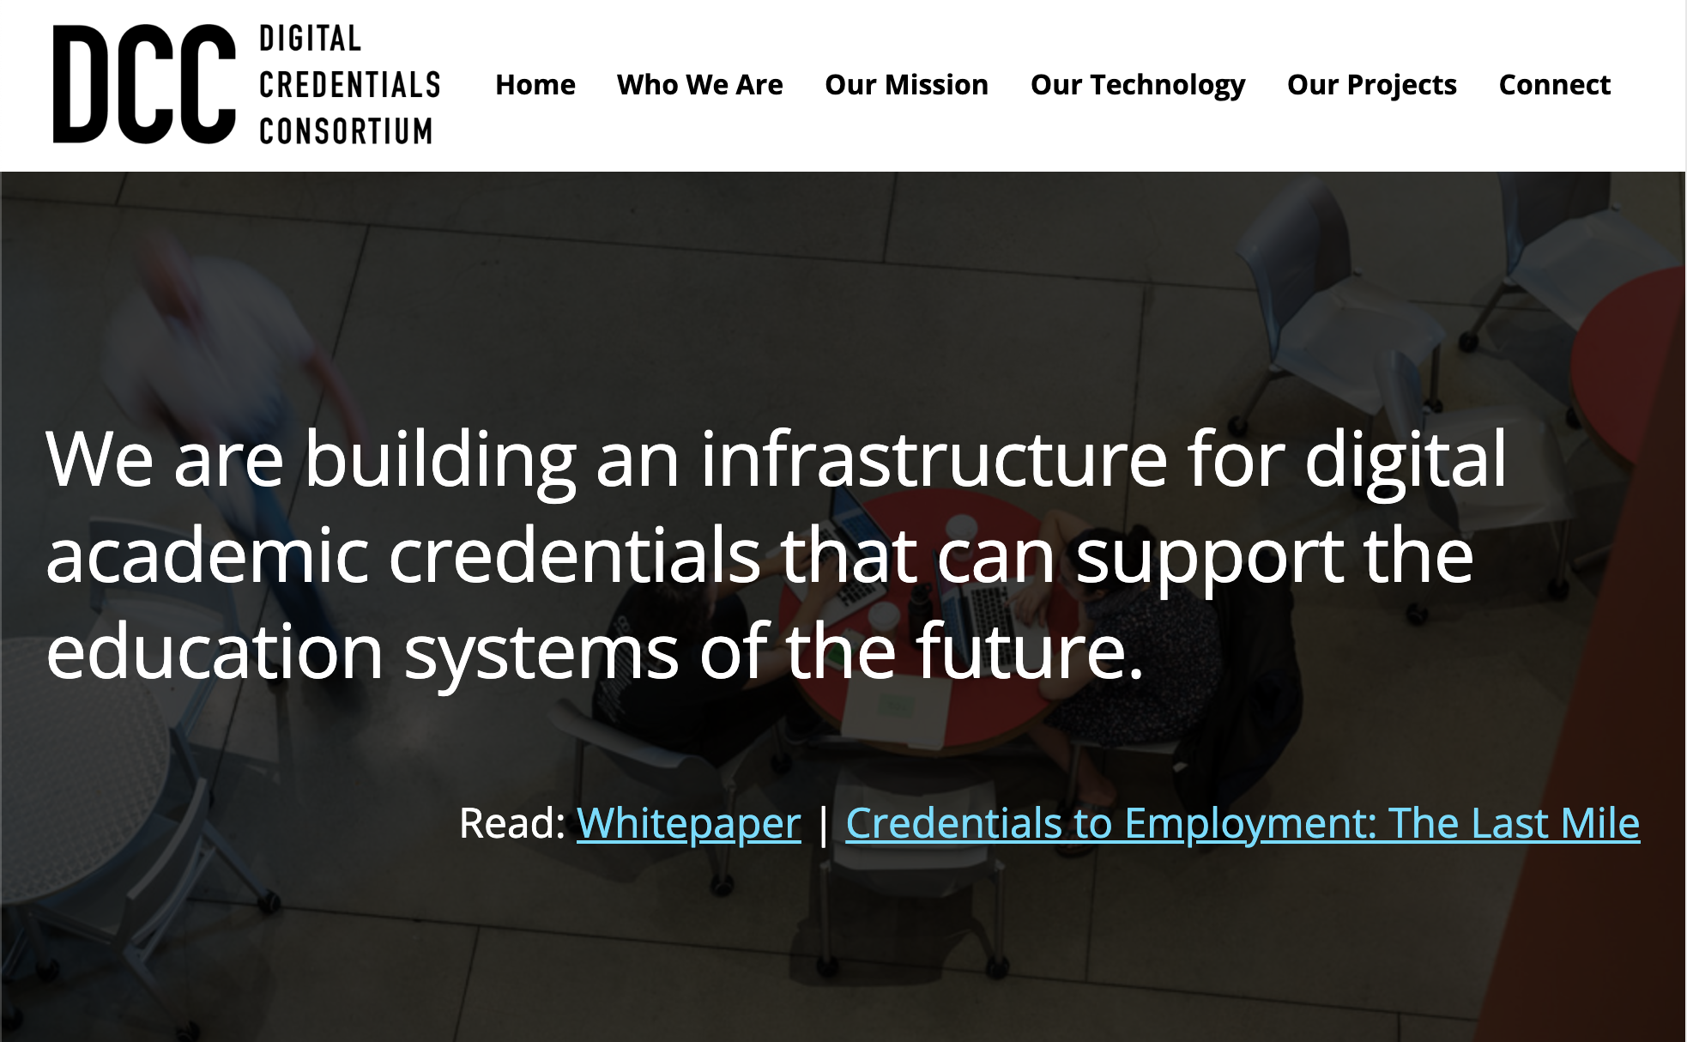


12 Founding Members
Delft University of Technology (Netherlands)
Georgia Institute of Technology (USA)
Harvard University (USA)
Hasso Plattner Institute, Potsdam (Germany)
Massachusetts Institute of Technology (USA)
McMaster University (Canada)
Tecnológico De Monterrey (Mexico)
Technical University of Munich (Germany)
University of California, Berkeley (USA)
University of California, Irvine (USA)
University of Milano-Bicocca (Italy)
University of Toronto (Canada)
White paper: bit.ly/DCC-whitepaper
Notes:
Philipp

Slide 5
Digital Credentials Consortium (DCC)
Vision
Create an education landscape that increases learner agency and promotes more equitable learning and career pathways
Mission
Create a trusted, distributed, and shared infrastructure that is the standard for issuing, storing, displaying, and verifying digital credentials
Notes:
Philipp

Slide 6
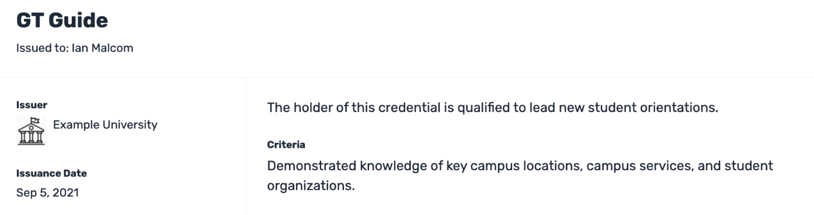
What’s a Digital Credential?
A “digital credential” — a data-based digital representation of a diploma, degree, program certificate, workshop certificate
Name of credential, name of recipient, university name, date issued, perhaps a description

Slide 7
Guiding Principles | Values
Learners - Commitment to learner agency and participation
Learners retain primary control over their credentials
Issuers - Commitment to issuer control of the design of the credential
Issuers control to whom they issue credentials, the particular achievement that the credential represents, and which credential options are available to the learner
Trust - Commitment to open processes, open standards, and software
Credentials can be verified without consulting original issuer

Slide 8
How does DCC do its work?
Develops open standards, open source reference libraries, core infrastructure services
  Co-lead W3C Verifiable Credentials for Education (W3C VC-EDU) Task Group
  Invited expert to IMS Global on Comprehensive Learner Record and Open Badges v3 specifications
  Connections to international efforts
  github.com/digitalcredentials
DCC members build tools and issue credentials
  Supported through Technical Working Group (DCC TWG)

Slide 9
Verifiable Credentials

Slide 10
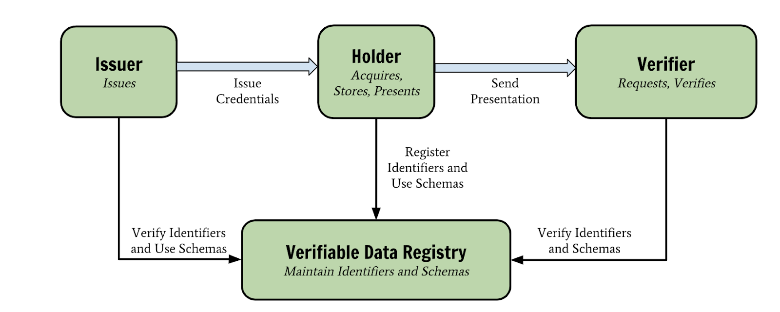
Verifiable Credentials Ecosystem
W3C Verifiable Credentials Data Model
College /
University
Employer /
Graduate School
Learner
DCC Credential
Tamper-evident credential where the authorship can be cryptographically verified, that meets the technical and policy specifications adopted by the DCC.
National Organization / DCC

Slide 11
Verifiable Credentials Ecosystem
DCC software & tools to support the ecosystem
College /
University
Employer /
Graduate School
Sign & Verify
Learner
DCC Credential
Tamper-evident credential where the authorship can be cryptographically verified, that meets the technical and policy specifications adopted by the DCC.
National Organization / DCC

Slide 12
Verifiable Credentials Ecosystem
DCC software & tools to support the ecosystem
College /
University
Employer /
Graduate School
Sign & Verify
Learner
DCC Credential
Tamper-evident credential where the authorship can be cryptographically verified, that meets the technical and policy specifications adopted by the DCC.
National Organization / DCC

Slide 13
Verifiable Credentials Ecosystem
DCC software & tools to support the ecosystem
College /
University
Employer /
Graduate School
Sign & Verify
Learner Credential Wallet
Learner
DCC Credential
Tamper-evident credential where the authorship can be cryptographically verified, that meets the technical and policy specifications adopted by the DCC.
National Organization / DCC

Slide 14
Verifiable Credentials Ecosystem
DCC software & tools to support the ecosystem
College /
University
Employer /
Graduate School
Sign & Verify
Learner Credential Wallet
VerifierPlus
Learner
DCC Credential
Tamper-evident credential where the authorship can be cryptographically verified, that meets the technical and policy specifications adopted by the DCC.
National Organization / DCC

Slide 15
Verifiable Credentials Ecosystem
DCC software & tools to support the ecosystem
College /
University
Employer /
Graduate School
Sign & Verify
Learner Credential Wallet
VerifierPlus
Learner
DCC Credential
Tamper-evident credential where the authorship can be cryptographically verified, that meets the technical and policy specifications adopted by the DCC.
DCC Registries
National Organization / DCC

Slide 16
Learner
Credential
Wallet

Slide 17

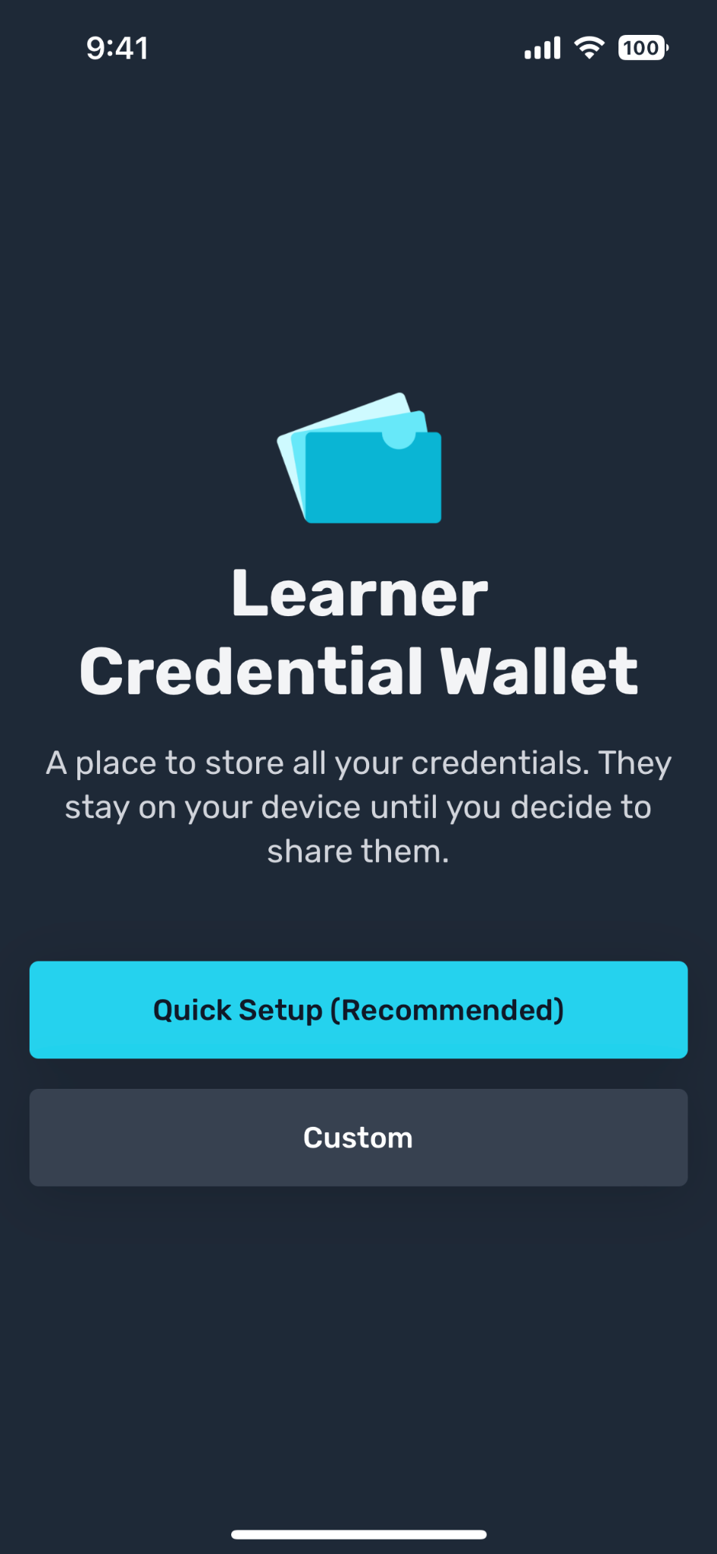
Learner Credential Wallet
Key component of digital credential ecosystem
  Prioritizes learner agency to control their own credentials and prevents lock-in
  Establishes a reference implementation
  Open source, freely available
Wallet specification released (May 2021)
Open-source code hosted on Github (Dec 2021)
Deployment pilots with U.S. institutions
Participant in interoperability plugfests (Jun & Nov 2022)

Slide 18
Learner Credential Wallet
Both Android and iOS versions
  Initial features complete
  Available from lcw.app
Key features
  Passphrase to secure wallet, biometric support
  Standards compliant: W3C Verifiable Credentials, Open Badges v3; VC-API
  Add via QR code, deep link from email, web page or LTI module
  Authenticate user before issue via OIDC call to institution Identity Provider, bearer token, SAML 2 (in progress)
  Share credential via file, public web link, shortcut to LinkedIn
  Multiple user profiles each with distinct identifiers

Slide 19
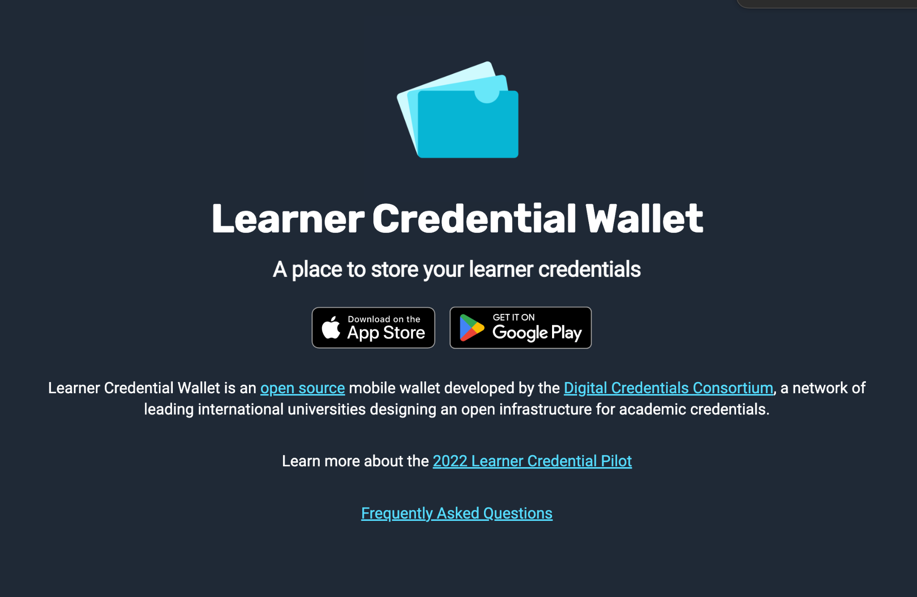

Slide 20
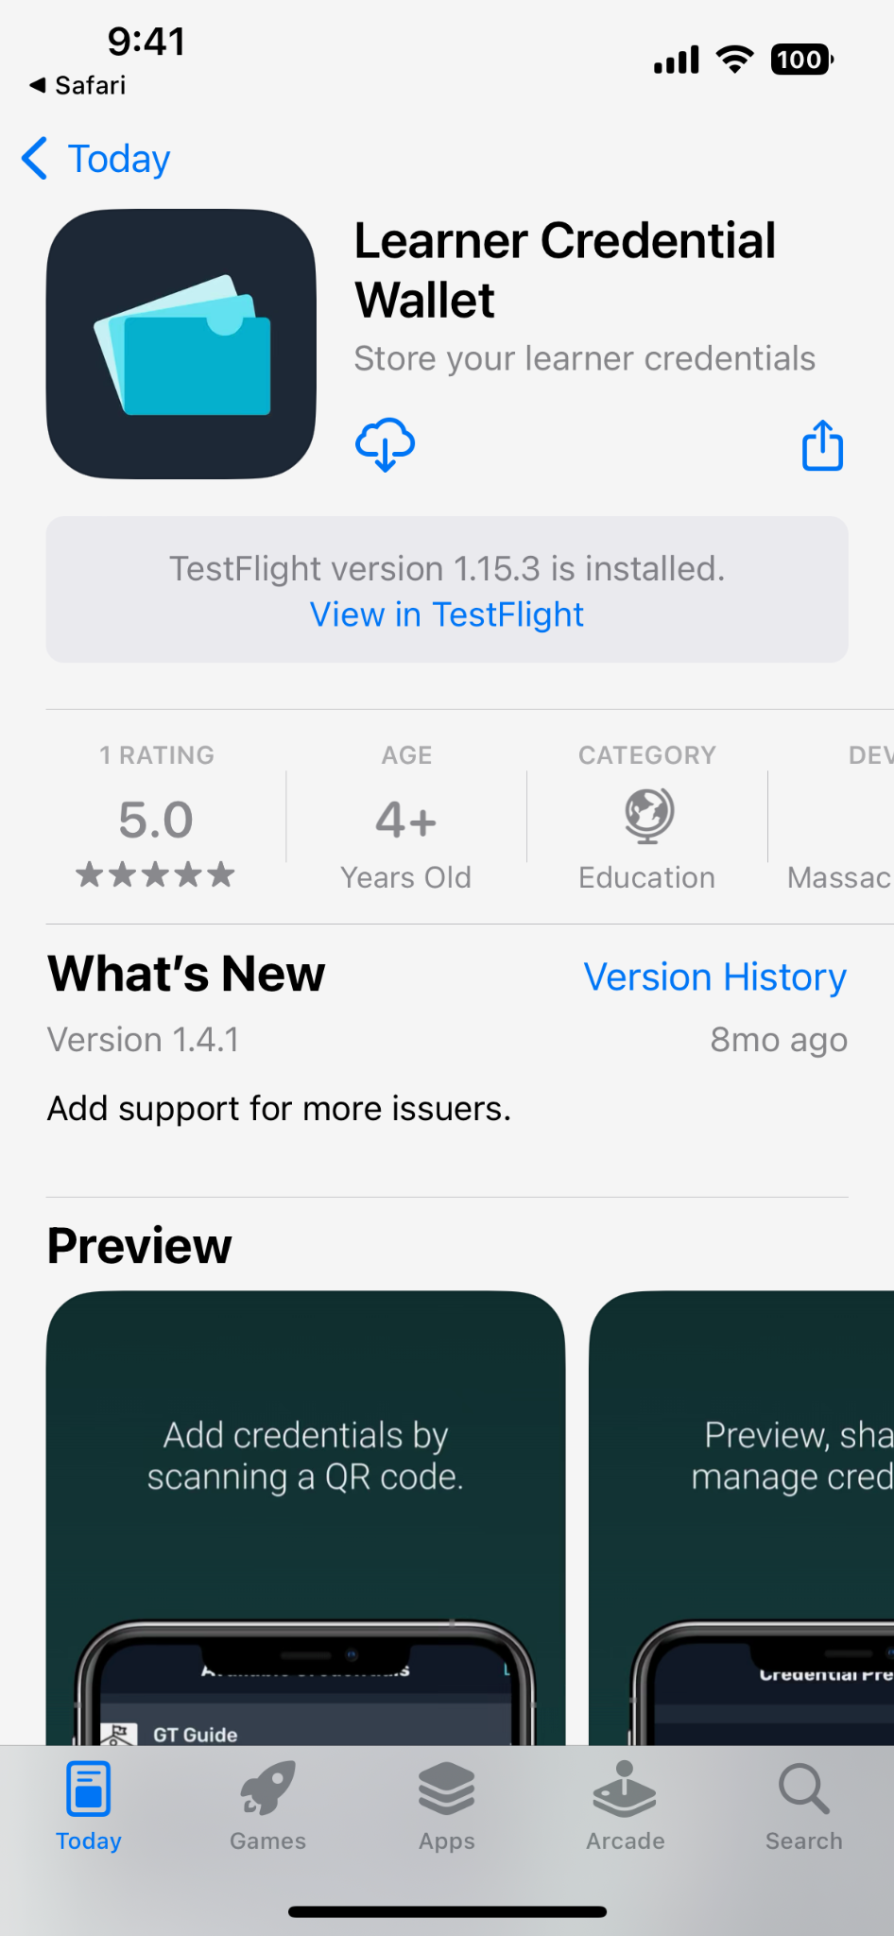
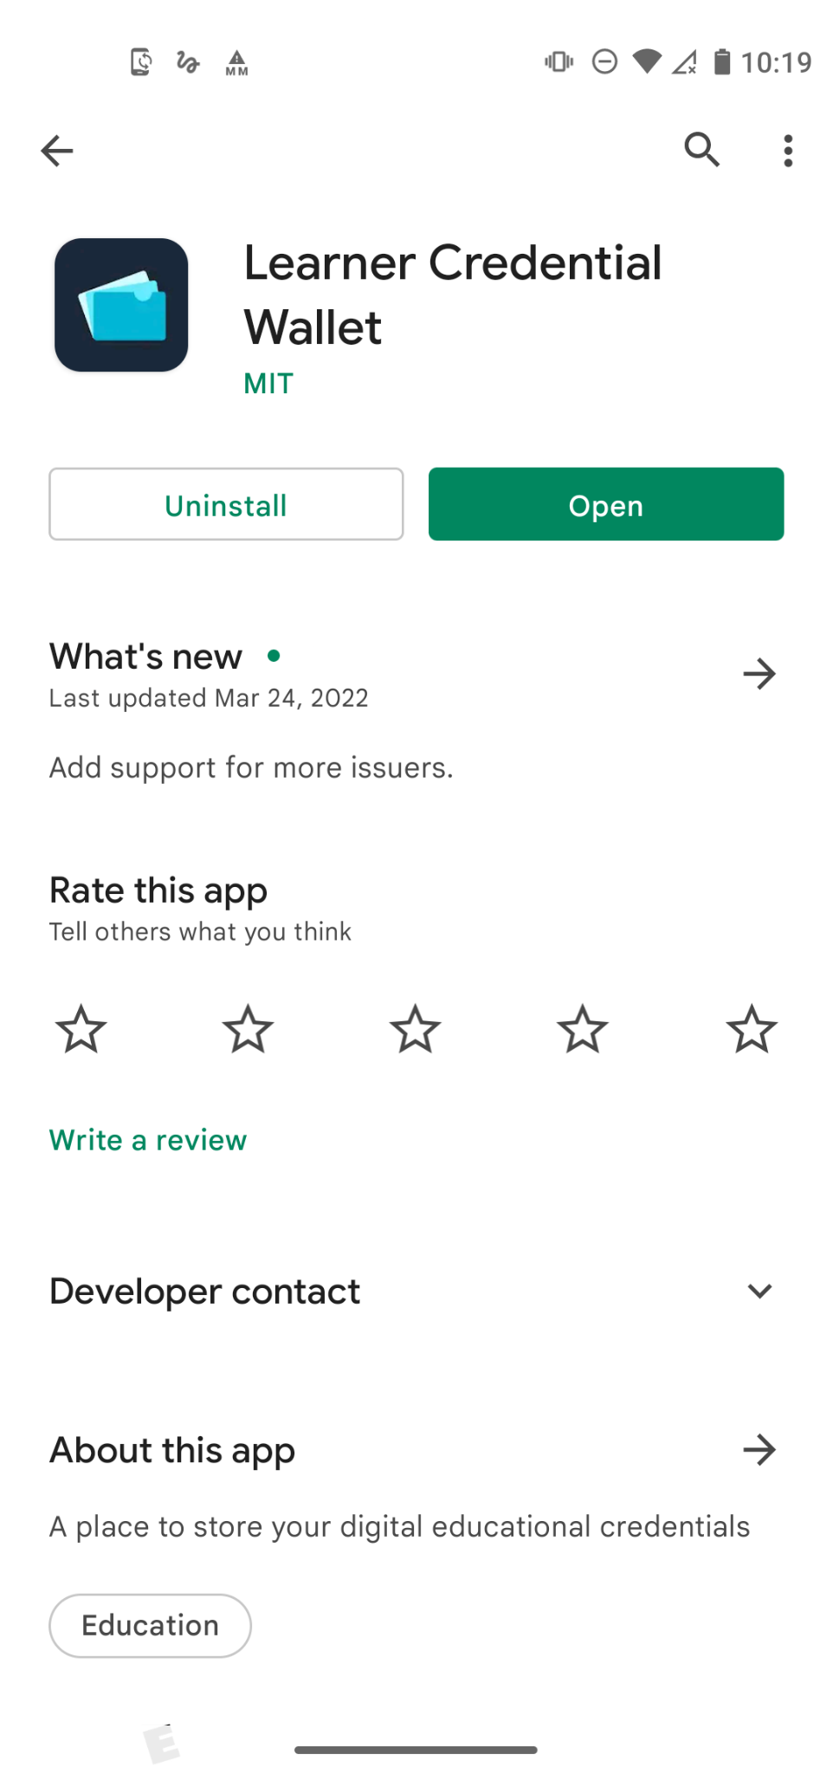

Slide 21
Live demo of Learner Credential Wallet
Adding a Credential from the Canvas Learning Management System

Slide 22
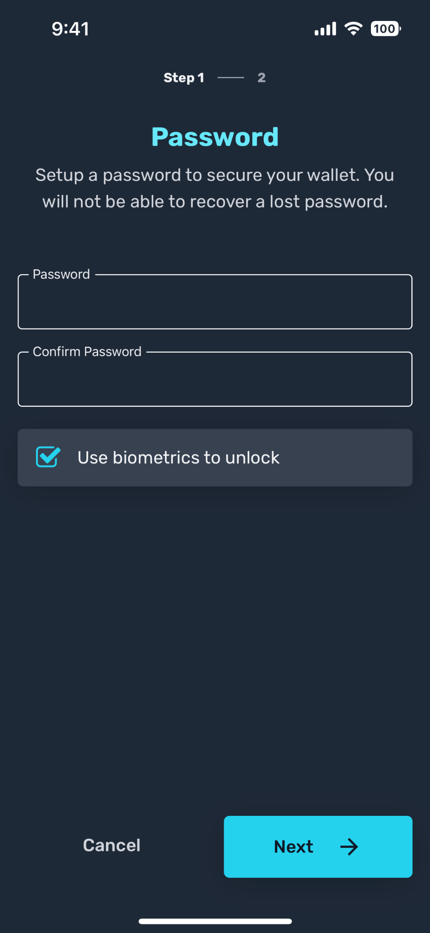
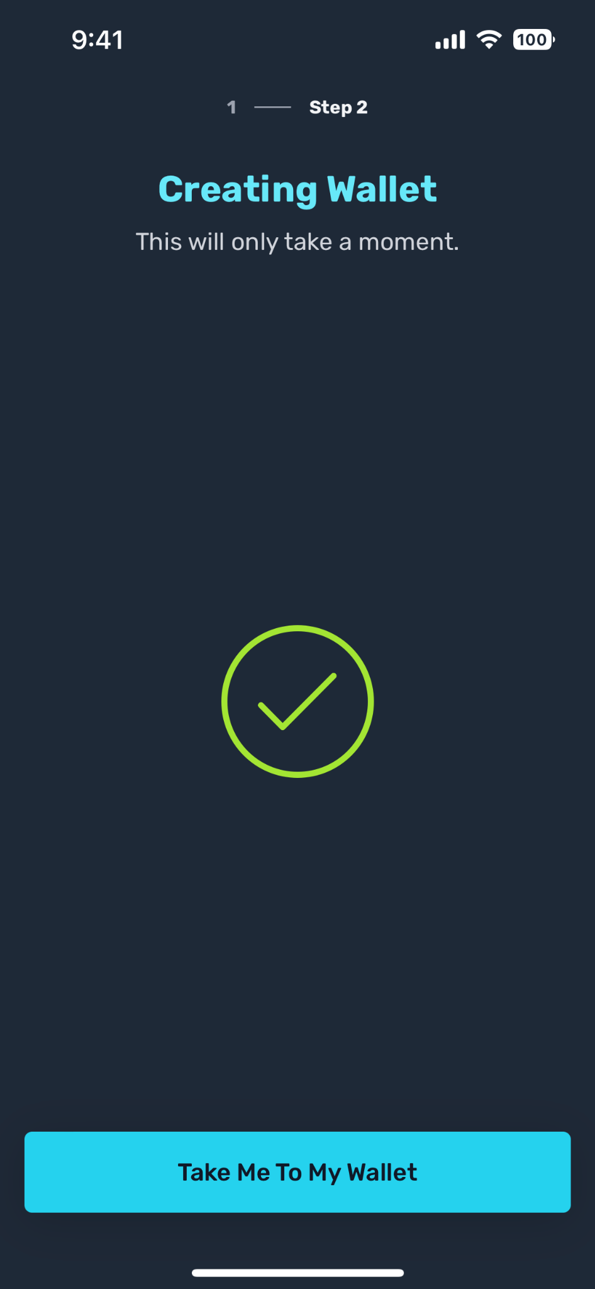
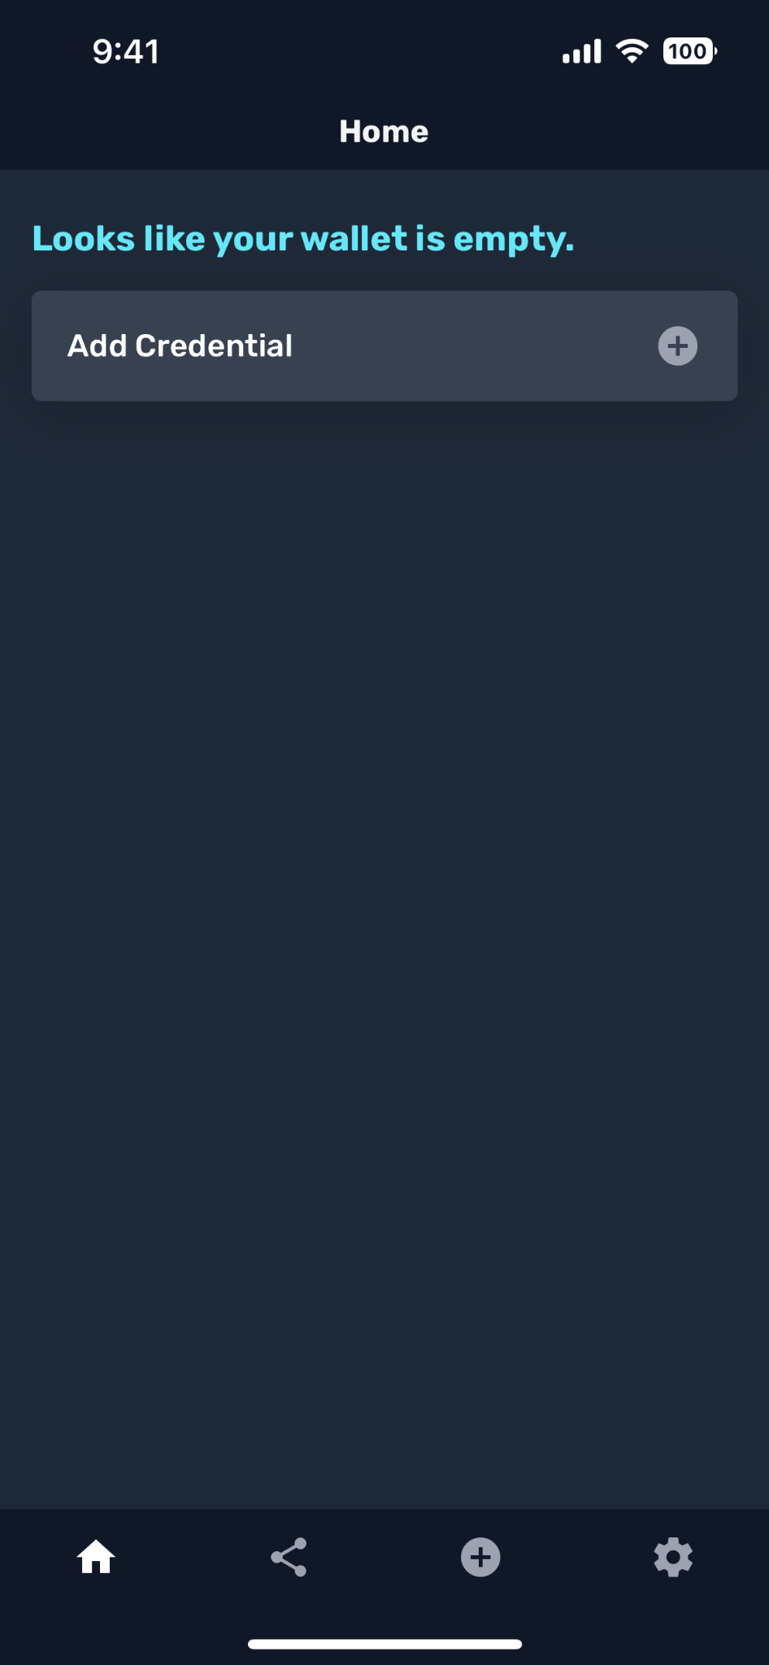
Install and setup Learner Credential Wallet

Slide 23
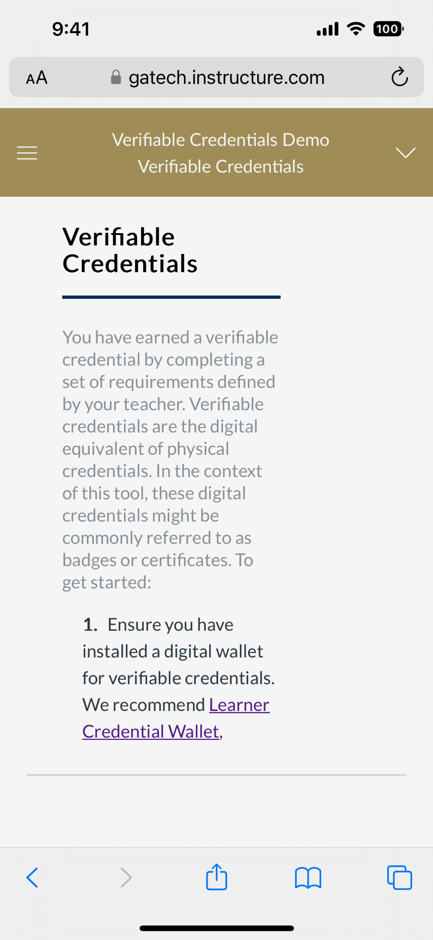
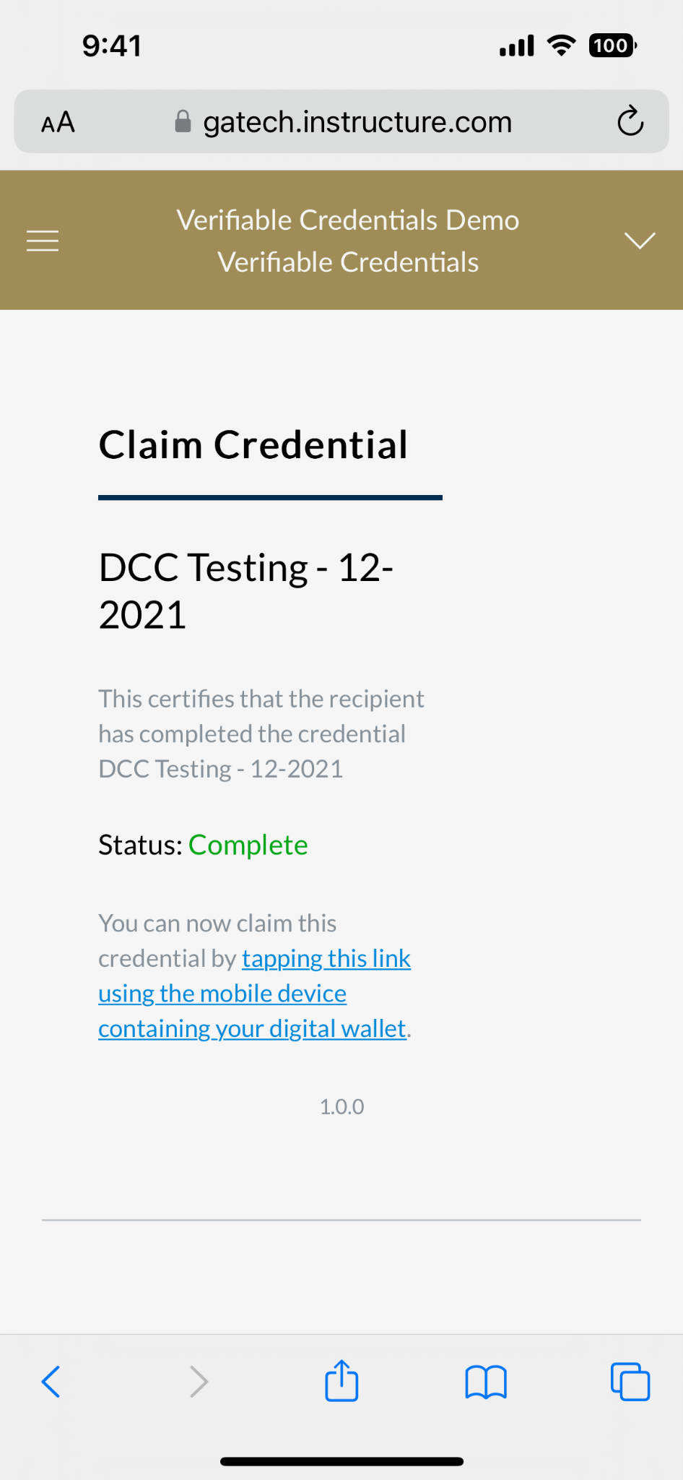
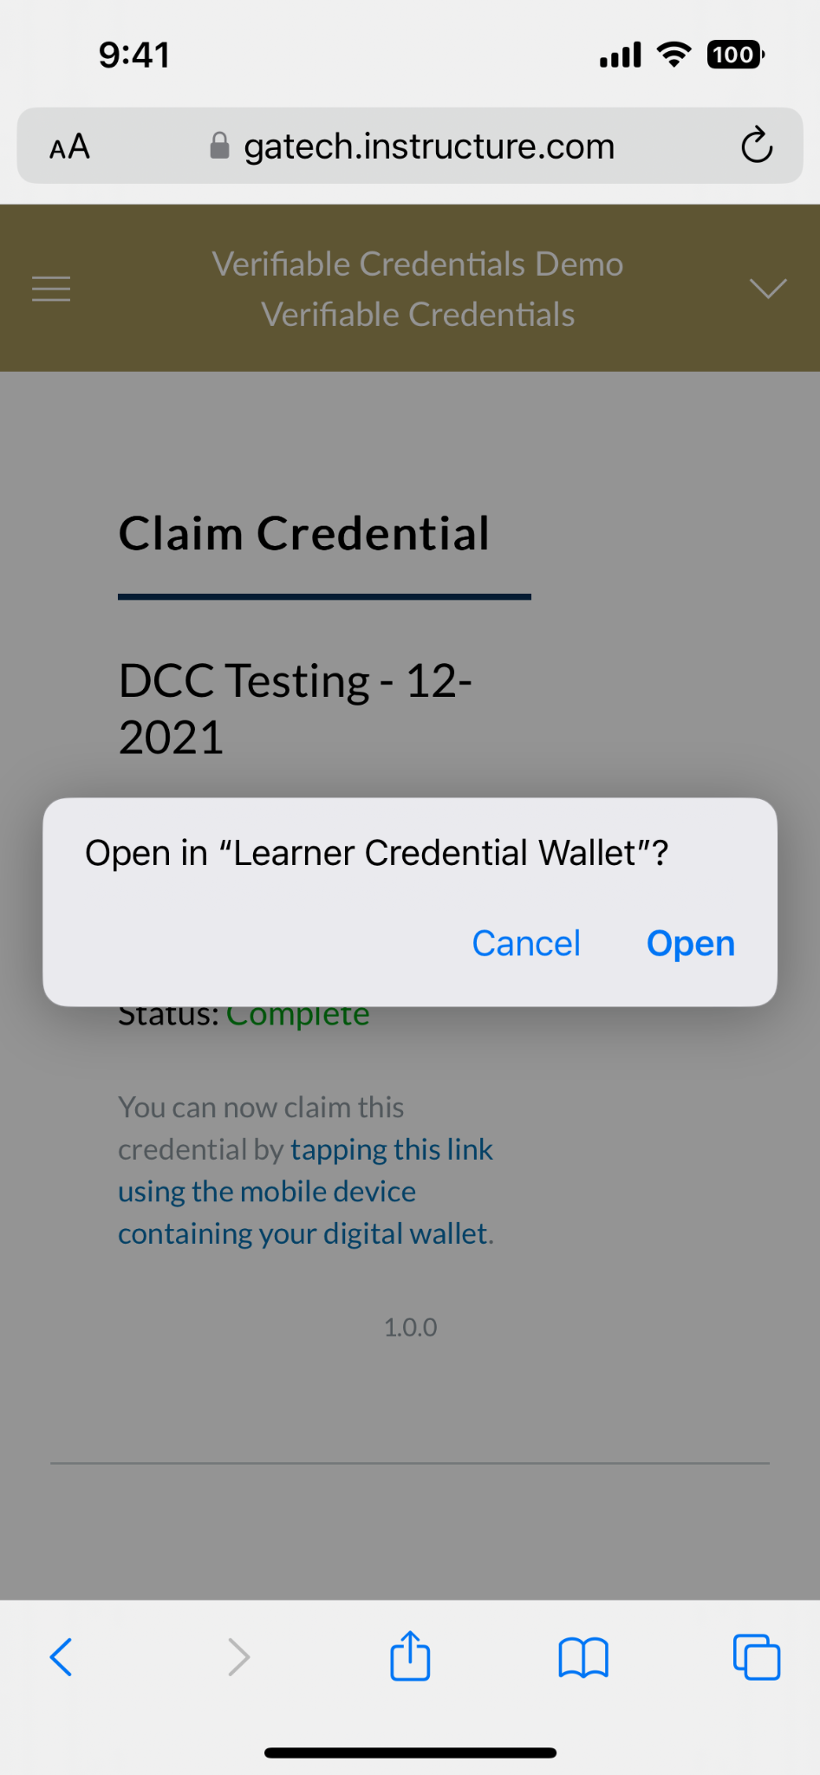
Request Credential from Learning Management System

Slide 24
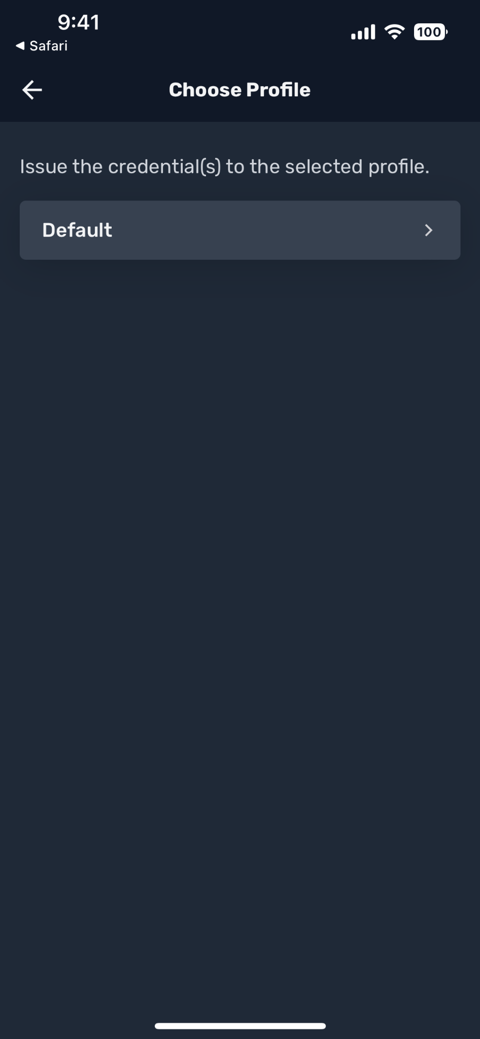
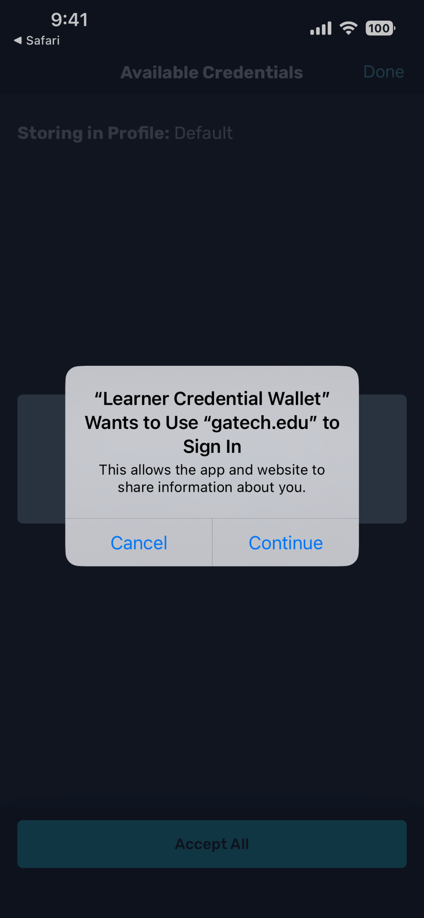
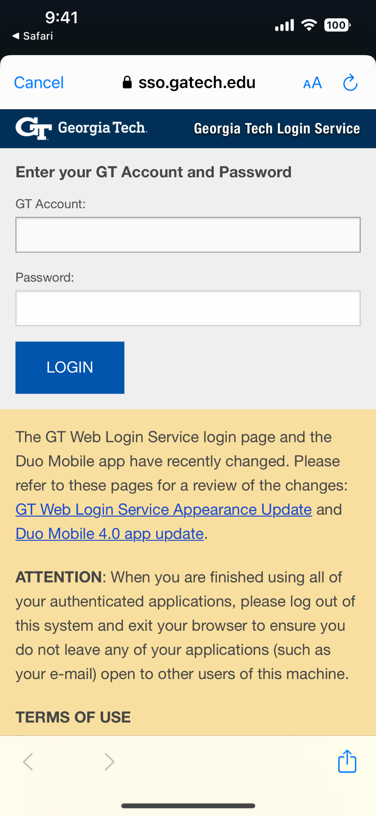
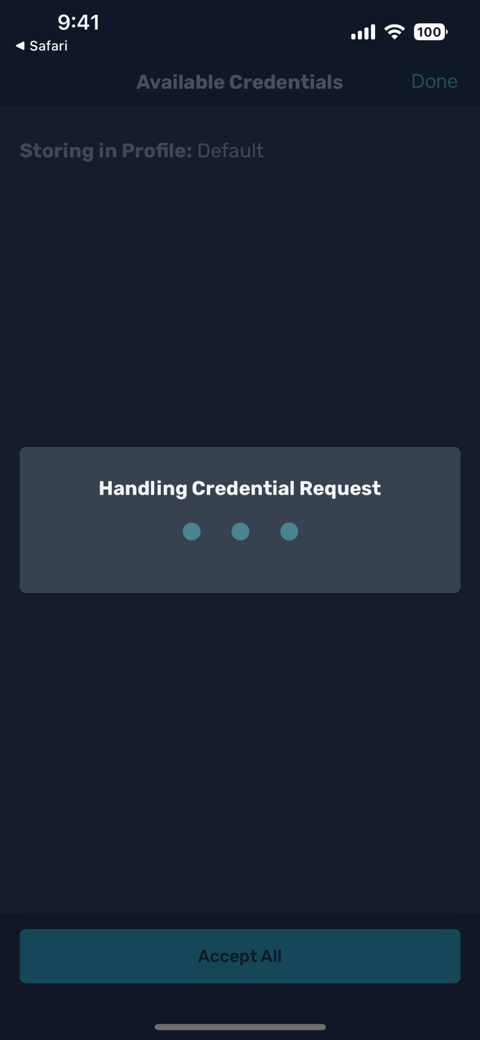
Select a Profile, Authenticate to Receive Credential

Slide 25
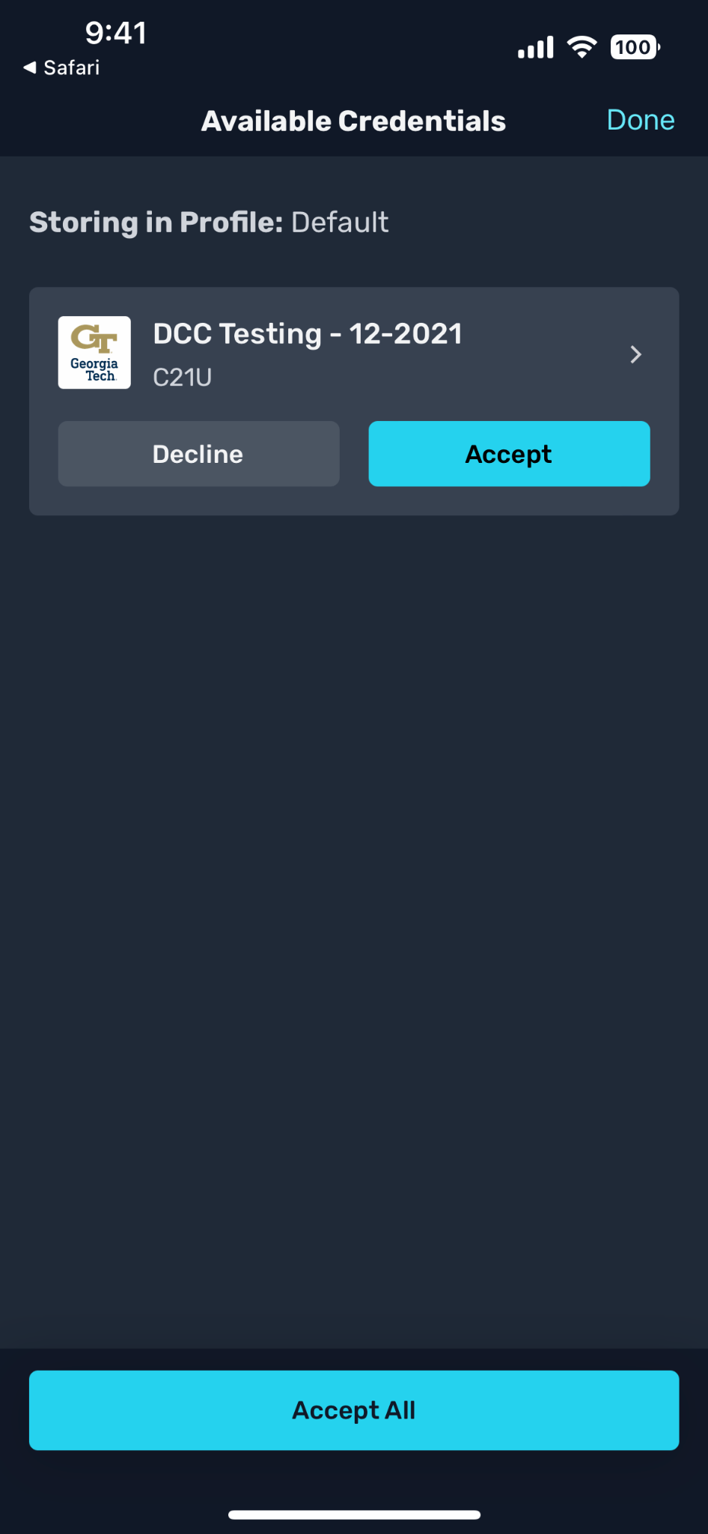
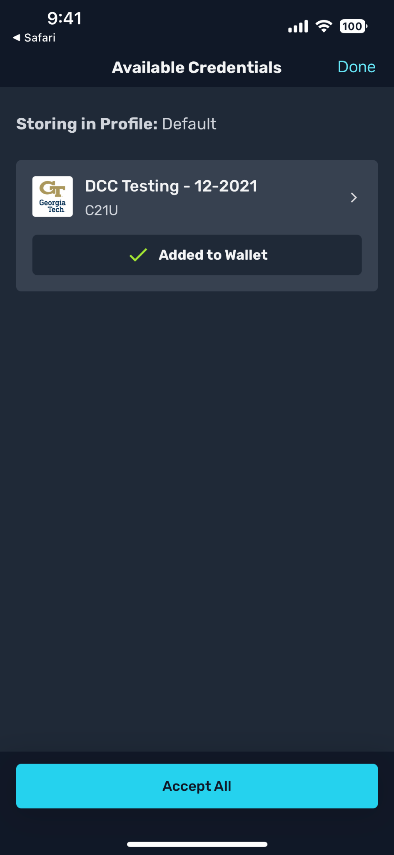
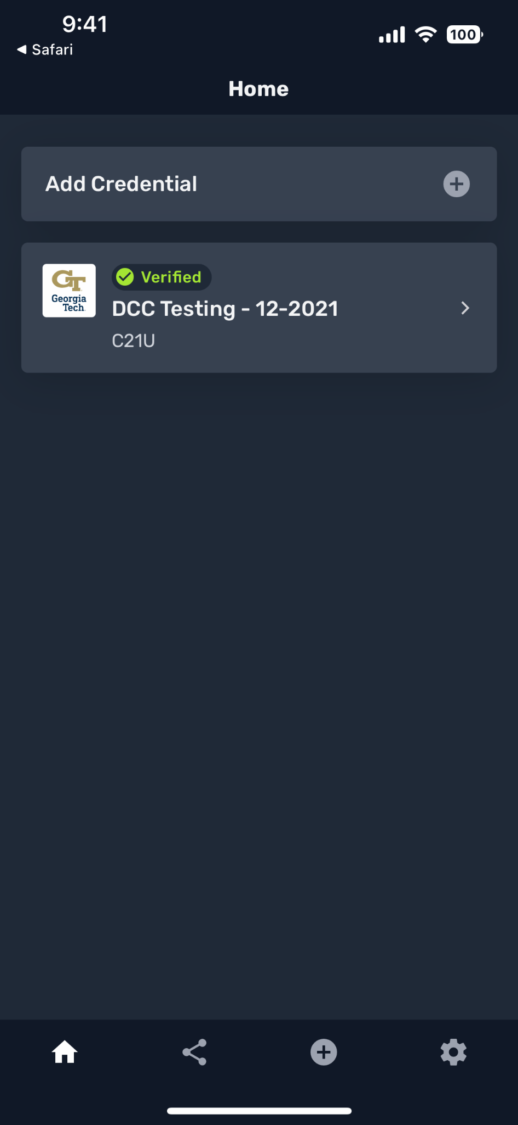
Accept Credential, Add to Wallet, View on Wallet Home Screen

Slide 26
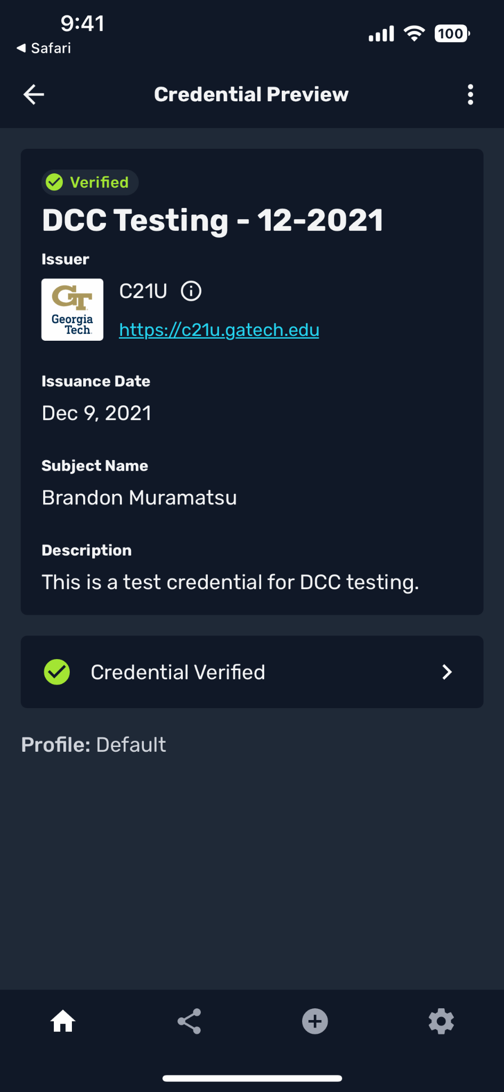
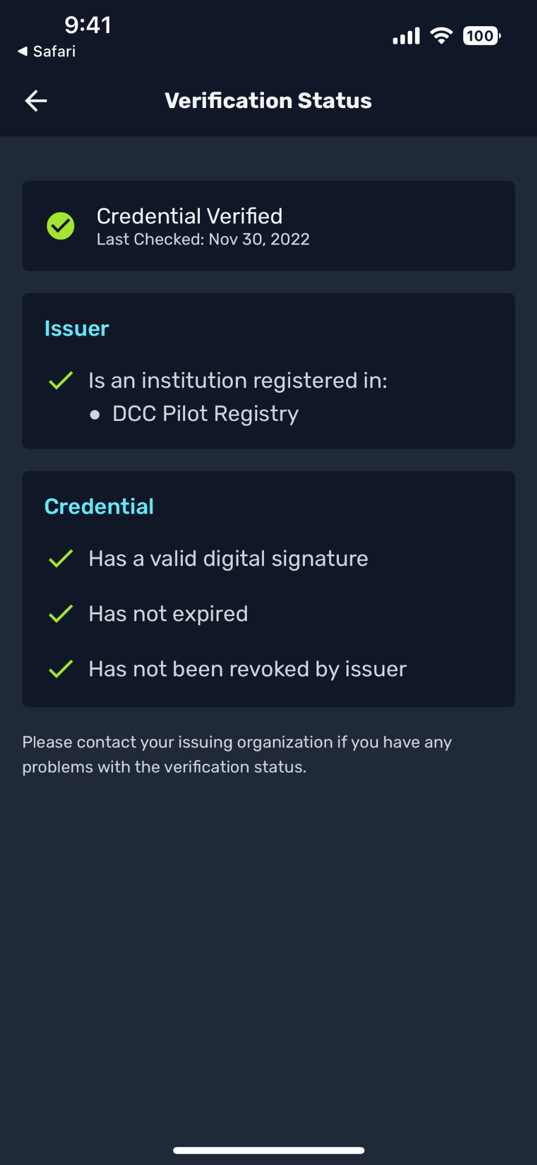
Credential Preview, Verification Status

Slide 27
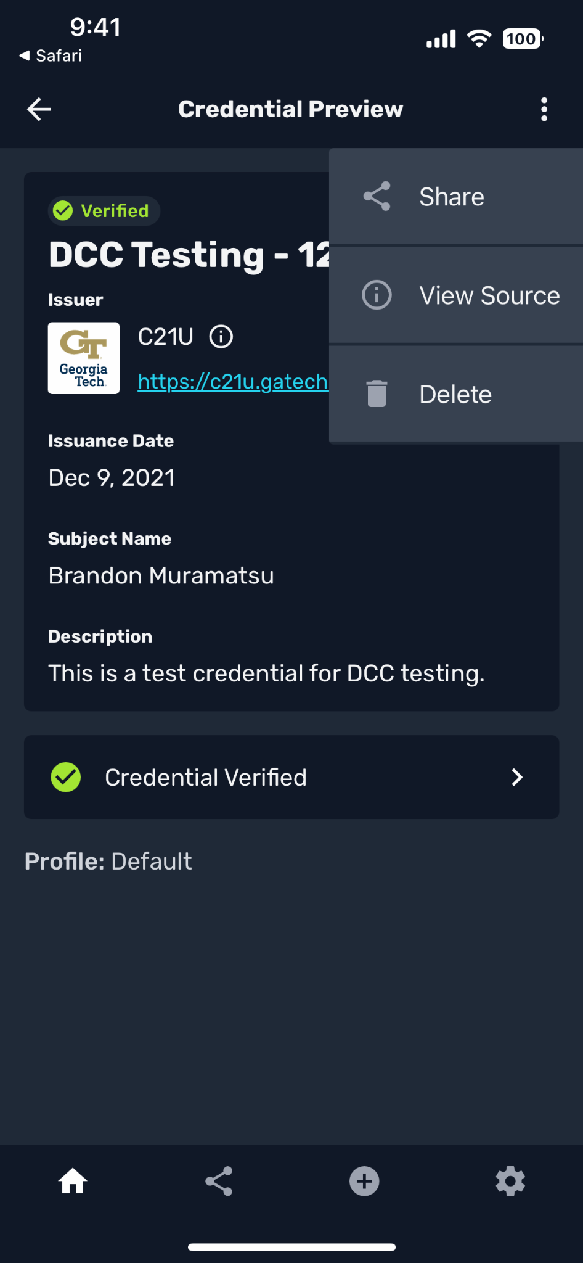
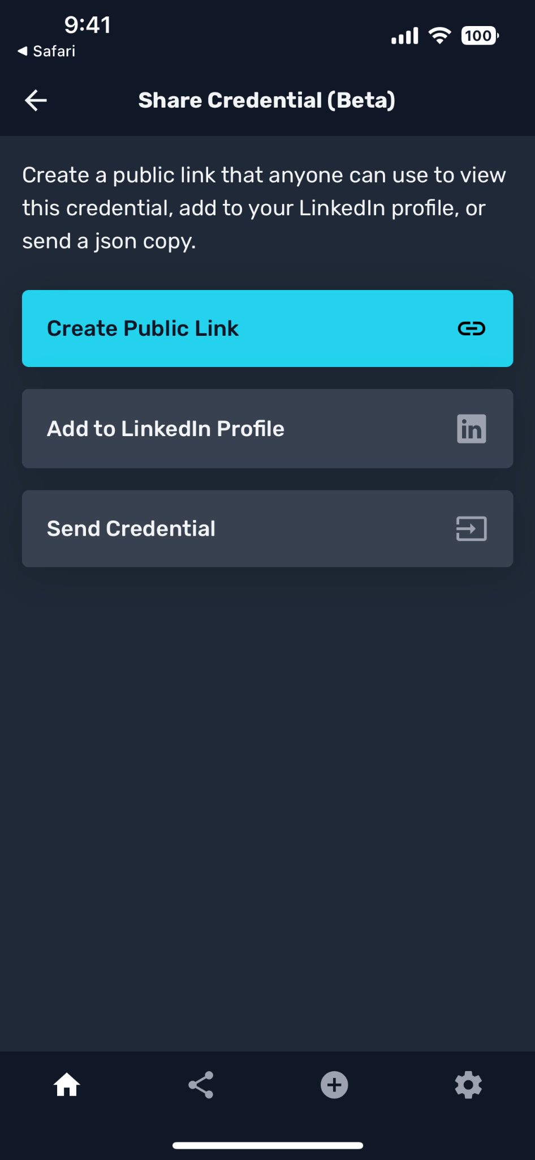
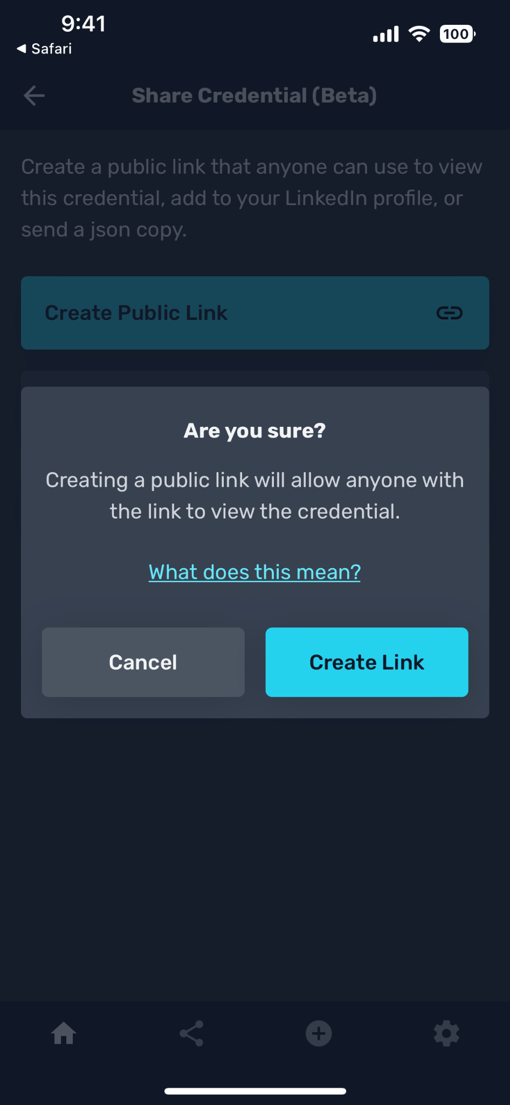
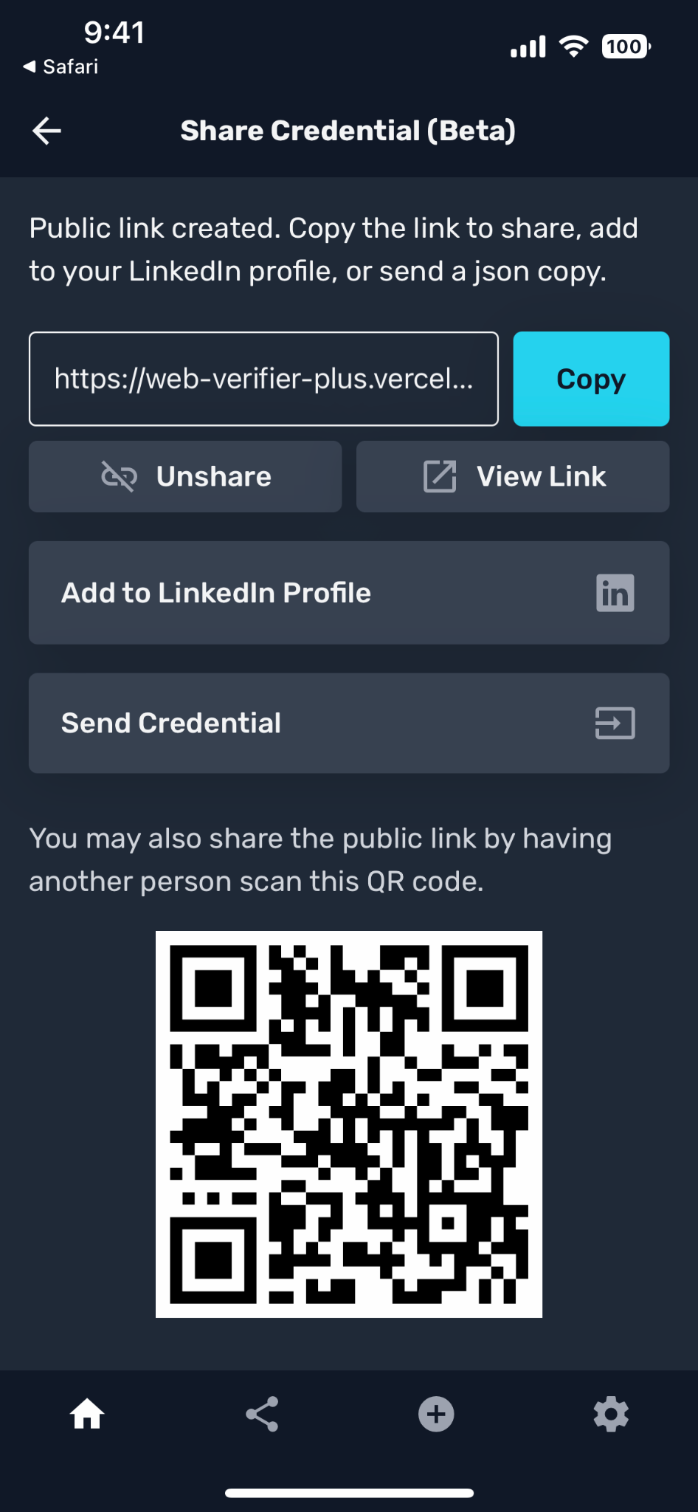
Share Credential, Create Public Link

Slide 28
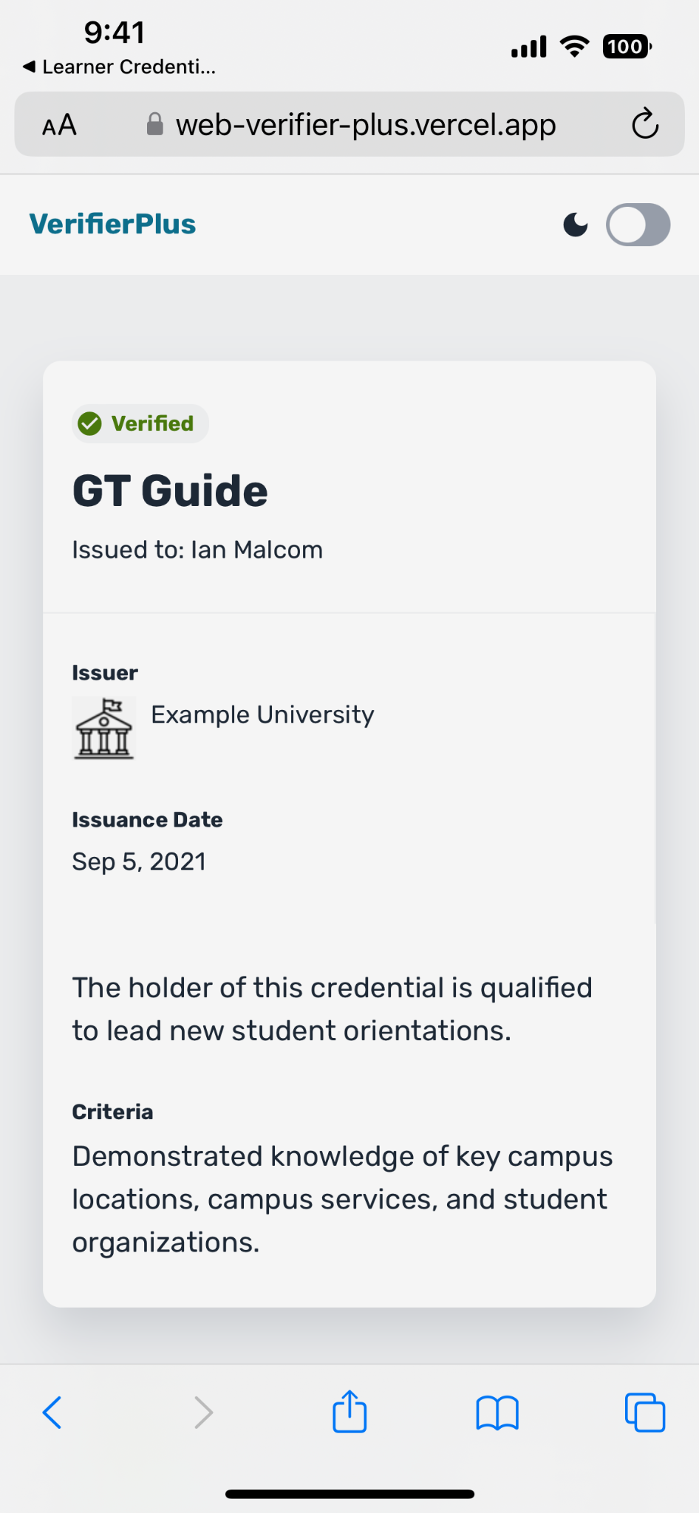
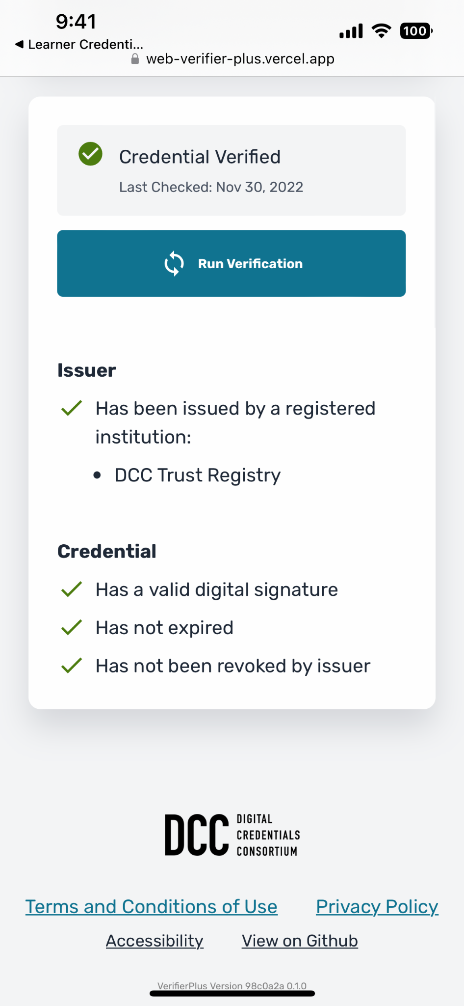
View Shared Public Credential, Verification

Slide 29
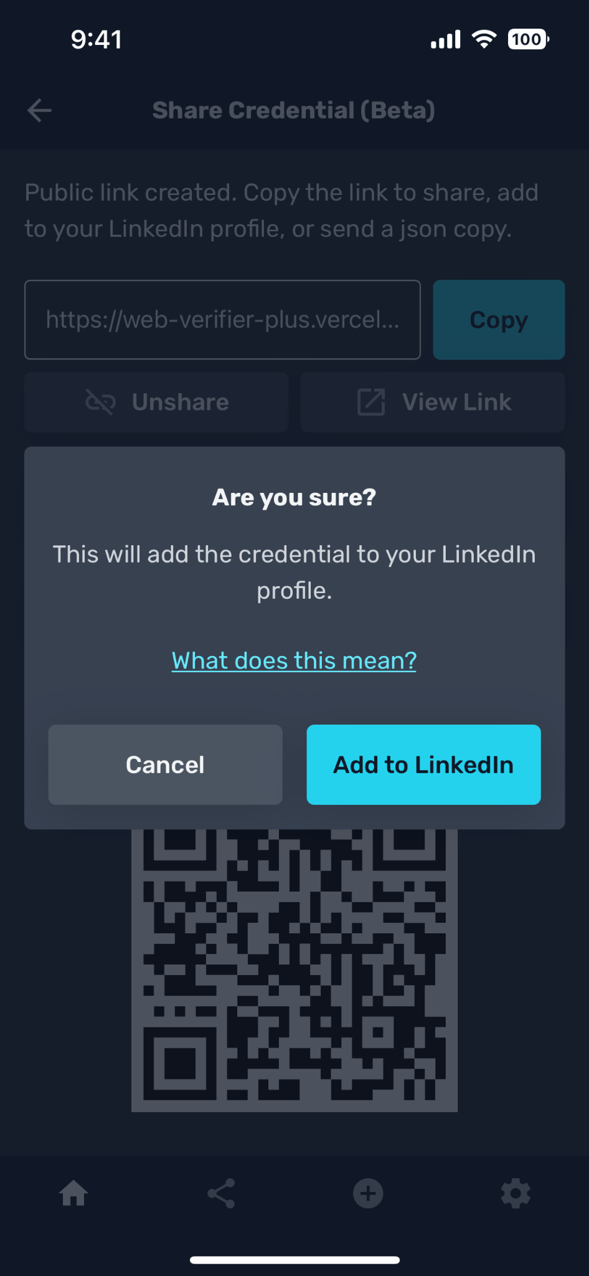
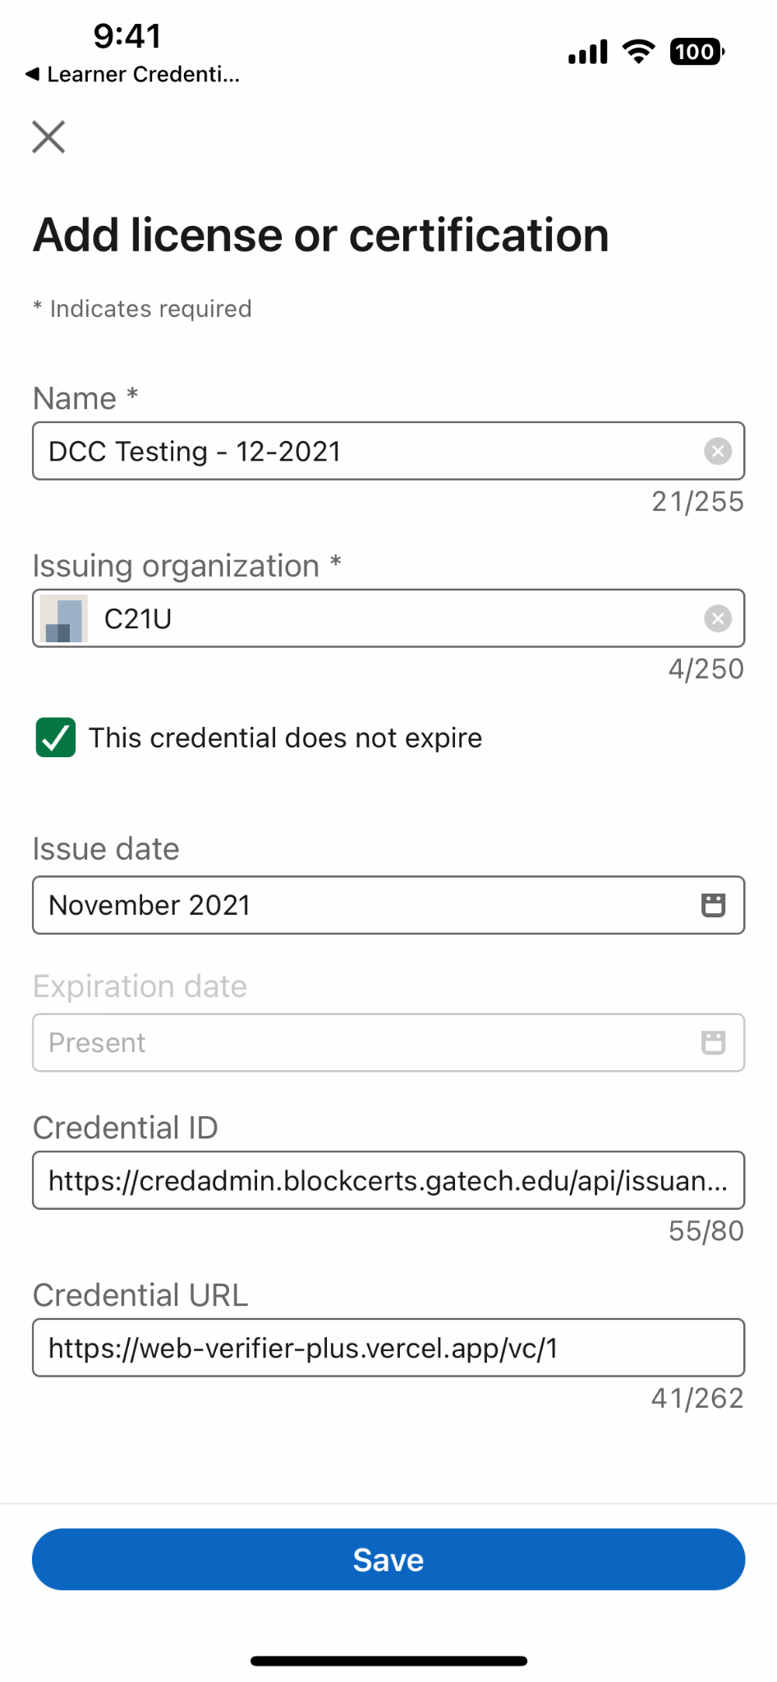
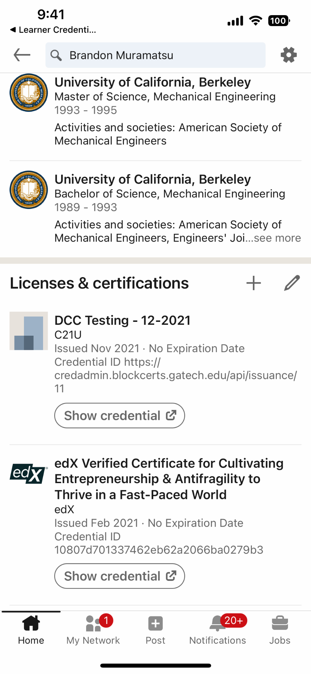
Add to LinkedIn Profile

Slide 30
Questions?
Brandon Muramatsu, mura@mit.edu

