Slide 1
Sustainability of OER Initiatives
Brandon Muramatsu, MIT
Institute for OER, July 15, 2022

Slide 2
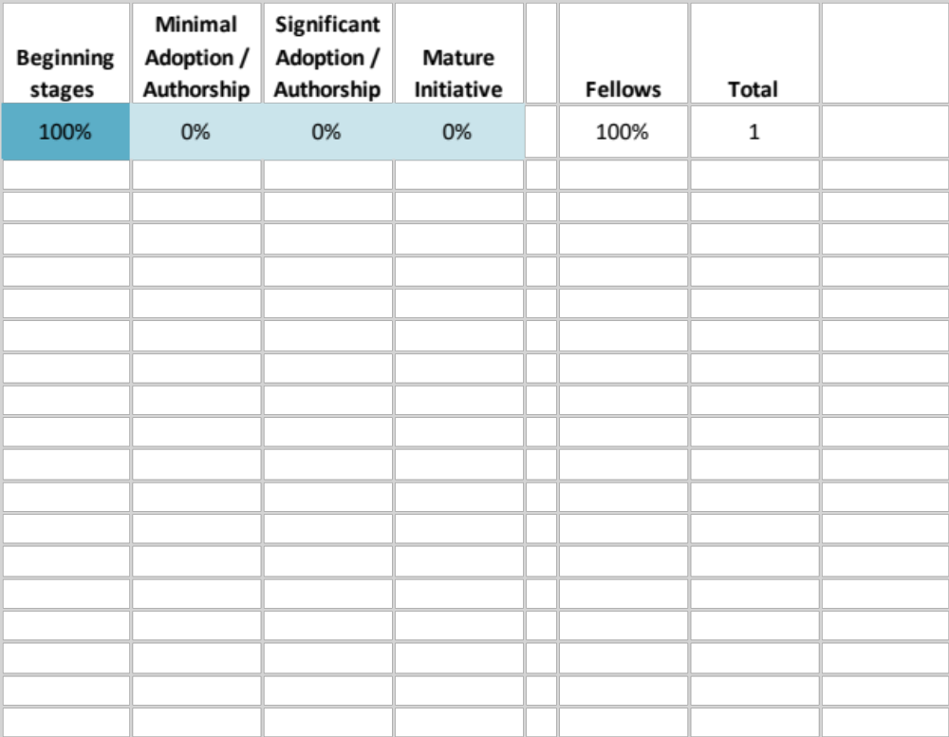
Introductions
Who are we? What do we hope to learn from this session?
  Your name
  Institution name
  Goals for this session

Slide 3
Poll: OER Stage
Change
Led moderate scale change
Participated in moderate scale change
Led smaller scale change
Participated in smaller scale change
No Answer
Zoom

Slide 4
About Me
Brandon Muramatsu, mura@mit.edu
  Associate Director, Projects, MIT Open Learning
Brief background on Brandon: Involved with Open Education since 2004
  Initially developing platform software for OpenCourseWare and courses for a university-wide OCW; nurtured OCW community and OER in higher education
  Direct courseware development, supporting faculty, creating repositories of content and assessments, advising/starting new institutions
  Led/leading OER initiatives in K-12 (India, Belize), Community Colleges (U.S.), 4-year Universities (U.S.)
  My day job is large-scale, multi-year education and education technology projects
    Open source assessment engine to support partially connected secondary schools (478)
    Building a new international STEAM high school with OER at it’s core; founding board member of a U.S. OER high school
    Advising on starting new research universities, regional innovation hubs

Slide 5
Session Goals
Discuss and identify areas for you to consider and explore more regarding sustainability of your OER Initiative

Slide 6
An OER Journey
Today Your college or university has just started an OER initiative and you’re getting lots of support from students!
In 2 years You just reported that your students have saved hundreds of thousands of dollars on textbooks through your OER initiative!
In 5 years Your OER initiative is at risk of shutting down. What happened?

Slide 7
An OER Journey of Change
Today Your college or university has just started an OER initiative and you’re getting lots of support from students!
In 2 years You just reported that your students have saved hundreds of thousands of dollars on textbooks through your OER initiative!
In 5 years Your OER initiative is at risk of shutting down. What happened?

Slide 8
Change
Is your OER initiative fundamentally about change?
  Are you trying to convince faculty and staff from multiple units or departments to support it? <- It’s a change initiative
  Are you trying to implement OER outside of one program or department? Is it university wide? <- It’s a change initiative of potentially medium or large scale
Does your institution change bottom up or top down?
  How does successful change happen at your institution?
  What does this mean for the success of your initiative?
  What leadership support do you need regardless?

Slide 9
Poll: Your Participation in Change Initiatives
Change
Led moderate scale change
Participated in moderate scale change
Led smaller scale change
Participated in smaller scale change
No Answer
Zoom

Slide 10
Poll: Your Participation in Change
Change
Led moderate scale change
Participated in moderate scale change
Led smaller scale change
Participated in smaller scale change
No Answer

Slide 11
Examples of change of the scale you’re considering at your institution, or you’ve experienced?
Development of new teaching modalities (remote synchronous)
Gen Ed curriculum and assessment revision
Switching to 3 campus system
Program for academic professionals
New internship experiences for students
Changing large course serving thousands of students
iPad initiative
New union contract; institution providing service
Challenges
  Change fatigue
  Understanding campus culture/politics

Slide 12
Examples of change of the scale you’re considering at your institution, or you’ve experienced?
Examples
More Examples

Slide 13
Examples of Institutional Change at MIT related to Education
MIT Task Forces -> Curricular Change
  Undergraduate Educational Commons (2004-2006)
  -> Revisions to core curriculum (GIR)
  Future of Education (2013-2014)
  -> Engaging MIT community with world; K-12 strategy; certification options
  Task Force 2021 (2020)
  -> (Not) fully online degrees

Slide 14
Who’s responsible for success of an institutional change at your institution?
Faculty convincing other faculty?
Provost-led
Faculty Senate
Supportive administration
Faculty-driven initiatives, but they require administrative support
Faculty Union
Standing committees (shared governance)
Board of Trustees
Communication is key

Slide 15
Case Study—MIT OpenCourseWare
In 2000, a MIT faculty committee was charged to develop a proposal for financially sustainable online course dissemination
Era of Dot Coms; University-led Fathom, UNext, etc.
Diverging MIT committee reports:
  “[s]trategic themes for possible implementation. It chose the banner of lifelong learning and recommended that MIT undertake a study to launch “Knowledge Updates,” minicourses based on MIT’s strength in cutting-edge science and technology, designed for MIT alumni.”
  Aspirations of a “unique opportunity for MIT to exert leadership, set an example for its peers, and make a truly significant impact. In contrast, the K[nowledge] U[pdate]s struck them as underwhelming.”

Slide 16
Case Study—MIT OpenCourseWare
In 2000, a MIT faculty committee was charged to develop a proposal for financially sustainable online course dissemination
April 4, 2001, MIT President Charles Vest announced that the Institute would make course material from virtually all undergraduate and graduate courses “accessible to anyone anywhere in the world, through our OpenCourseWare initiative”
  Mission alignment: The Institute is committed to generating, disseminating, and preserving knowledge, and to working with others to bring this knowledge to bear on the world’s great challenges.
Abelson, H., Miyagawa, S. & D. Yue. (2021). On the 20th Anniversary of OpenCourseWare: How It Began. MIT Faculty Newsletter. VOL. XXXIII NO. 5. May/June 2021. Retrieved from: https://fnl.mit.edu/may-june-2021/on-the-20th-anniversary-of-opencourseware-how-it-began/

Slide 17
Elements of MIT Education Shared with the World 2000-2012
Course Content
=
MIT OCW
Courses
= MIT
Residential
Cambridge MA
Experiences
Residential
Cambridge MA

Slide 18
MIT OpenCourseWare
Celebrated 20th anniversary in 2021
  http://web.mit.edu/webcast/ocw/1320/
  https://ocw.mit.edu/about/
Continues to publish courses, expand use of video
Podcast and continued insight into how MIT teaches

Slide 19
MIT Case Study Postscript
Courses (2012)
  MIT co-founded edX to share MITx courses with the world, not MIT degrees
Professional Education (2016)
  MIT invented MicroMasters® to enable learners to earn ~ 50% of a professional Master’s degree via MITx MOOC courses, then apply to MIT to complete their degree (or via pathway partners)
  MIT launched xPRO to provide professional certification programs
MIT Bootcamps (2014)
  MIT launched intensive 1 week entrepreneurship (and other) bootcamps

Slide 20
Elements of MIT Education Shared with the World 2012 to Present
Course Content
=
MIT OCW
Courses
MITx
MicroMasters
MIT Bootcamps
Experiences
Residential
Cambridge MA
OCW Educator
2000-2012
How we Teach
What are MIT’s courses like?
In-person Experiences

Slide 21
MIT Case Study Postscript – Part 2
March 2020 -> Summer 2020
  OCW, MITx put in place key elements to allow MIT to pivot
  Digital Learning Lab, Scientists and Fellows in many departments who had worked with faculty to offer MITx online courses
  Some faculty with experience with online courses
  Plus the “solve the problem” core attitude at MIT

Slide 22
Why have similar initiatives persisted at your institution?
Why has a similar initiative persisted?
More

Slide 23
Sustainability

Slide 24
What does sustainability mean in your context? What’s important for sustainability?
What’s important?
More

Slide 25
Possible Elements of Your OER Program
Curriculum development and publishing, curation?
Professional development?
  Authoring
  Pedagogy and use with students
  Assessments
Student involvement
  As learners?
  As creators?

Slide 26
Sustainability Issues You Might Consider
Content
  Static or interactive
  Course materials, textbooks
  Assessments
Platform
  Authoring
  Use
  Repository
Professional Development
Maintenance
Funding Lifecycle & Business Model
Student learning outcomes
Champions, Institutional Sponsor, Labor of Love

Slide 27
OER: Content
What’s the existing relationship between faculty and course materials?
  Do they author and maintain a significant portion of their own material? Or are they using primarily publisher provided materials?
Are you focusing on open textbooks -> ZTC courses?
  What about teacher’s guides, assessments?
  Primarily static? Interactive platforms?
How much curricular content are you creating or using from others?
  How often are the materials updated?
  Who does the updating? Publisher or faculty member?
  How often will faculty need to review the OER they use?
Are 3rd party materials reliably accessible and stable?

Slide 28
OER: Courseware / Interactive Platforms
Are you planning on using courseware or an interactive platform?
  What happens when you change your LMS?
  Can you migrate from the courseware to another platform? (“Standards” for this are essentially non-existent)

Slide 29
OER: Assessments
Typical Quiz and Test?
Authentic Assessment?
  Who creates the assessments?
  How often are they updated?
  Migration to future platforms?

Slide 30
OER: Initiative Funding
How is the initiative being funded?
  External or internal grants or other one time funding? What happens after the one-time funding ends?
  Does the initiative assume or require a fundamental change in work expectations? For example, will faculty be expected to write and maintain their own course materials?

Slide 31
Logic Models & Theory of Change

Slide 32
Defining the Narrative your OER Project:
How does a Logic Model help?
Asks you to identifies assumptions ahead of time
Asks you to state expected outcomes (short-term) and impact (long-term)
Develops causal linkage between assumptions and inputs with outcomes and impact
  Shows how what you’re doing will result in what can be expected, short and long term

Slide 33
Logic Models Support Theory of Change
A Theory of Change explains the process of change by outlining causal linkages in an initiative, i.e., its shorter-term, intermediate, and longer-term outcomes. The identified changes are mapped – as the "outcomes pathway" – showing each outcome in logical relationship to all the others, as well as chronological flow. The links between outcomes are explained by "rationales" or statements of why one outcome is thought to be a prerequisite for another. (See Clark and Tapin)
The innovation of Theory of Change lies (1) in making the distinction between desired and actual outcomes and (2) in requiring stakeholders to model their desired outcomes before they decide on forms of intervention to achieve those outcomes.
Sources:
Clark, H. & D. Taplin. (2012). Theory of Change Basics: A Primer on Theory of Change. New York: Actknowledge.
Wikipedia contributors. (2021, April 25). Theory of change. In Wikipedia, The Free Encyclopedia. Retrieved 13:56, August 15, 2021, from https://en.wikipedia.org/w/index.php?title=Theory_of_change&oldid=1019787733

Slide 34
Tool: Logic Model and its Key Elements
Assumptions: Beliefs we have including about our capabilities, the people and organizations involved
Inputs: Resources or knowledge we bring to the project
Outputs: Activities of the project
Outcomes: Expected short-term results of the project
Impact: Expected long-term results of the project
Risks
What does success look like? What does sustainability mean?

