Slide 1
Contextualizing and Extending the Reach of Open Education
Brandon Muramatsu
Massachusetts Institute of Technology
Massachusetts, United States
James Glapa-Grossklag &
Joy Shoemate
College of the Canyons
California, United States
Dr. DeLaina Tonks
Mountain Heights Academy
Utah, United States

Slide 2
Open Educational Resources (OER) have become essential infrastructure worldwide
We can learn from the varying contexts at different types of institutions with different learner and instructor populations:
Community Colleges: College of the Canyons
Secondary Schools: Mountain Heights Academy
Worldwide Learning Opportunities: MIT

Slide 3

Building AI Literacy Through Open Educational Practices:
Empowering Faculty and Students
James Glapa-Grossklag &
Joy Shoemate
College of the Canyons
California, United States

Slide 4

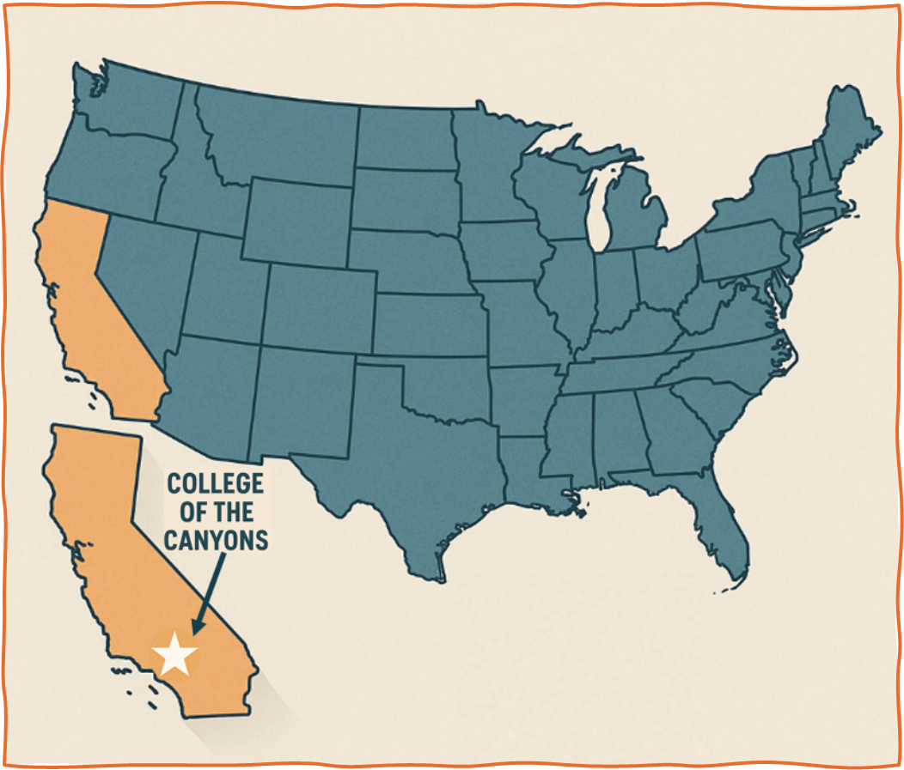
Our Context
Community college
  Located in Los Angeles, California, serving over 39,000 students annually
  Offers over 100 associate degree programs and nearly 200 certificate programs
  1 of 116 California Community Colleges, serving nearly 2 million students annually
Broad access and under-funded
Need to develop and offer our own PD
PD in AI falls to Online Education department by default

Slide 5
Developing AI Literacy at College of the Canyons
Professional development for faculty
Non-credit courses for students
Goal: Equip both groups with practical and ethical AI competencies
  Faculty: Examine and evolve pedagogical practices
  Students: Gain academic and professional AI competencies

Slide 6




Faculty ‘AI Series’ Professional Development
Four week-long online facilitated courses
Promoting
  Understanding of generative AI capabilities and limitations
  Evaluation of ethical considerations
  Development of Student-Centered AI Policies
  Thoughtful integration of AI tools
Encouraging
  Critical examination of pedagogical practices
  Innovation and reflective teaching
  Collaborative exploration, experimentation, and resource-sharing

Slide 7

Student ‘AI Literacy’ Course Series
Two-week-long, online facilitated Non-Credit
Certificate courses
In Gen Al Research & Study Skills, students explore:
  ﻿﻿How to effectively use Al tools in studying, research, and projects across various disciplines.
﻿﻿In Gen Al Bias and Ethical Considerations, students:
  Critically evaluate Al tools and content
  ﻿Explore strategies for recognizing and mitigating biases.
  Consider copyright, privacy, accuracy, and academic integrity.

Slide 8
Student and Faculty Courses:
Rooted in Open Educational Practices (OEP)
Dedicated faculty support to evaluate teaching practices, emphasizing:
  ﻿Collaborative projects
  ﻿Student-centered learning
  ﻿Transparency and knowledge sharing
﻿Leverages open pedagogy and student co-creation through:
  ﻿Opportunities to share resources and suggest edits
  ﻿Course Revisions based on input from participants

Slide 9

Leveraging Generative AI to Update OER
Career Technical Education (trades) programs are Zero Textbook Cost (ZTC) pathways:
  Land Surveying
  Water Technology
Developed OER in consultation with industry professionals
OER appreciated as an important tool for program viability
AI integration provides:
  Opportunity to enhance existing OER creations AI integration
  Ability to better meet students’ needs

Slide 10
AI for Learning
Self-paced, asynchronous course designed to
  Help academic learn how to effectively employ AI in the classroom
  Recognize AI as a new partner in teaching
  Apply custom chatbots and prompt engineering skills
  Evaluate AI-generated responses
Co-designed by educators for educators
Carnegie Mellon University and College of the Canyons, supported by the Axim Collaborative
Notes:
CONTENT SLIDE – title and content block, max 30-40 words. Bullets optional, keep to 3-5 bullets.

Slide 11
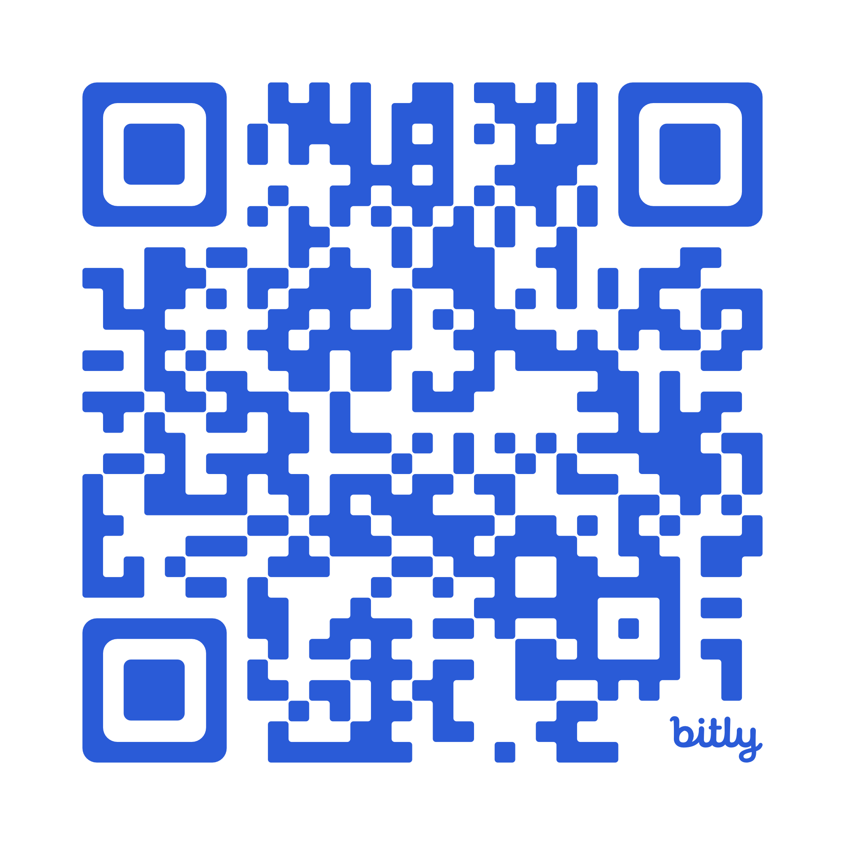

AI 4 Learning Network (AI4LN)
Start learning at
https://oli.cmu.edu/courses/ai-for-learning/
Notes:
CONTENT SLIDE – title and content block, max 30-40 words. Bullets optional, keep to 3-5 bullets.

Slide 12

OER-Enabled Pedagogy Supported by Generative AI
Dr. DeLaina Tonks
Mountain Heights Academy
www.mountainheightsacademy.org
Utah, United States

Slide 13

Mountain Heights Academy
Public, online charter school in Utah, USA
1,700 students statewide
7th to 12th grades (secondary school)
130 faculty/staff
Vision: To be the leaders in digital education
Mission: To develop connected and successful learners
First secondary school globally to implement a 97% OER curriculum in 2009.

Slide 14
Mountain Heights Academy
Asynchronous courses with content for each week due Friday at 6pm
Teachers have 4 office hours available to help students and 4 hours for reaching out to students and parents, grading, tinkering with course content, reviewing data, etc.
Students are provided a laptop to work on
Curriculum aligns with Utah’s state standards

Slide 15
OER Evolution at Mountain Heights Academy
Full course release in MoodleRooms
Lessons added to OER Commons
Open pedagogy OER released for leadership, ed tech, teacher competency, and instructional design
Reset using generative AI, reteaching ID principles/processes

Slide 16
OER-Enabled, AI-Supported
Pedagogy
AI Tool: SchoolAI.com, a walled garden, safer for students under 18
PD on grading and ethical use
How to communicate appropriately if a student is suspected of using AI inappropriately
Using data to create AI-resilient, process-based, or AI-inclusive assignments that deepen critical thinking skills

Slide 17
AI Panel Handout
🤖 AI Panel Handout November 3, 2025
This document summarizes key takeaways, strategies, and expectations from the recent AI Panel discussions regarding the ethical and effective integration of Artificial Intelligence into our courses.
💡 Core Philosophy
AI is Here to Stay: AI is not going anywhere. The focus must be on finding the best ways to embrace it for educational benefit.
A Collective Responsibility: It is every teacher's responsibility to determine how to utilize AI in their specific classroom context effectively. This is the core focus of the assignment redesign work this year.
We Are All Learning: Don't be afraid to try something; if an assignment bombs, revamp it for the next one.

Slide 18
School AI: Tour Primary Tool
🛠️ School AI: Your Primary Tool
School AI is the main tool the school is investing in for educational needs.
Walled Garden: School AI is a "walled garden," meaning everything inside is secure and private, you can use it for student data.
Pacing & Practice: Use it regularly and consistently. The more you use it, the better you get.
Dot (2.0): The new AI assistant that streamlines your workflow and is the unified place for resource creation and problem-solving.
  Action: Ask Dot any questions you have about 2.0.

Slide 19
Grading & Ethical Use
✍️ Grading & Ethical Use
Using School AI to assist with grading is ethical because it's a closed garden, ensuring student privacy.
Using AI as a Grading Tool
Tool, Not Final Outcome: Use AI as a tool, not the final outcome. You must always read through, verify, and tweak the feedback and grade before assigning it.
2.0 Strategy: Use Threads for Efficiency: For big, grading-intensive assignments, create a separate thread (conversation) in Dot. Put your full, extensive setup prompt (rubric, key) in the first message. The prompt is saved, so subsequent student submissions can be graded quickly using the command: "Grade it the same way."
Grading Time Shift: Grading process-based assignments can be more intensive upfront, but using Dot counteracts that extra time, leading to significant savings from not worrying about cheating.

Slide 20
Confronting Suspected AI Use & Plagiarism
🧑‍🎓 Confronting Suspected AI Use & Plagiarism
Curiosity Over Consequence: Always go into the conversation with a curious mindset rather than a consequential one. Frame it as a learning experience.
Tactics for Verification
Establish a Baseline: Get an initial writing sample from every student early in the course.
Revision History: Use Revision History to see time spent and whether students copied/pasted.
Real-Time Chat: Use a real-time chat conversation with the student to verify if their spontaneous writing style matches their submitted work.
Focus on Requirements: Instead of saying, "You cheated," say, "You didn't use the resources (or follow the process) in your answer. Please redo this." This forces them to engage with the core goals of the assignment.
Use Policy: Follow steps in SOP: AI Integration Guide for Teachers

Slide 21
Addressing Cheating
Addressing Cheating
AI Detection is Flawed: AI checker tools (like Zero GPT, PlagiarismCheck.org) are not completely accurate and can be wrong. Treat them as one piece of information, not definitive proof.
Cheating Rate Unchanged: Studies suggest that the percentage of students cheating has remained largely unchanged since the emergence of AI. If a cheater is going to cheat, they will find a way.
Reduce Incentive, Not Eliminate Risk: Acknowledge you cannot make things 100% AI-proof. Your goal is to reduce the incentive and make authentic engagement the easiest path for students.
Final Responsibility: Do your best to design engaging, process-based assignments, and then let go of the stress of catching every cheater. Students and parents bear the ultimate responsibility for their own learning.
Parent Communication: When discussing inappropriate use with a parent, email them all the evidence/data first before calling. Then, call and maintain a curious tone, asking: "Is there any data that I am missing?"

Slide 22
AI-Resilient Assignments
⭐ AI-Resilient Assignments
AI-Resilient Assignments are not just hard for AI; they focus on skills that emphasize uniquely human capabilities. See the “AI-Resilient Assignments” section of the playbook for examples of what this looks like.
AI-Resilient assignments should aim to do one of two things:
Process-Based (Emphasizing Human Skills)
These tasks require students to log their steps, show iterations, and reflect.
Deepen Critical Thinking (Using AI for Deeper Learning)
These tasks require students to critique AI outputs and build AI literacy.
5-star Assignments and AI-Ready Best Practices
See the “Teacher Final Checks: AI‑Ready Best Practices” section of the playbook for a checklist of items that 5-star assignments have.

Slide 23
Teacher Workflow & Examples
.

Slide 24
AI & Teacher Workflow
AI & Teacher Workflow How AI can streamline your overall teaching process, communication and collaboration.
Assessment & Feedback Quiz Creation. Auto-generate quiz questions and specific feedback for each answer. Personalized Feedback. Generate rough-draft feedback on student submissions. Course Organization Content Summarization. Summarize or reorganize materials for clarity and flow. Tiering. Adapt and scaffold assignments, readings, or assessments for tiers. Communication Newsletters & Announcements. Draft communications with AI-generated templates. Translation. Translate content for multilingual students/families. Positive Messaging. Suggest constructive phrasing for sensitive/crucial conversations. Collaboration Brainstorming. Generate project-based learning ideas, cross-curricular activities, etc. Meeting Support. Summarize meeting notes and creation action item lists for PLCs or department meetings from meeting transcripts. Efficiency Tips Prompt Logging. Keep a list of effective prompts for future use.

Slide 25
Using AI for Content Creation
AI & Teacher Workflow How AI can streamline your overall teaching process, communication and collaboration.
Assessment & Feedback Quiz Creation. Auto-generate quiz questions and specific feedback for each answer. Personalized Feedback. Generate rough-draft feedback on student submissions. Course Organization Content Summarization. Summarize or reorganize materials for clarity and flow. Tiering. Adapt and scaffold assignments, readings, or assessments for tiers. Communication Newsletters & Announcements. Draft communications with AI-generated templates. Translation. Translate content for multilingual students/families. Positive Messaging. Suggest constructive phrasing for sensitive/crucial conversations. Collaboration Brainstorming. Generate project-based learning ideas, cross-curricular activities, etc. Meeting Support. Summarize meeting notes and creation action item lists for PLCs or department meetings from meeting transcripts. Efficiency Tips Prompt Logging. Keep a list of effective prompts for future use.
Using AI for Content Creation How AI can help you create instructional materials, assessments, and differentiated resources directly for student use.
Utilize SchoolAI to draft assignments, then review for accuracy and tone to ensure the content matches your voice and course style. Examples of what AI can help you with: Exemplars & Models. Create sample assignments and model responses for students. Content Generation. Create effective content for a Genially Hotspot, slideshow, assignment instructions, or video script. Activity Creation and Lesson Planning. Plug in a standard and have AI draft a related activity, outlines, unit plans, or activity instructions. Assessment Items. Incorporate MAP-style questions or create quick, non-graded formative assessments. Differentiation. Reduce word count and Lexile level for tiered students, or generate prompts at different difficulty levels.

Slide 26
Using AI for Content Creation continued
Video-to-Question. Create questions from videos. Tiered Rewrites. Rewrite materials at a #th-grade reading level (or other levels as needed). Course Outlines. Generate rough drafts of a 10-week course outline based on your standards. Assignment Prompts. Differentiate assignments with varied writing prompts on the same content. Rubric Creation. Draft rubrics for summative assessment or final projects. Real-World Applications. Brainstorm examples that connect academic concepts to authentic, real-life situations.

Slide 27


Resources
OER + Generative AI
Overview
LINK
OER-enabled AI
LINK

Slide 28

Improving Worldwide Learning Opportunities: Mobile, Universal AI & AI Tutors, AI+OER
Brandon Muramatsu
Massachusetts Institute of Technology
Massachusetts, United States

Slide 29

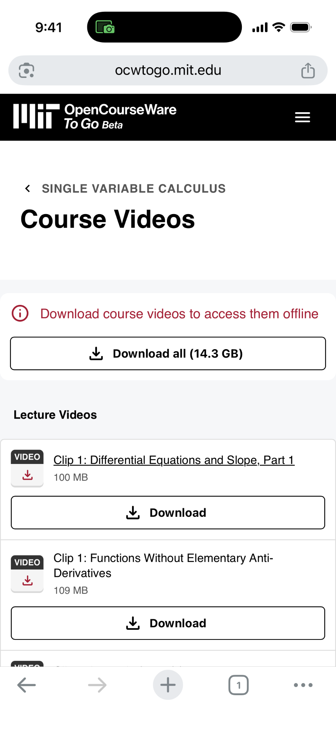
MIT OpenCourseWare To Go
Designed for mobile
Offline, download
Curated list of courses

Slide 30
Universal AI in Pilot Now
Universal AI is a comprehensive curriculum that spans both theoretical foundations and practical applications of artificial intelligence.
Key takeaways
Gain a practical understanding of real-world applications of AI, including:
  The underlying technologies powering AI
  The different types of AI
  How AI systems function and make decisions
Develop the skills to identify opportunities for AI to increase efficiency and improve decision making
Explore the ethical implications of AI
Understand domain-specific uses and applications of AI
Main topics
Basic Python
Data analytics and machine learning
Predictive, prescriptive, and multimodal AI
Generative AI
Large language models
AI ethics and the future of work
AI-Enabled Learning
Gen AI tutors and guides

Slide 31
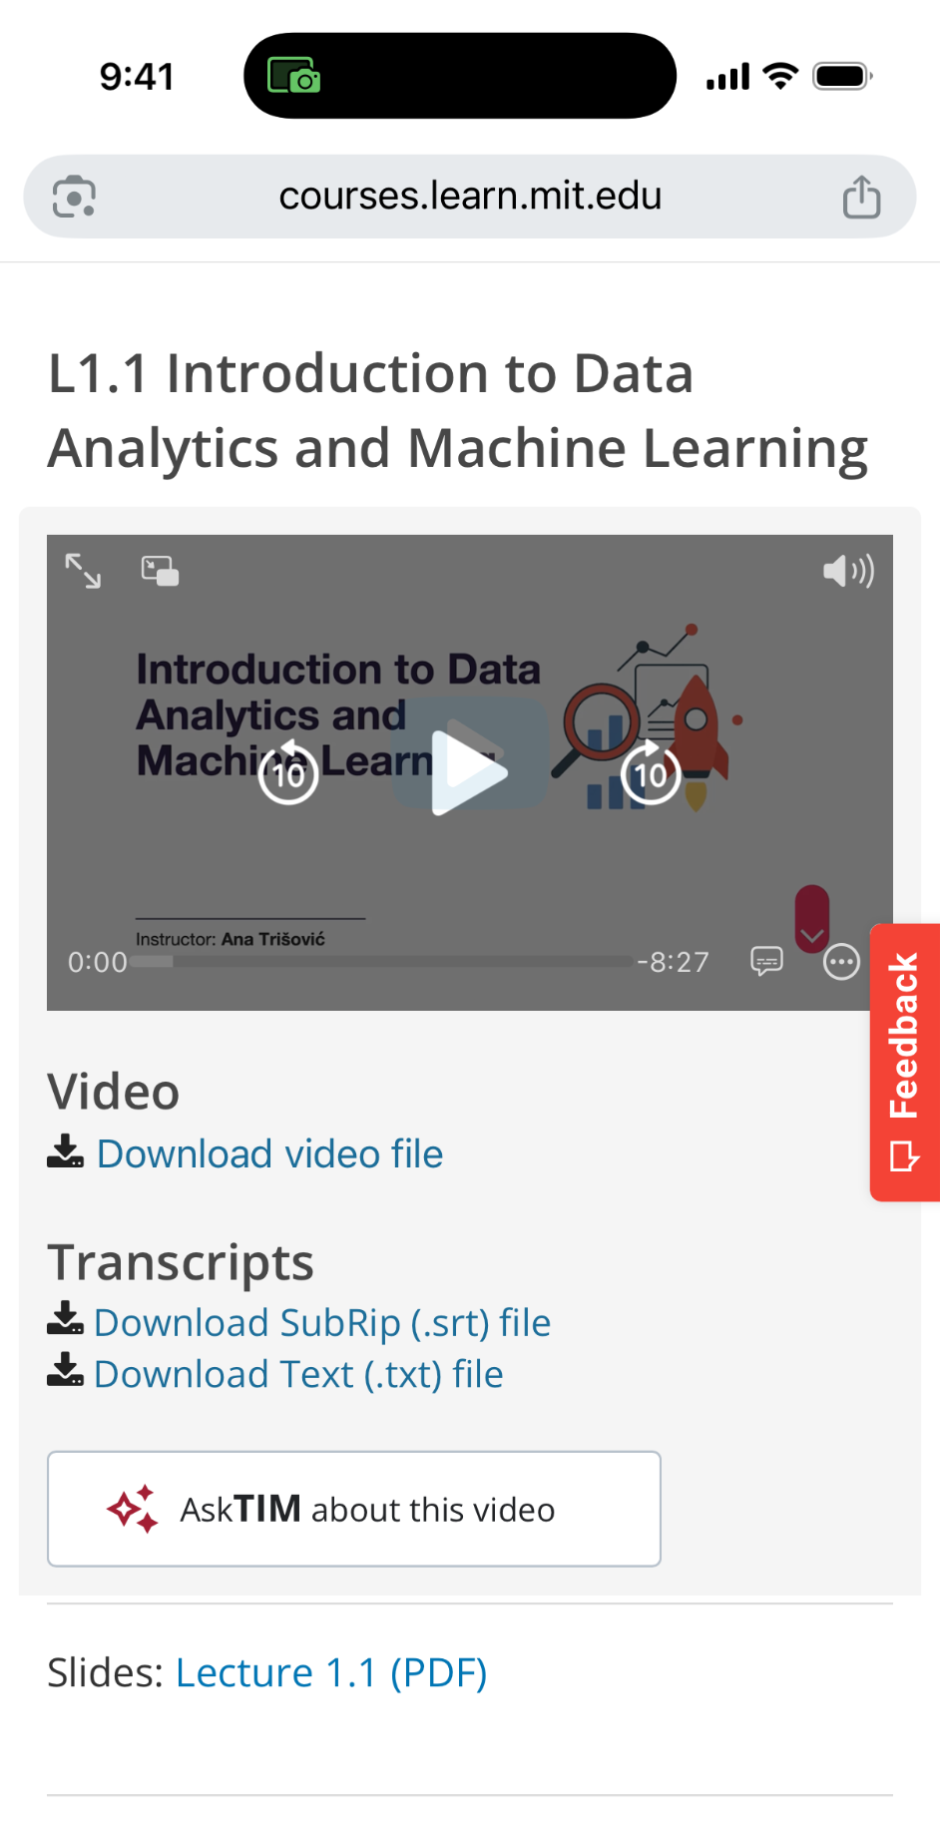
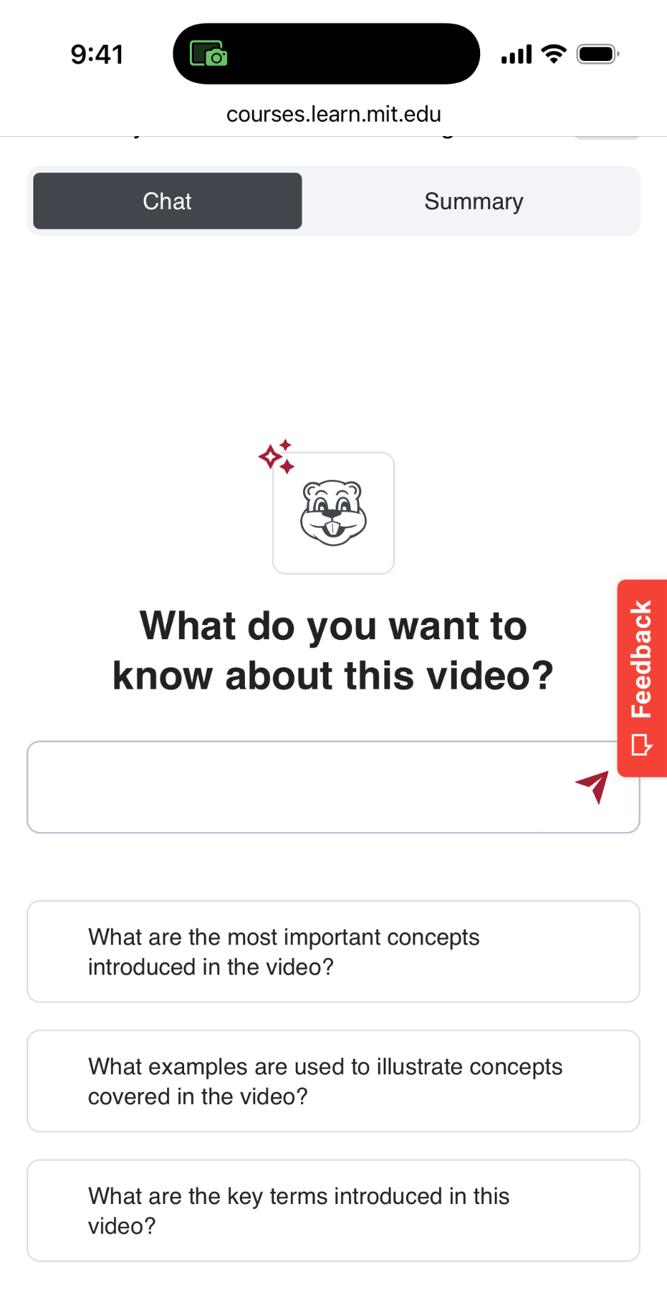
Universal AI
AI Tutors
Video tutors
Assessment tutors
And more
Experiments
Machine Translation
Customization

Slide 32

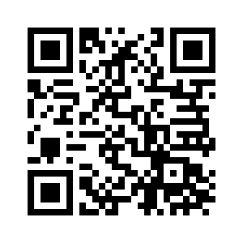
MIT Open Learning
AI + Open Education Initiative
Launched to explore AI’s impact on open education (July 2024)
Published 9 papers from international authors on how AI accelerates and complicates open education (January 2025)
Hosted a speaker series (April/May 2025)
and field update event (October 2025)
Now planning in-person events to advance
the field through collaborations between AI researchers and open education experts
aiopeneducation.pubpub.org
Notes:
Funder: Supported by the William and Flora Hewlett Foundation
Image credit: Image by MIT Open Learning

Slide 33
Thanks and Contact Us
James Glapa-Grossklag
James.Glapa-Grossklag@canyons.edu
Joy Shoemate
Joy.Shoemate@canyons.edu
Dr. DeLaina Tonks
dtonks@mountainheightsacademy.org
Brandon Muramatsu
mura@mit.edu

