Slide 1

The Potential of
Open Educational Resources at the
Itz’at STEAM Academy, Belize
Brandon Muramatsu, MIT
DeLaina Tonks, Mountain Heights Academy
Cite as: Muramatsu, B., Tonks, D. (2024). The Potential of Open Educational Resources at the
Itz’at STEAM Academy, Belize. OE Global 2024. November 15, 2024.
Notes:
Claudia

Slide 2

Itz’at STEAM Academy
Opened September 2023 to 64 students in First Form (equiv. U.S. 8th grade), 75 new First Form students started August 2024
Opportunity: Establish an innovative, contemporary STEAM secondary school in Belize based on MIT principles of “mind and hand” and heart, active learning, project-based learning focusing on UN Sustainable Development Goals
2

Slide 3
The Opportunity
Encode OER policies & practices from the start
Ensure (via license) the ability to use the school’s materials broadly within Belize, and our collective work more broadly
Provide an example of OER for the Belizean education system

Slide 4
Journey to OER at Itz’at
Build on the work of Mountain Heights Academy and MIT
Develop an OER Policy
Implement the OER Policy

Slide 5
Why this team?
Helped to launch the Open Educational Resources movement with MIT OpenCourseWare in 2001
OER and “Mind, hand and heart” deeply infuse our work
Opened Mountain Heights Academy, a charter high school in 2009, utilizing OER for all course materials
Expertise and experience in advising other high schools adopting OER
Expertise in developing OER lesson plans, etc.

Slide 6

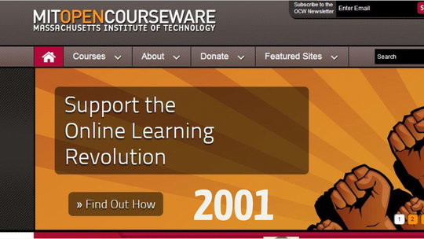

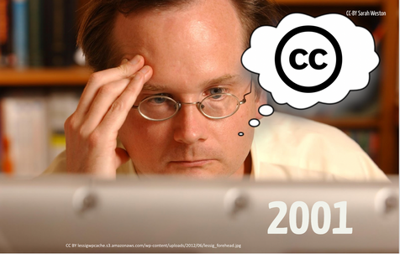
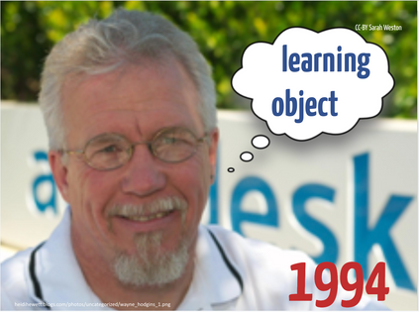
A (Brief) History of OER
6
CC-BY DeLaina Tonks

Slide 7
Mountain Heights
Founded in 2007
Opened in 2009
Positioned as the first secondary school to implement OER curriculum
Functions as an online, public charter school
Serves 1,500+ students all over Utah
Scores above state average in Science and English
7

Slide 8
Mountain Heights Vision, Mission, Goals
Vision is to be the leader in digital education
Mission is to develop connected and successful learners
One of our schoolwide goals is to increase OER impact, by supporting others

Slide 9
Mountain Heights Values
Audacious
Problem-solvers
Open & Flexible
Innovative
Communicative
Service Learning
Personal Responsibility
9

Slide 10
Mountain Heights Experiences
Evolution of OER
Experimented, evaluated, learned
Identified multiple benefits of OER, including just-in-time instruction and differentiation by tiering
Teachers as instructional designers, supported by two instructional coaches

Slide 11
Itz’at STEAM Academy: OER Policy
To help meet the mission and vision, the school will:
Design the school’s curriculum such that the use of Open Educational Resources comprises a majority percentage of teaching and learning materials.
Develop materials, especially those for use in teaching and learning at the school, as Open Educational Resources utilizing a permissive license.
Utilize OER to provide ready access to materials and to personalize materials to meet the needs of individual students.
Promote the use and awareness of OER through professional development activities supported by the school.
Promote the creation, use and awareness of OER by students.
Communicate the use of and value of OER with parents, other community members and the education system in Belize.
”Itz’at STEAM Academy Open Educational Resources Policy”. July 15, 2024.

Slide 12
Key Elements of the Policy
Patterned after Mountain Heights
  Copyright, Attribution
  CC-BY License
  Students
  Teacher Support
As a new school, distinguishing what’s used in the classroom, vs. what (and when) the school publishes the OER
Encoding recognition of individual efforts

Slide 13
OER Policy: Copyright
Itz’at STEAM Academy
  will hold the copyright of all materials developed for use at the school by its teachers, educators, administrators and other staff.
  will be the publisher of all materials developed for use at the school by its teachers, educators, administrators and other staff.
A copyright statement may be included with materials published by the Itz’at STEAM Academy.
  Copyright © 2022, Itz’at STEAM Academy
”Itz’at STEAM Academy Open Educational Resources Policy”. July 15, 2024.

Slide 14
OER Policy: License
The Itz’at STEAM Academy will publish and license the materials developed by its teachers, educators, administrator and other staff with a current Creative Commons Attribution license.
As of June 2022, all materials will be licensed with a Creative Commons Attribution 4.0 International License.
”Itz’at STEAM Academy Open Educational Resources Policy”. July 15, 2024.

Slide 15
OER Policy: Attribution & Citation
Attribution
Individuals contributing to the development of materials developed and/or published by the Itz’at STEAM Academy will have the option of having their name listed along with the Itz’at STEAM Academy on a material-by-material basis. Contributions by those outside of the school may be included upon request and with consent of the publisher. Contributions will follow generally accepted practice of attribution in academic publications.
Good practice for attribution of the materials described by this policy is to include the title, author, source and license.
Citation
Good practice for citation of materials developed by the school is to follow standard citation guidelines such those published by the American Psychological Association or the Modern Language Association.
”Itz’at STEAM Academy Open Educational Resources Policy”. July 15, 2024.

Slide 16
OER Policy: Students
Students of the Itz’at STEAM Academy will hold the copyright of materials they develop during their attendance at the school.
Students may opt out of which materials are used by the school as part of lesson plans and activities. (For example, students will engage in project work and the school may request that some or all of the project materials be included as part of future lesson plans and activities.)
Student materials that are not opted and are used as part of lesson plans and activities will be licensed with a current Creative Commons Attribution license.
”Itz’at STEAM Academy Open Educational Resources Policy”. July 15, 2024.

Slide 17
OER Policy: Publishing OER
Itz’at STEAM Academy OER will be published in a publicly available website and/or repository that may include: the school’s website; a Ministry of Education, Culture, Science and Technology website / repository; and one or more international OER repositories (e.g., OER Commons).
”Itz’at STEAM Academy Open Educational Resources Policy”. July 15, 2024.

Slide 18
OER Policy: Support for Teachers
The Itz’at STEAM Academy will support teachers, educators, administrators and other staff in the development and use of OER. This support will take the form of regular professional development and includes support for copyright clearance, finding OER, use of a school style guide, etc.
”Itz’at STEAM Academy Open Educational Resources Policy”. July 15, 2024.

Slide 19
Implementing Itz’at’s OER Policy within curriculum design
Curriculum Architecture
Competences & Competencies
Course Design
Lesson Planning (Find, Adapt OER)
Learning & Teaching
19

Slide 20
Implementation Challenges
Brand new school, campus under construction as the school opened
New pedagogical approach of competency-based and project-based learning → teachers learning a new system, becoming curriculum developers
Typical challenges in helping teachers / faculty / instructional designers transition to OER
“Building the airplane as we’re flying it”

Slide 21
Implementing Itz’at’s OER Policy within curriculum design. How did we do?
Curriculum Architecture
Competences & Competencies
Course Design
Lesson Planning (Find, Adapt OER)
Learning & Teaching
School
Opens
21

Slide 22
Learn More
Itz’at STEAM Academy, https://www.itzat.edu.bz
Mountain Heights Academy, https://mountainheightsacademy.org
  OER → https://mountainheightsoer.org
MIT Open Learning, https://openlearning.mit.edu

