Slide 1

2023

Slide 2

Learner Controlled Digital Credentials—Moving Toward Portable, Cryptographically Secure Data
Brandon Muramatsu, MIT
Gillian Walsh, MIT
Copyright 2023 MIT
Unless otherwise specified this work is licensed under a Creative Commons Attribution 4.0 International License
Notes:
Copyright 2023 MIT
Unless otherwise specified this work is licensed under a Creative Commons Attribution 4.0 International License

Slide 3
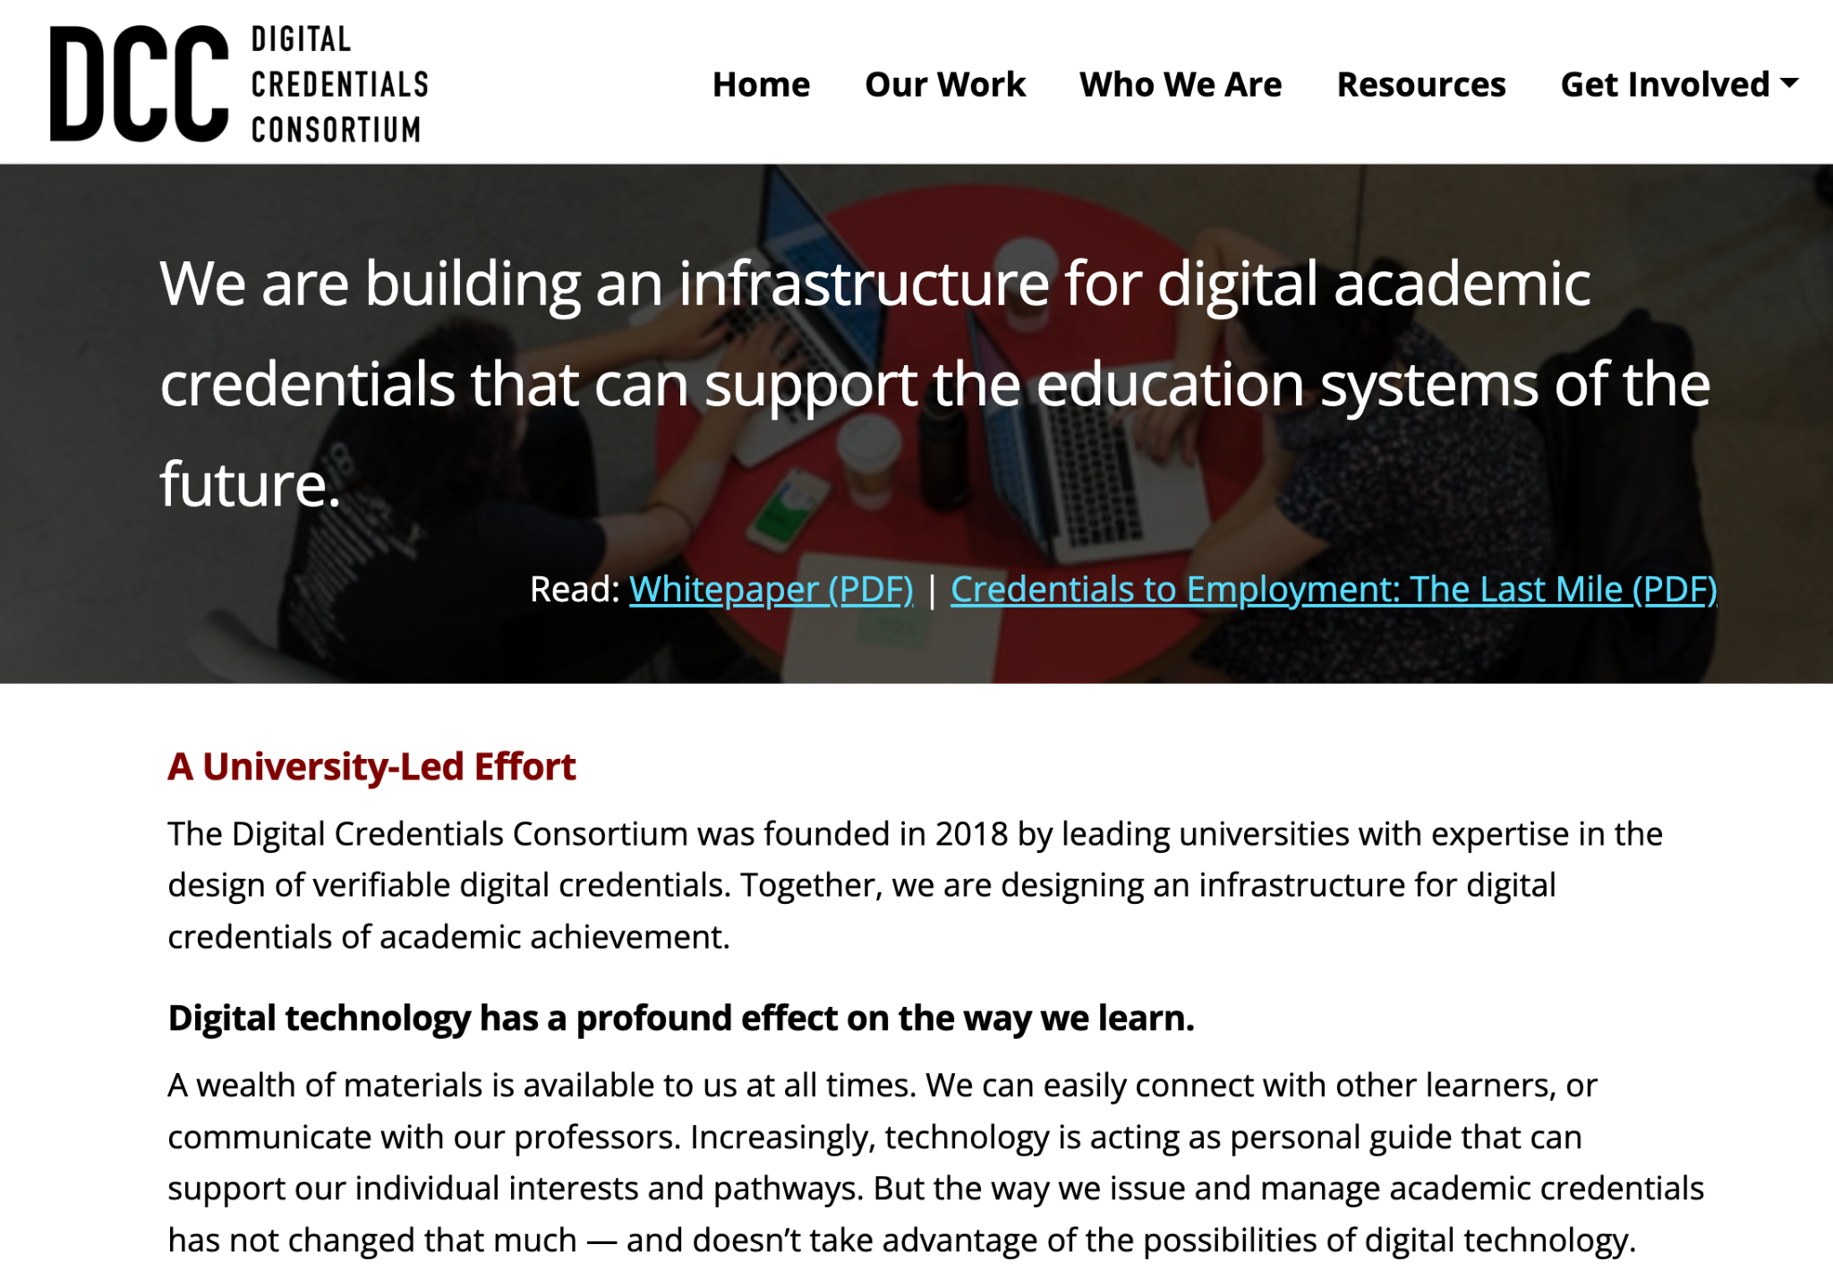

Digital Credentials Consortium Members
Delft University of Technology* (Netherlands)
Georgia Institute of Technology* (USA)
Harvard University* (USA)
Hasso Plattner Institute, Potsdam* (Germany)
Massachusetts Institute of Technology* (USA)
McMaster University* (Canada)
Tecnológico De Monterrey* (Mexico)
Technical University of Munich* (Germany)
University of California, Berkeley* (USA)
University of California, Irvine* (USA)
University of Milano-Bicocca* (Italy)
University of Toronto* (Canada)
Western Governors University (USA)
https://digitalcredentials.mit.edu/
Founded in 2019
* Founding Members
Notes:
Copyright 2023 MIT
Unless otherwise specified this work is licensed under a Creative Commons Attribution 4.0 International License

Slide 4

DCC Guiding Principles | Values
Learners - Commitment to learner agency and participation
Learners retain primary control over their credentials
Issuers - Commitment to issuer control
Issuers [e.g., universities] control to whom they issue credentials, the particular achievement that the credential represents, which credential options are available to the learner, the lifecycle of issuing
Trust - Commitment to open processes, open standards, and software
Credentials can be verified without consulting original issuer
Notes:
Copyright 2023 MIT
Unless otherwise specified this work is licensed under a Creative Commons Attribution 4.0 International License

Slide 5
Putting DCC Guiding Principles into Action
Leading and contributing to the development of open standards
  Co-leading W3C Verifiable Credentials for Education Task Force; participating in development of Open Badges v3; deep technical expertise in key technologies
Supporting an open source mobile wallet
  Enabling learner control and privacy preserving
  Enabling sharing of credentials, credentials → employers
Supporting open source software to enable universities to issue Verifiable Credentials / Open Badges v3
  Working with DCC members to deploy VC-based issuing
Supporting DCC Members in issuing verifiable digital credentials
Enabling the development of a LER Ecosystem
Notes:
Copyright 2023 MIT
Unless otherwise specified this work is licensed under a Creative Commons Attribution 4.0 International License

Slide 6
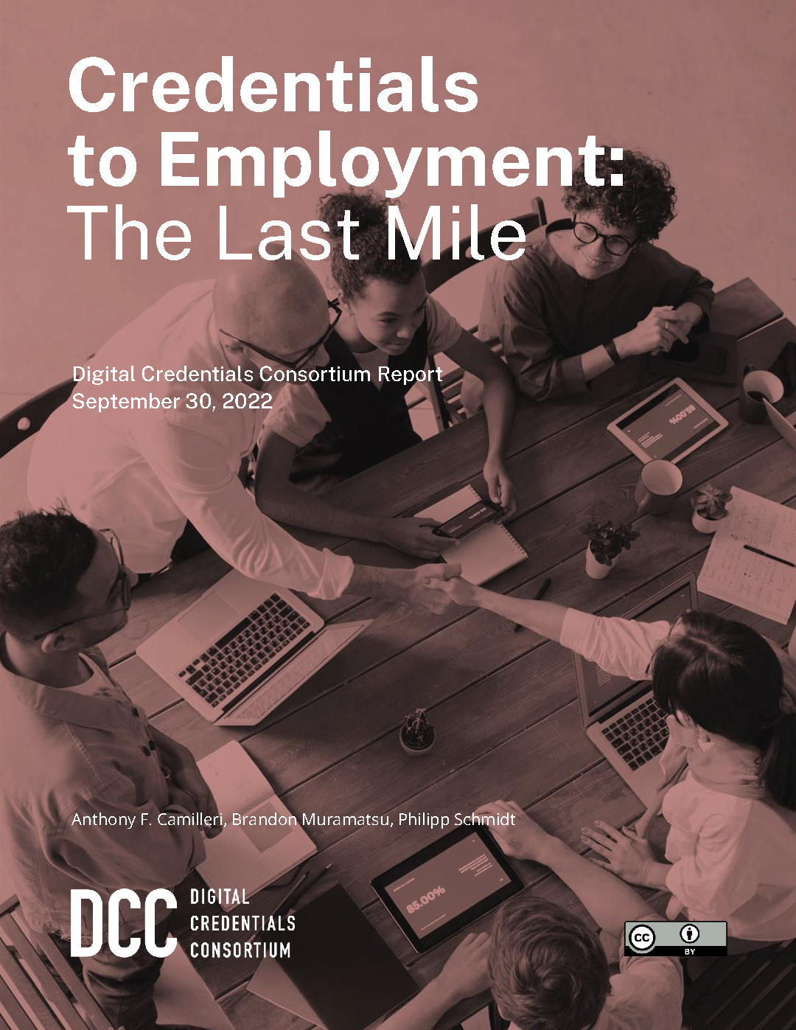
“Last Mile” Report
https://bit.ly/DCCLastMile
Employers want to match the skills held by
applicants to jobs, BUT there’s a disconnect
Resumes, paper and PDF, are still the lingua franca
Digital credentials need to contain granular information about learning outcomes or achievements to map to skills needed for a job
Adoption of Verifiable Credentials is directly related to the way they are integrated into Human-Resource Management Systems—not currently supported, won’t be added by vendors unless there is demand
Notes:
Source: Executive Summary from Camillieri, A., Muramatsu, B. & P. Schmidt. (2022). Credentials to employment: the last mile. https://digitalcredentials.mit.edu/docs/Credentials-to-Employment-The-Last-Mile.pdf
Map the space between the promise of digital credentials that represent skills, competencies and abilities and their widespread adoption in employment-related use cases
Copyright 2023 MIT
Unless otherwise specified this work is licensed under a Creative Commons Attribution 4.0 International License

Slide 7
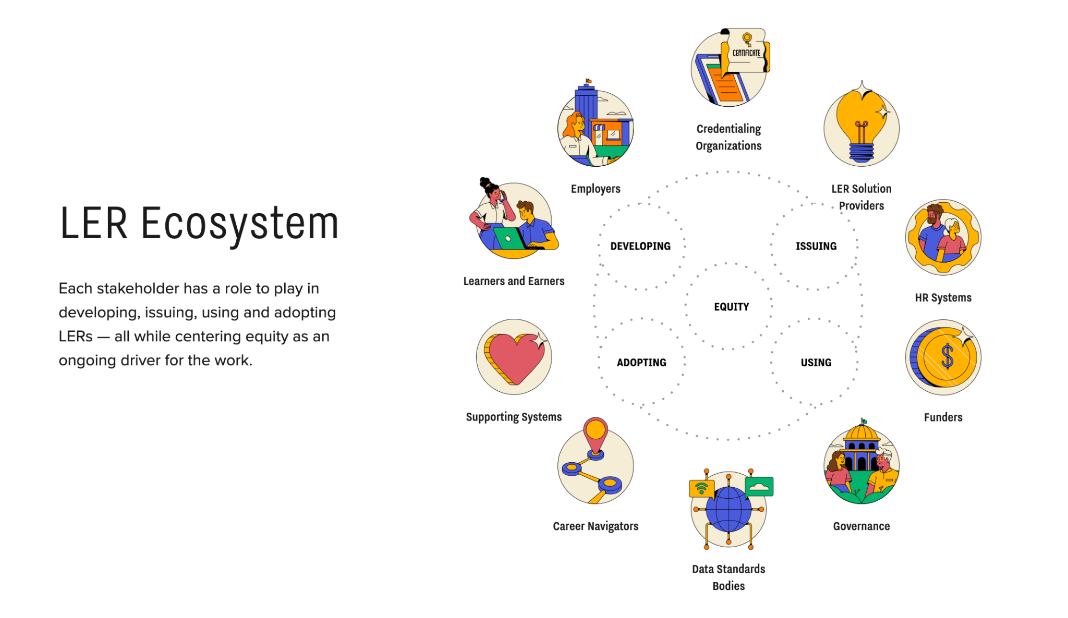
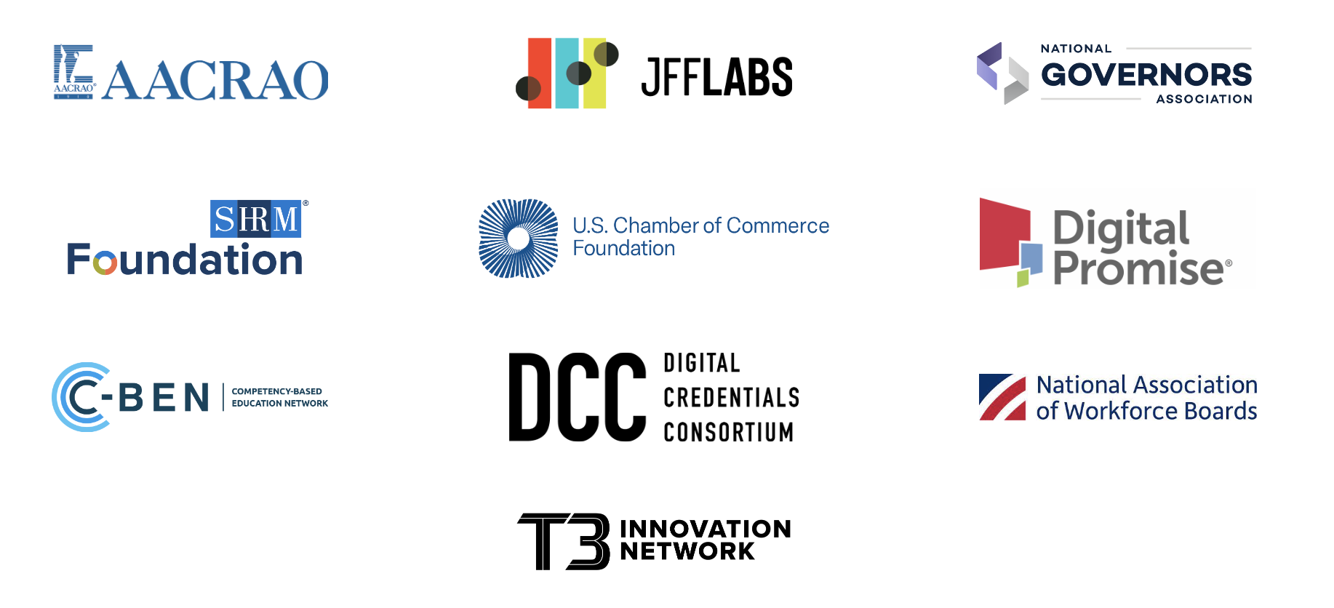
LER Ecosystem Map
https://lermap.t3networkhub.org
Notes:
Copyright 2023 MIT
Unless otherwise specified this work is licensed under a Creative Commons Attribution 4.0 International License

Slide 8
Verifiable Credentials &
DCC Open Source Software:
Underlying standards and technology to enable issuing verifiable digital academic credentials
Notes:
Copyright 2023 MIT
Unless otherwise specified this work is licensed under a Creative Commons Attribution 4.0 International License

Slide 9
DCC’s Starting Point in Technology—Open Standards
W3C Verifiable Credentials Data Model
  -> 1Edtech Open Badges v3 context
W3C VC-API
  Provides data model and HTTP protocols to issue, verify, present, and manage data used in such an ecosystem
CHAPI
  Protocol allows a digital wallet to receive Verifiable Credentials from an independent third-party issuer - or present Verifiable Credentials to an independent third-party verifier - in a way that establishes trust and preserves privacy
Learner Credential Wallet Specification
  Describes the necessary wallet features and technical requirements enabling individuals to curate and present their learning and employment records to others in an interoperable manner
Notes:
Copyright 2023 MIT
Unless otherwise specified this work is licensed under a Creative Commons Attribution 4.0 International License

Slide 10
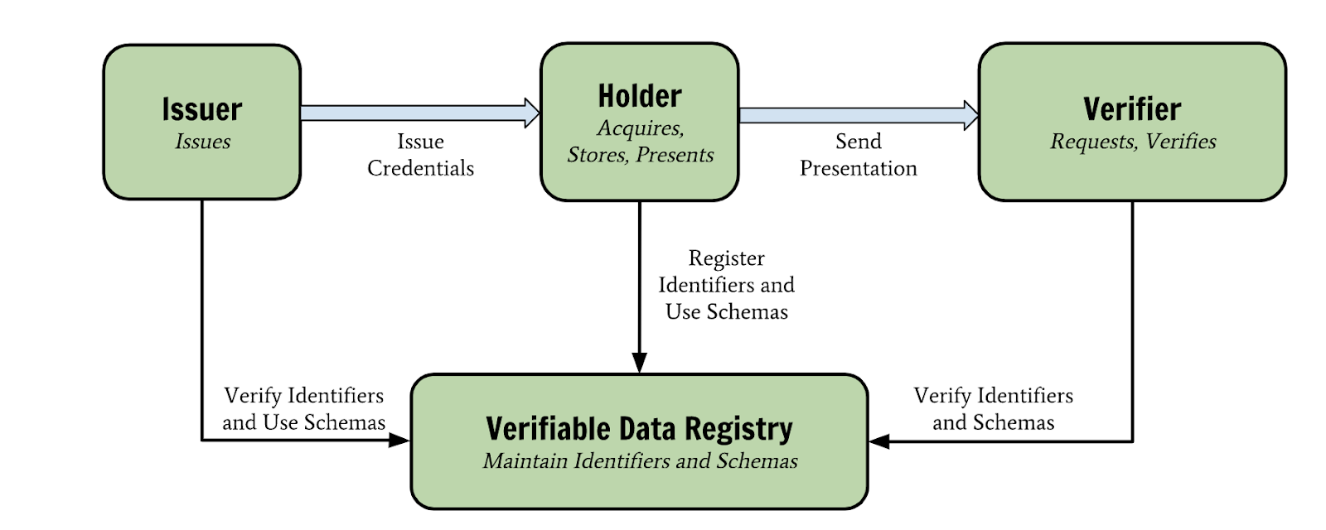
Verifiable Credentials Ecosystem
Employer /
Graduate School
DCC Credential
Tamper-evident credential where the authorship can be cryptographically verified, that meets the technical and policy specifications adopted by the DCC.
Uses credentials conforming to W3C Verifiable Credentials 1.1 Data Model (e.g., Open Badges v3)
College / University
Learner
National Organization / DCC
Ecosystem Diagram from W3C Verifiable Credentials Data Model
Notes:
Copyright 2023 MIT
Unless otherwise specified this work is licensed under a Creative Commons Attribution 4.0 International License

Slide 11
Verifiable Credentials Ecosystem
DCC open source software supports all aspects of VC ecosystem
Employer /
Graduate School
DCC Credential
Tamper-evident credential where the authorship can be cryptographically verified, that meets the technical and policy specifications adopted by the DCC.
Uses credentials conforming to W3C Verifiable Credentials 1.1 Data Model (e.g., Open Badges v3)
College / University
Learner
Issuer Compo-
nents
Learner Credential Wallet
Verifier
Plus
Registries
National Organization / DCC
DCC open source software can help you get started!
Notes:
Copyright 2023 MIT
Unless otherwise specified this work is licensed under a Creative Commons Attribution 4.0 International License

Slide 12
Motivations in Ecosystem Participants
Notes:
Copyright 2023 MIT
Unless otherwise specified this work is licensed under a Creative Commons Attribution 4.0 International License

Slide 13
Verifiable Credentials Provide Opportunities
Decentralized (Individual) / Centralized (Repository/Union Catalog)
“Personal Agency” / Issuer- or Service Provider-controlled
Data (Digital) / Digitalised — data / PDF of Paper
Doing what’s ”right” (better) / doing what’s “easy”
Some things don’t change
  Trust; Identity: Issuers and Holders
Some things probably should change
At the end of the day, it’s not been about the technology—certainly not now with most enabling technologies available. Policy, trust and “human tendencies” continue to be primary challenges.
Notes:
Copyright 2023 MIT
Unless otherwise specified this work is licensed under a Creative Commons Attribution 4.0 International License

Slide 14
Holders—Learners
Need…
Credentials that are verifiable
To be able to use of their choice of ”wallet”
To be able to add credentials from multiple issuers
To control their own credentials
  Claim credentials as needed
  Decide with whom they want to share them; share between “wallets”
  Share them in a way of their choosing, ultimately differential disclosure
  Manage their own identity (aka self-sovereignty)
“Interoperability”
Notes:
Copyright 2023 MIT
Unless otherwise specified this work is licensed under a Creative Commons Attribution 4.0 International License

Slide 15
Holders—Learners
Need not allow…
Non-privacy preserving features
A “wallet” to track their use: who are they, what credentials have they received, how / to whom have they shared their credentials
The issuing organization or third-party service provider to track use, beyond fundamental minimums
Notes:
Copyright 2023 MIT
Unless otherwise specified this work is licensed under a Creative Commons Attribution 4.0 International License

Slide 16
Issuers—Universities and Service Providers
Universities Need to:
Implement standards based, and trusted digital credentials
Determine who gets what credential
Determine if their credential is issued appropriately and not mis-issued [issuance registry]
Ensure their credential contents and prevent tampering → cryptographically sign
Manage their credential: issue, update / replace, revoke
Credential should be verifiable → cryptographic signature, issuer registry
Universities May Want to:
Design the credential display
Allow a third party to issue on their behalf [issuing organization]
  Issuing Organizations May Want to:
Track recipients claiming their credential
Track recipients sharing their credential
Verify the credential directly
Support Learner Needs
May support less learner control
Notes:
Copyright 2023 MIT
Unless otherwise specified this work is licensed under a Creative Commons Attribution 4.0 International License

Slide 17
Verifiers—Employers/Graduate School
Need to be able to “verify” a credential
  Has it been tampered with?
  Is there trust that the issuer is who they expect it to be?
May want to verify directly with the issuer
  Verifiable Credential standard and DCC open source software don’t require this, https://verifierplus.org
Notes:
Copyright 2023 MIT
Unless otherwise specified this work is licensed under a Creative Commons Attribution 4.0 International License

Slide 18
DCC Issuing and
Learner Credential Wallet
Notes:
Copyright 2023 MIT
Unless otherwise specified this work is licensed under a Creative Commons Attribution 4.0 International License

Slide 19
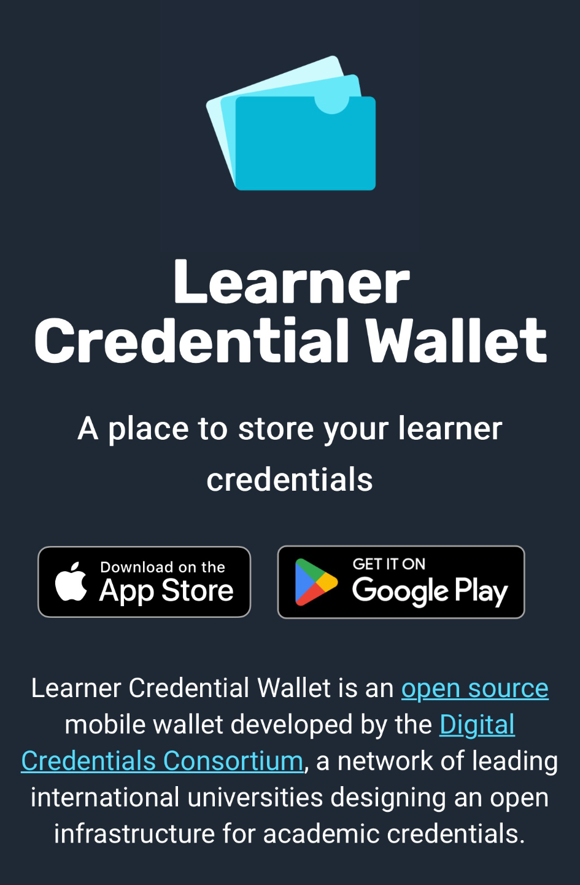
Example of Claiming a Credential
Recipient receives an email on mobile phone
1. Install LCW
College Unbound is working with the Digital Credentials Consortium team at MIT to evaluate a new technology to make it easier for CU degree holders to access and share your degree.
To receive your digital credential in this new format:
Visit lcw.app and install the Learner Credential Wallet for iOS or Android on your mobile phone
Open this email on your mobile phone (after installing the app) and follow this personalized link to retrieve your credential (don't share the link for this credential)!
Notes:
Copyright 2023 MIT
Unless otherwise specified this work is licensed under a Creative Commons Attribution 4.0 International License

Slide 20
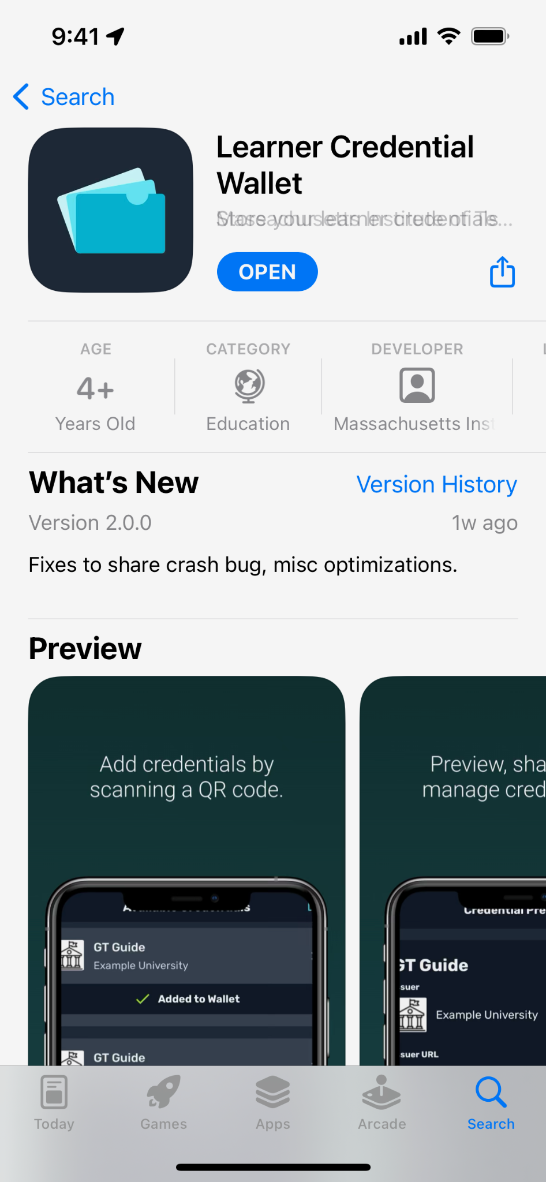
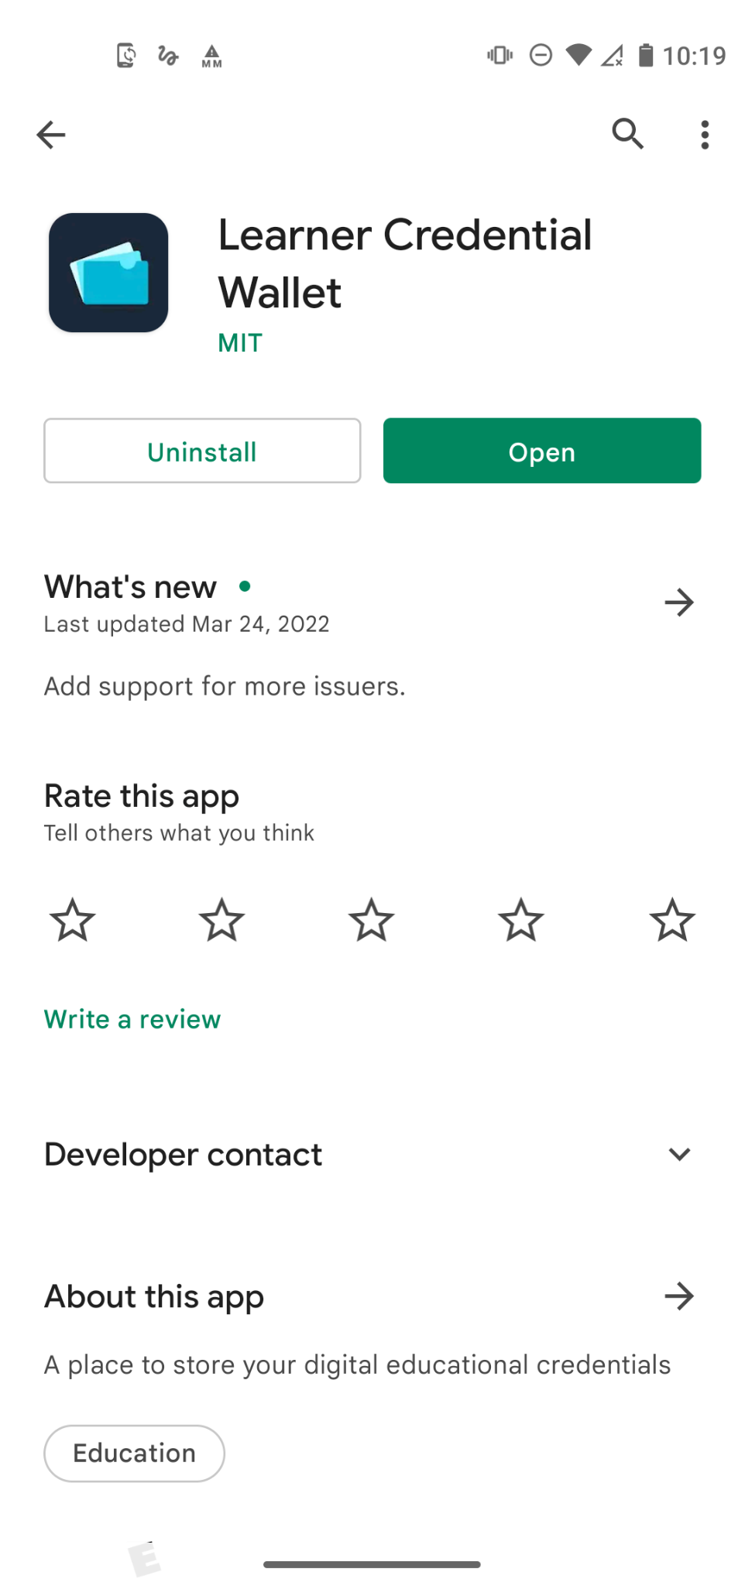
Get Learner Credential Wallet from an App Store

Slide 21
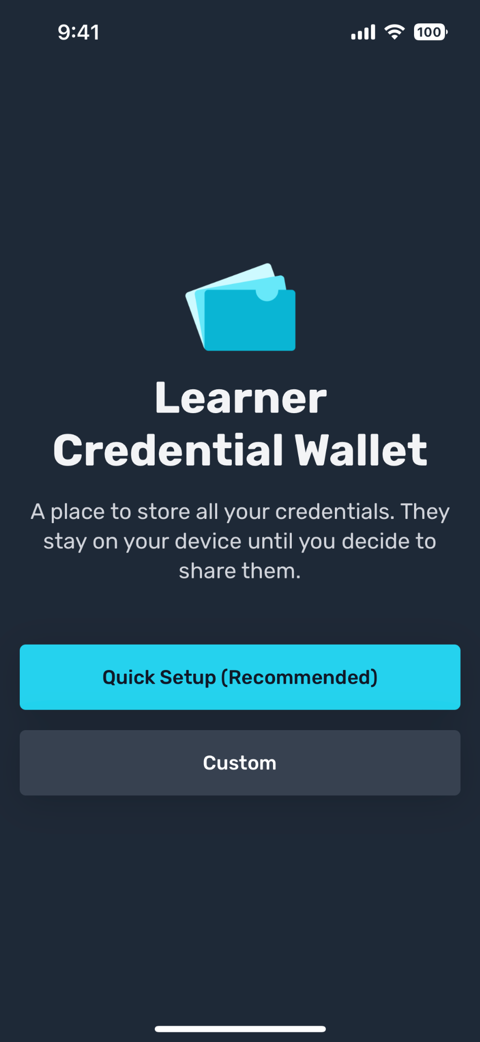
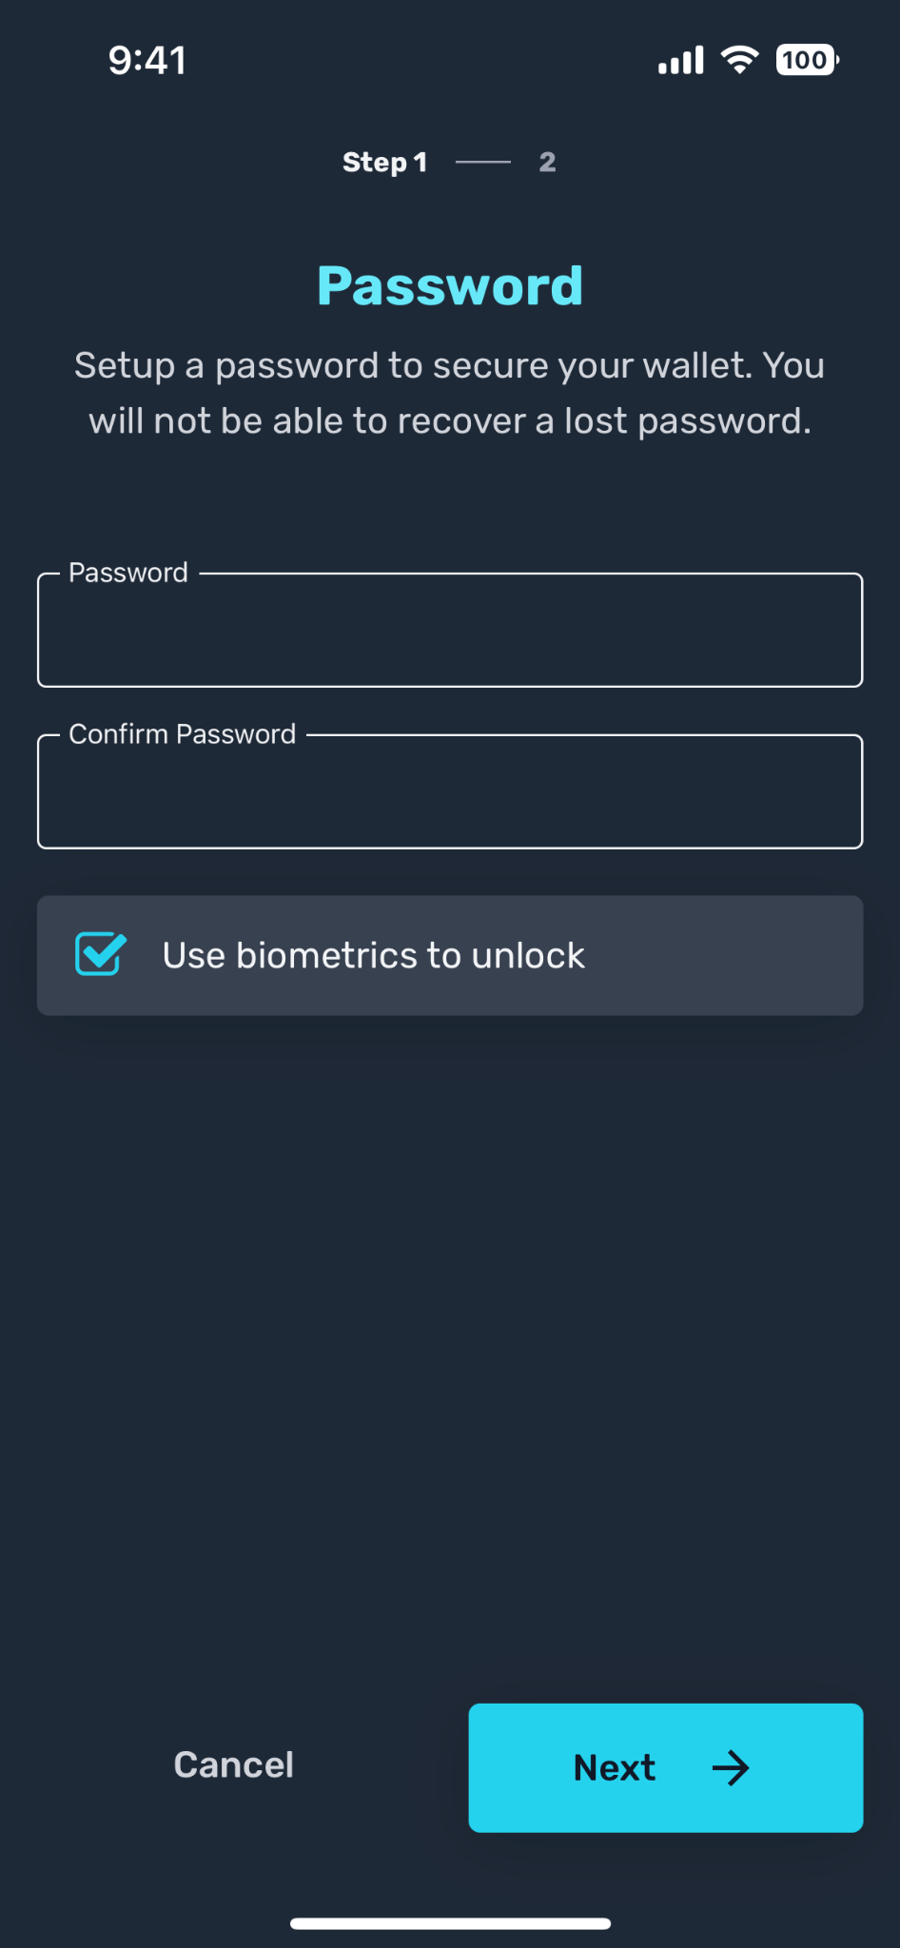
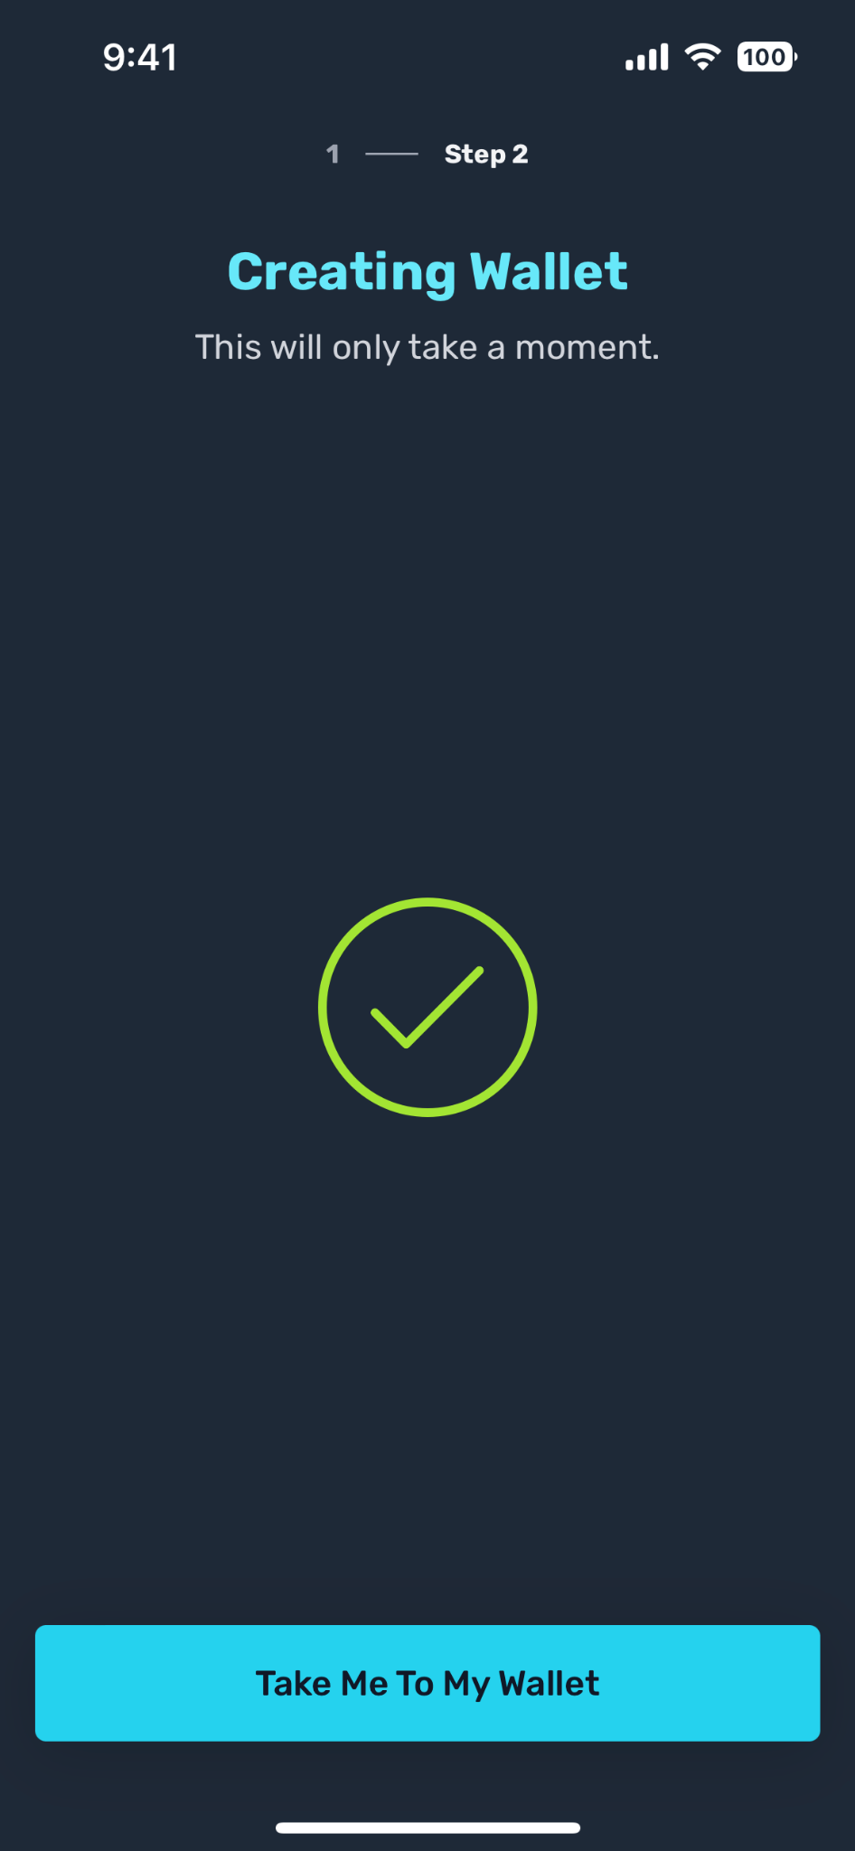
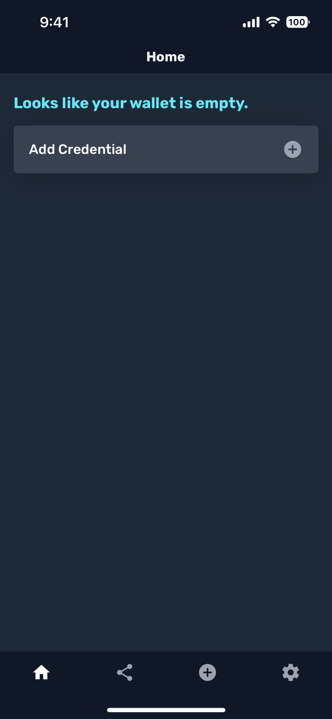
Install and setup Learner Credential Wallet
Notes:
Copyright 2023 MIT
Unless otherwise specified this work is licensed under a Creative Commons Attribution 4.0 International License

Slide 22
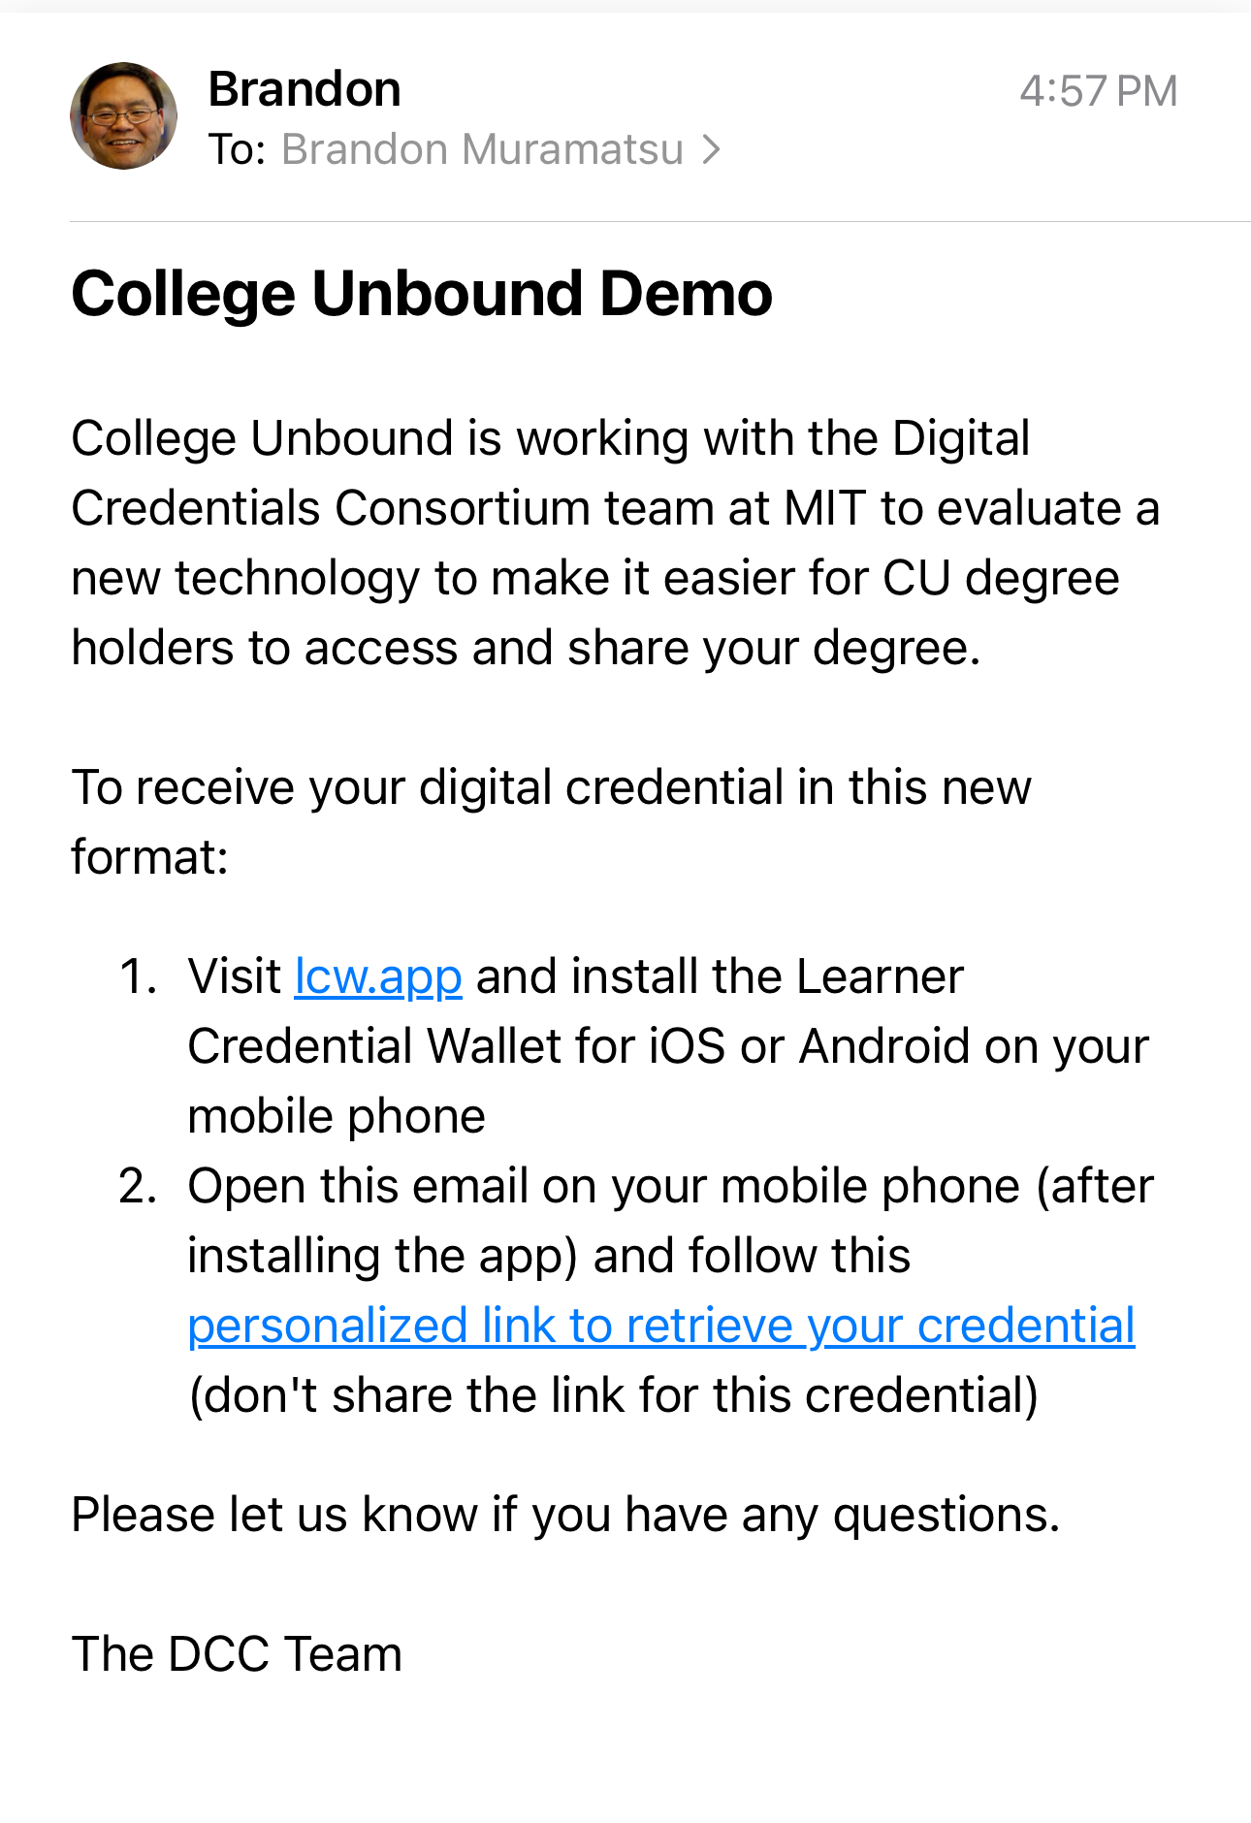
Example of Claiming a Credential
Recipient receives an email on mobile phone
2. Claim Credential
College Unbound is working with the Digital Credentials Consortium team at MIT to evaluate a new technology to make it easier for CU degree holders to access and share your degree.
To receive your digital credential in this new format:
Visit lcw.app and install the Learner Credential Wallet for iOS or Android on your mobile phone
Open this email on your mobile phone (after installing the app) and follow this personalized link to retrieve your credential (don't share the link for this credential)
Notes:
Copyright 2023 MIT
Unless otherwise specified this work is licensed under a Creative Commons Attribution 4.0 International License

Slide 23
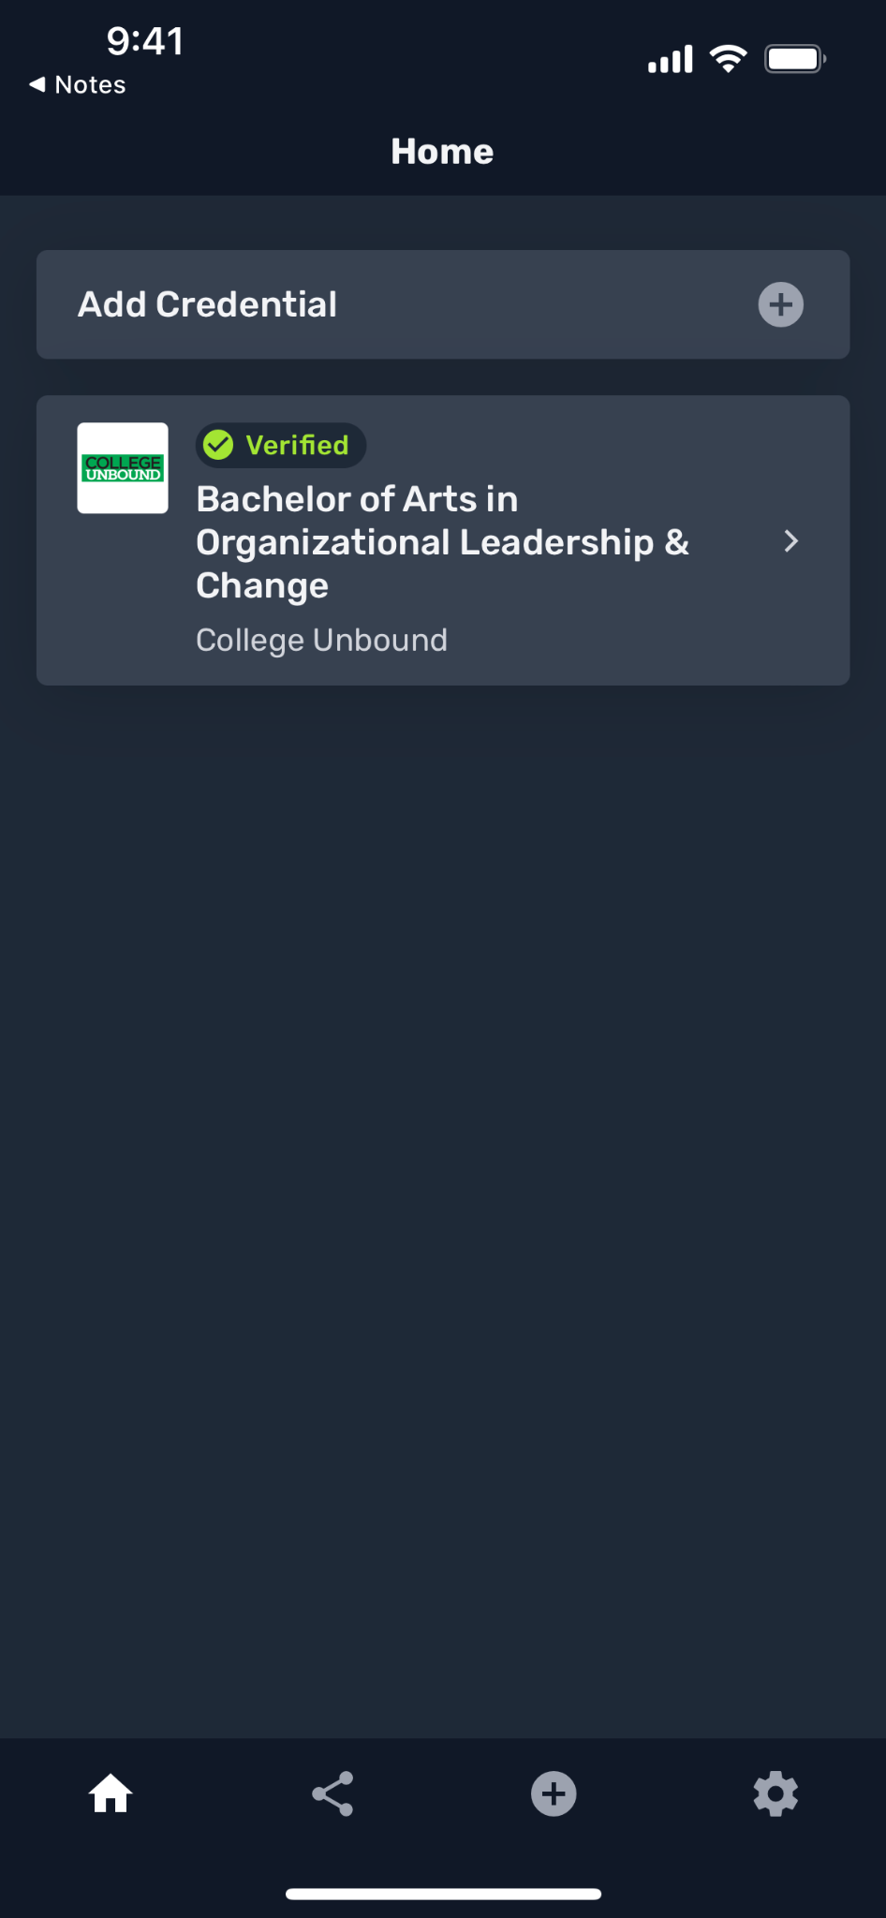
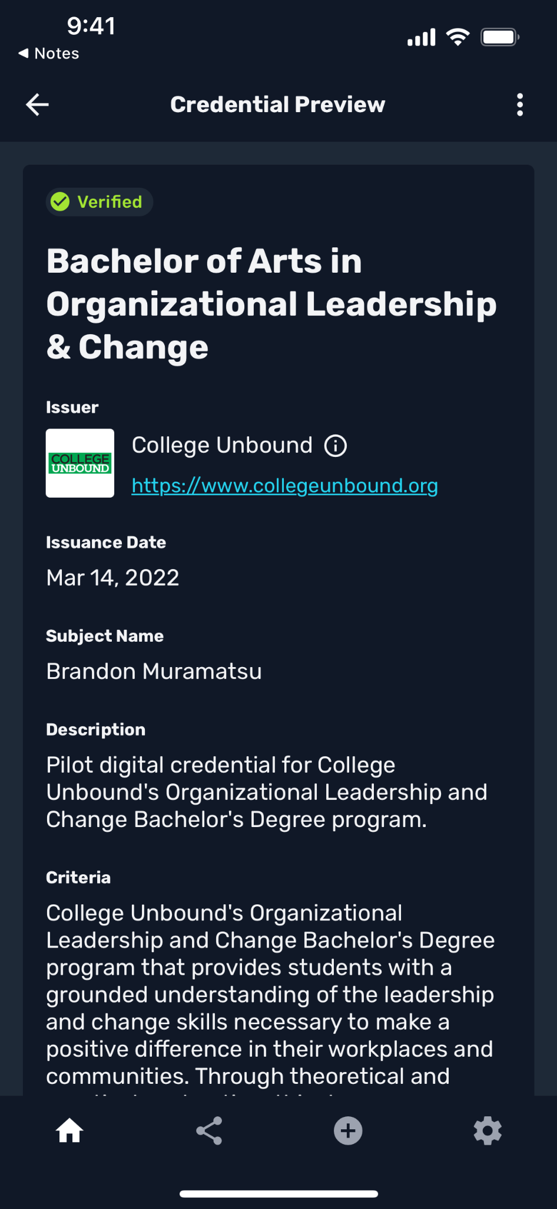
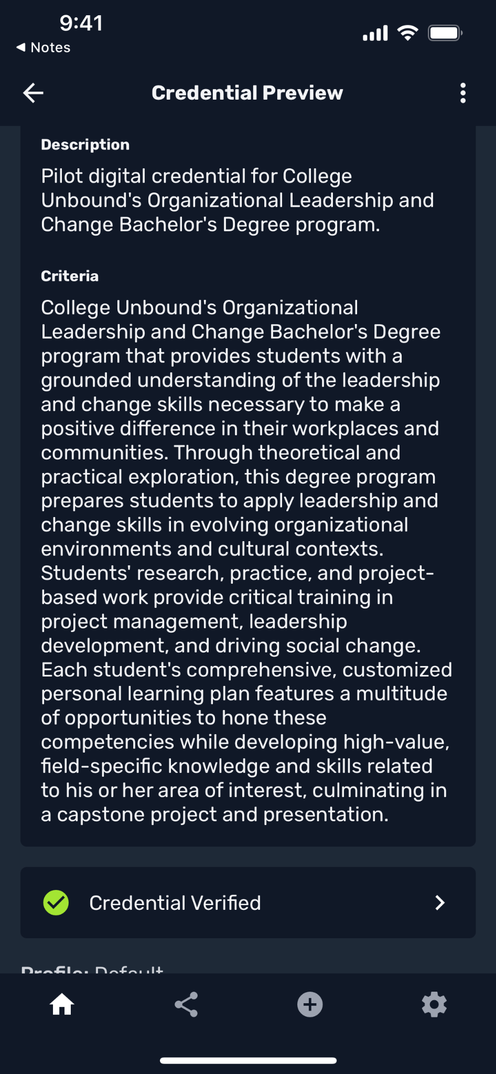
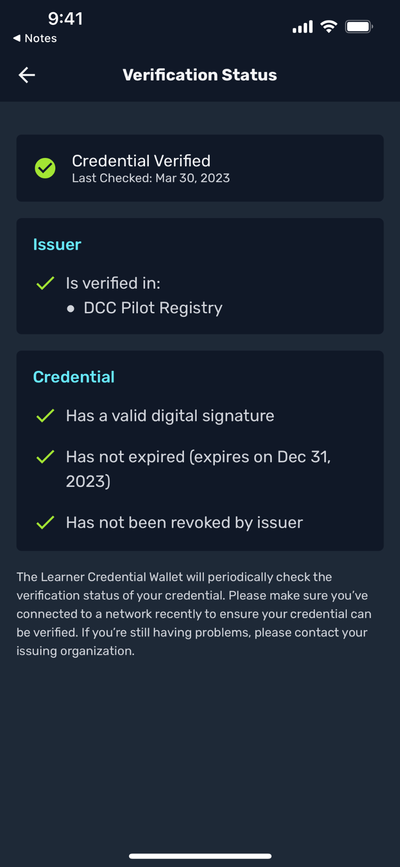
Credential Preview, Verification Status
Notes:
Copyright 2023 MIT
Unless otherwise specified this work is licensed under a Creative Commons Attribution 4.0 International License

Slide 24
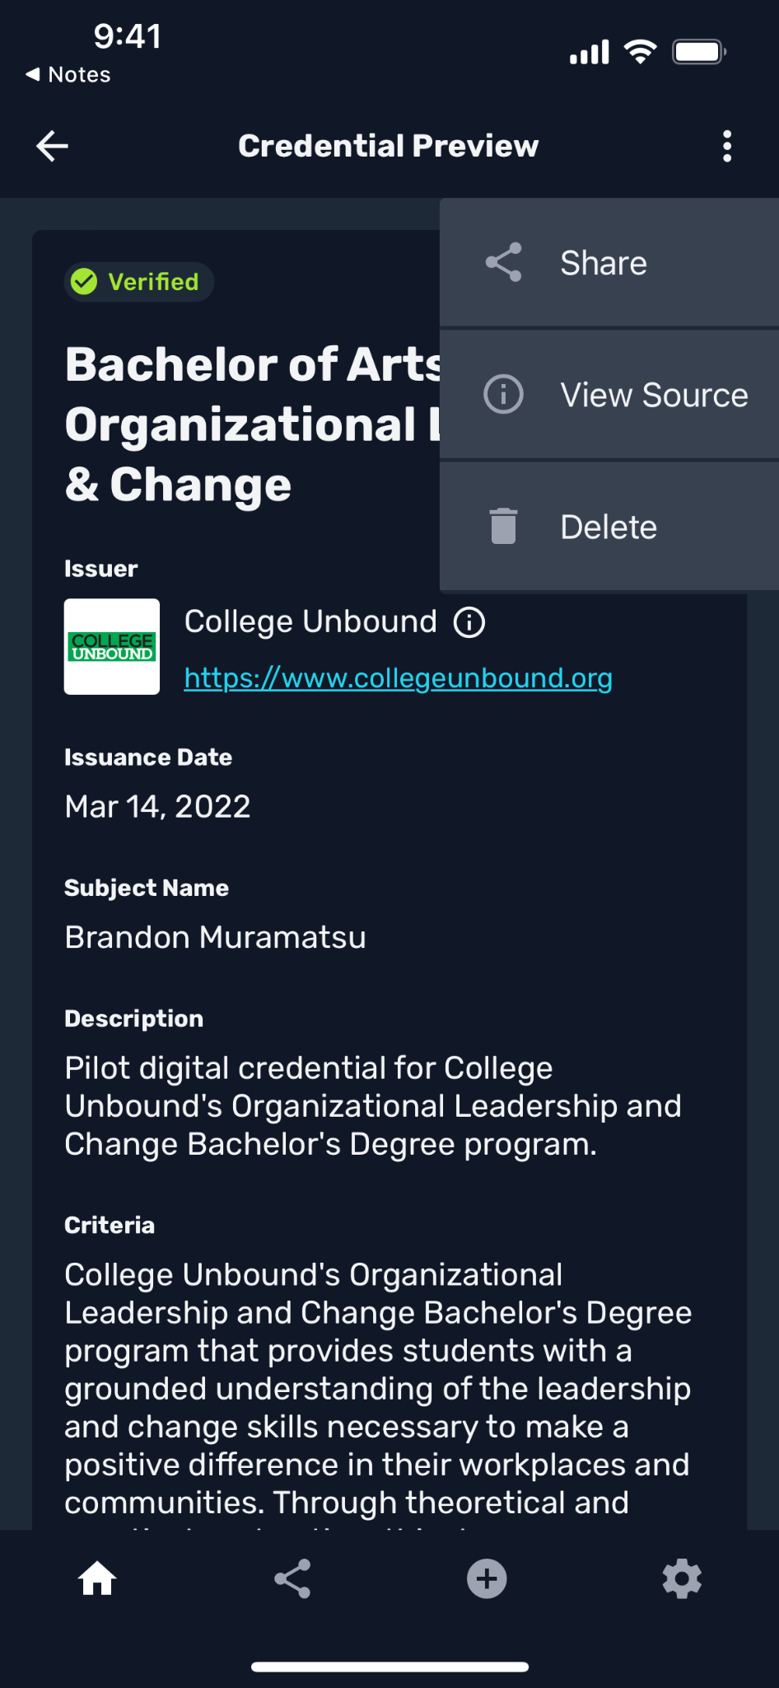
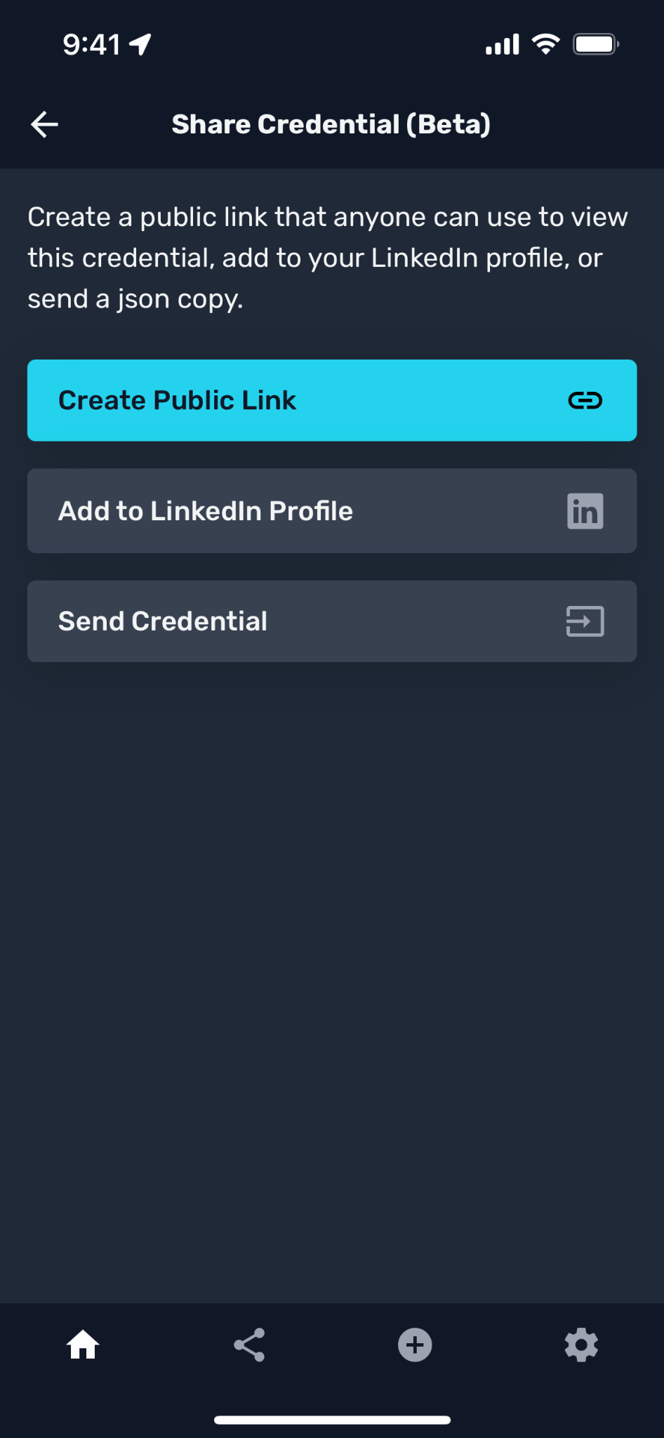
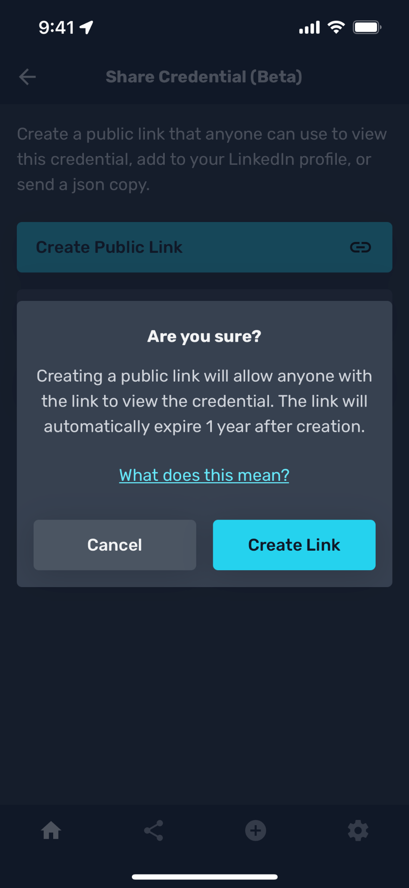
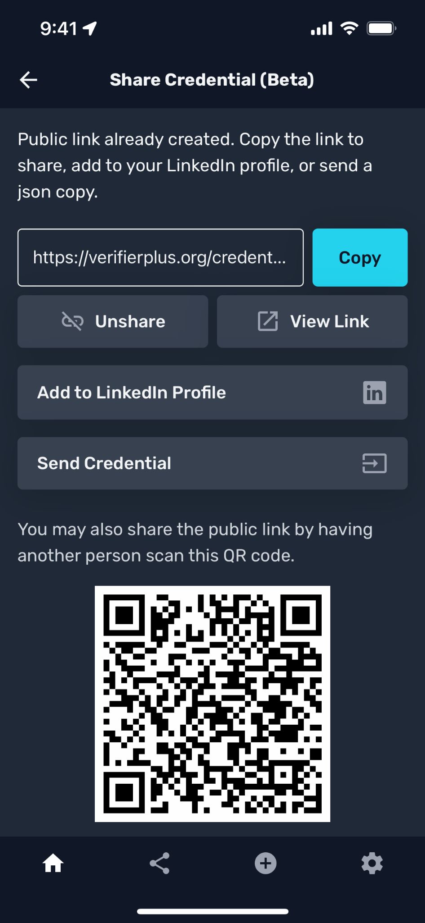
Share Credential, Create Public Link
Notes:
Copyright 2023 MIT
Unless otherwise specified this work is licensed under a Creative Commons Attribution 4.0 International License

Slide 25
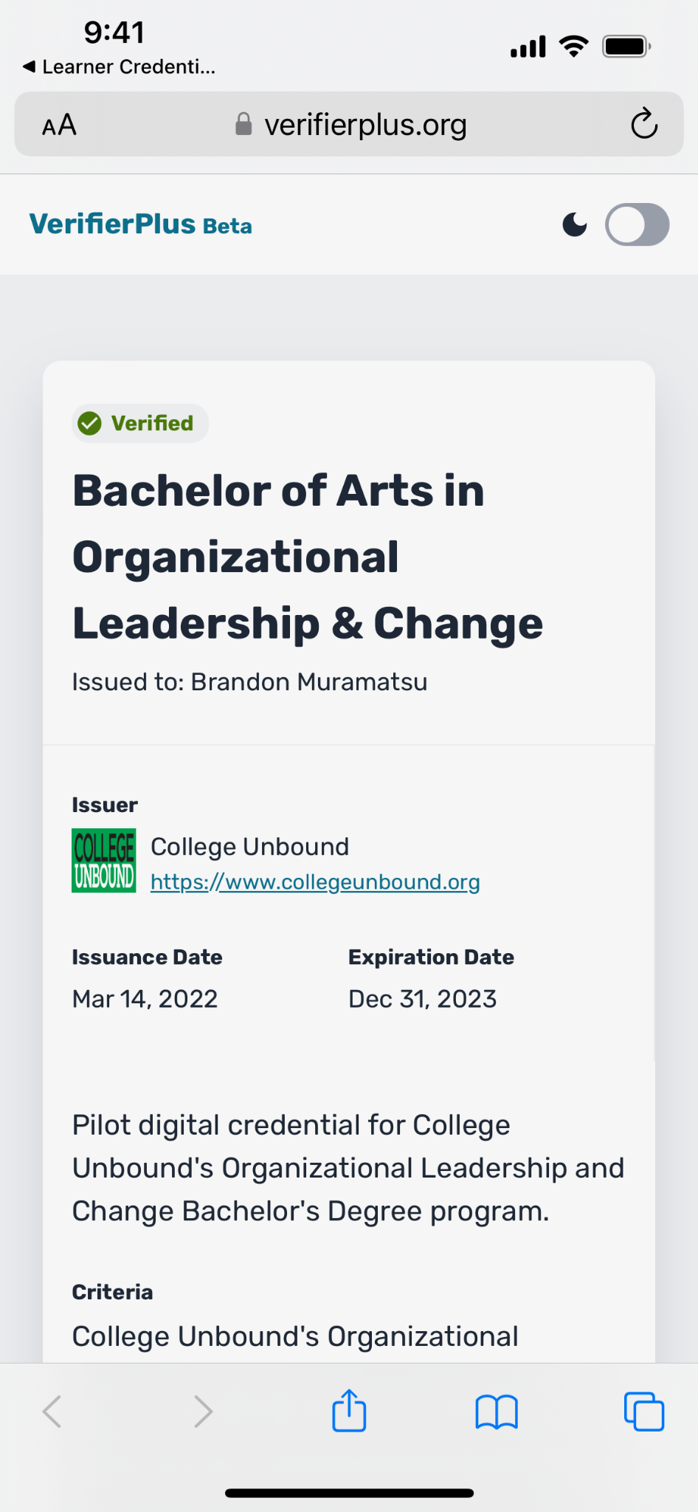
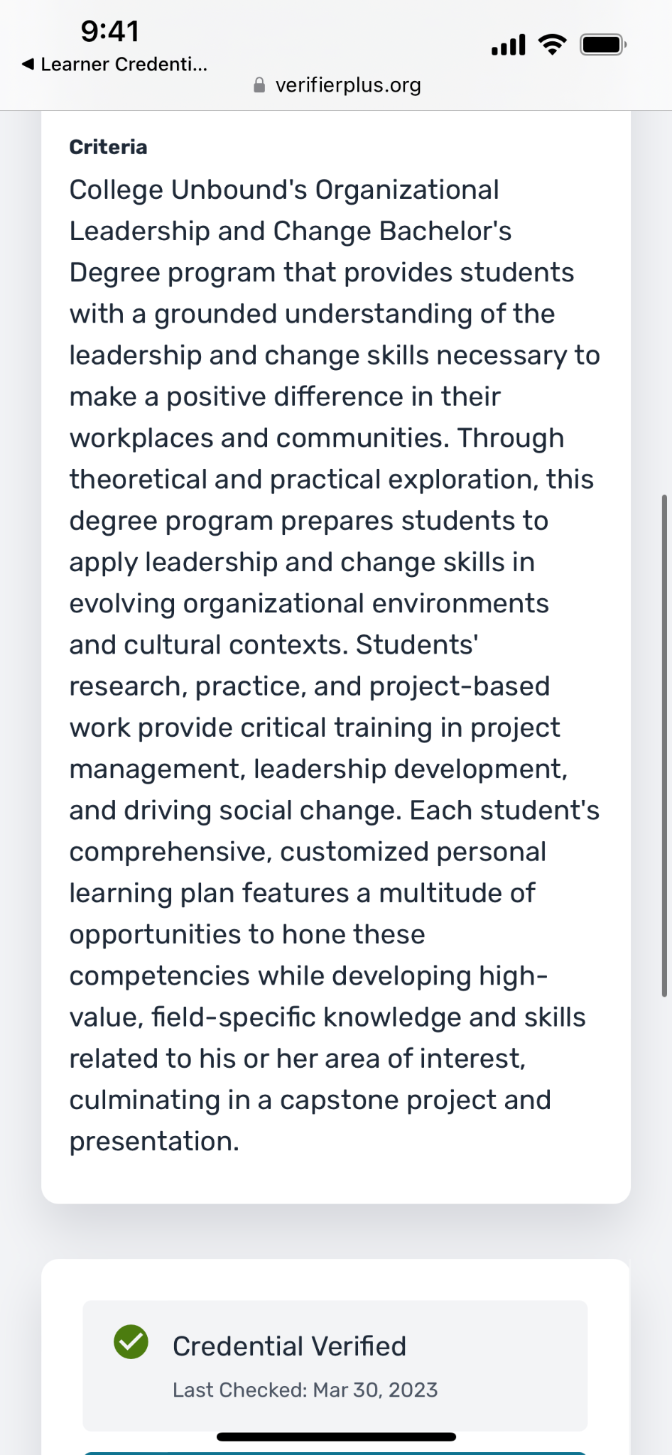
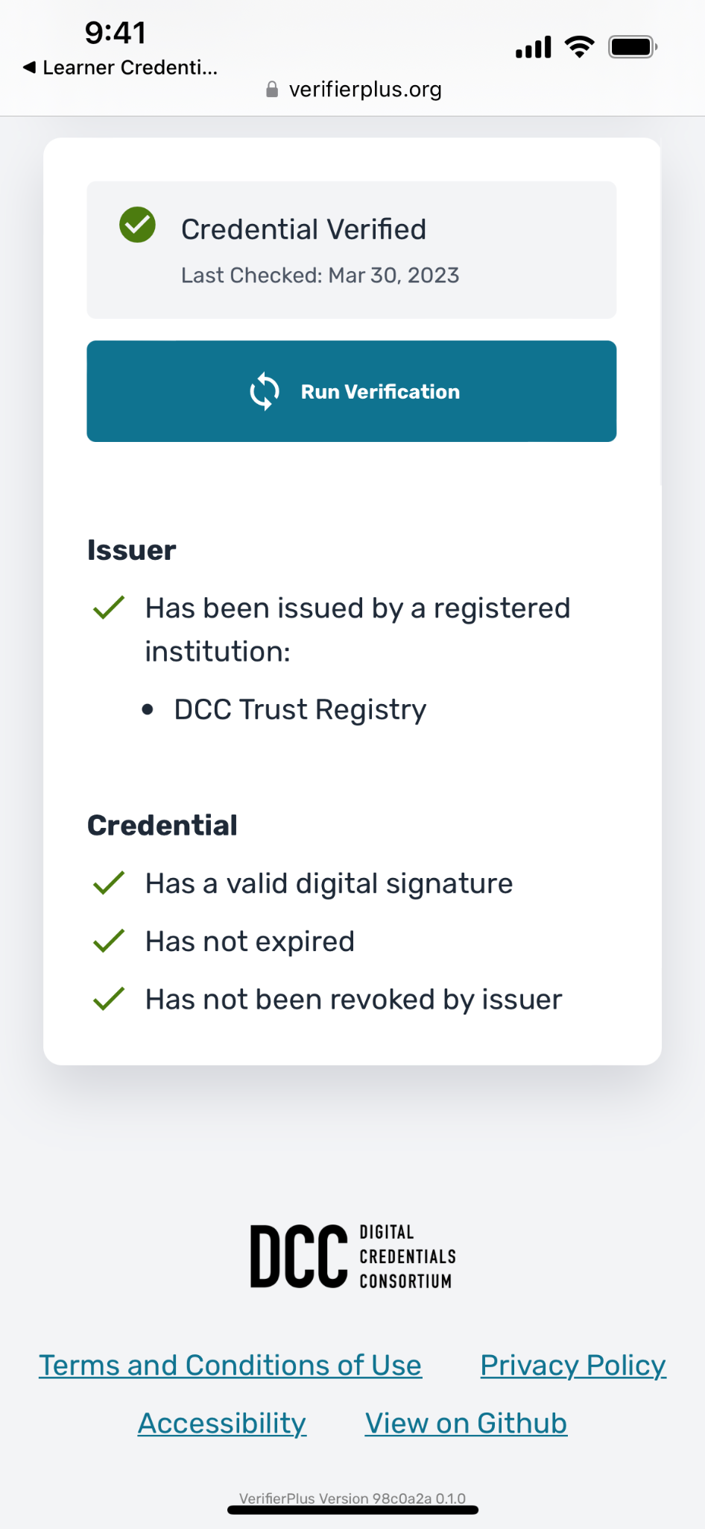
View Shared Public Credential, Verification
Notes:
Copyright 2023 MIT
Unless otherwise specified this work is licensed under a Creative Commons Attribution 4.0 International License

Slide 26
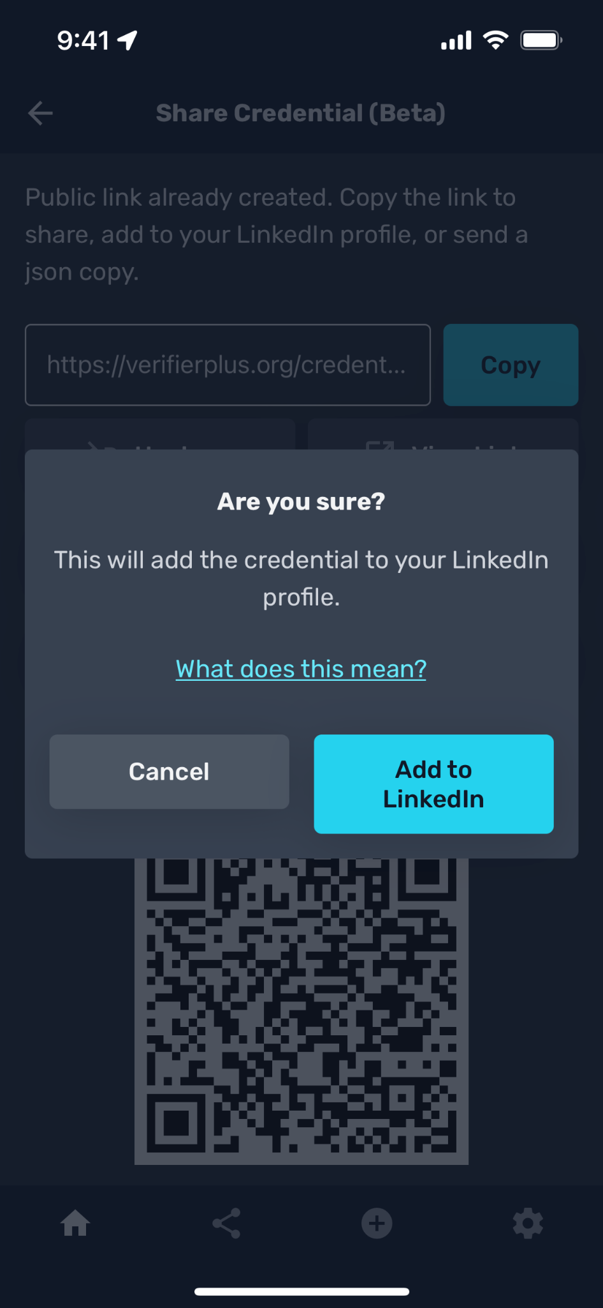
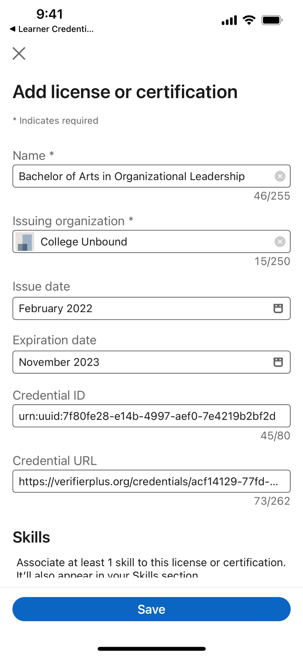
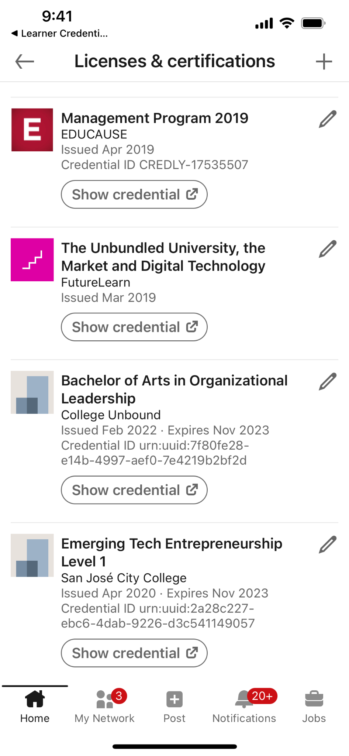
Add to LinkedIn Profile
Notes:
Copyright 2023 MIT
Unless otherwise specified this work is licensed under a Creative Commons Attribution 4.0 International License

Slide 27
Questions?
Brandon Muramatsu, mura@mit.edu
Higher education or post-graduate institution? Interested in membership in DCC? Contact Us!
Open source software to issue/verify verifiable credentials / Open Badges v3: https://github.com/digitalcredentials
Notes:
Copyright 2023 MIT
Unless otherwise specified this work is licensed under a Creative Commons Attribution 4.0 International License

