Slide 1

Starting A(nother) OER Secondary School, The Itz’at STEAM Academy
Brandon Muramatsu, MIT
DeLaina Tonks, Mountain Heights Academy
John Newport, Itz’at STEAM Academy
Kirky DeLong, MIT
Jon Fila, Consultant
Cite as: Muramatsu, B., Tonks, D., Newport, J., DeLong, K., & Fila, J. (2024). Starting A(nother) OER Secondary School, The Itz’at STEAM Academy. OER2024 - Digital Transformation in Open Education. March 27, 2024.
Notes:
Claudia

Slide 2

Itz’at STEAM Academy
Opened September 2023 to 64 students in First Form (equiv. U.S. 8th grade)
Opportunity: Establish an innovative, contemporary STEAM secondary school in Belize based on MIT principles of “mind and hand” and heart, active learning, project-based learning focusing on UN Sustainable Development Goals

Slide 3
Why this team?
Helped to launch the Open Educational Resources movement with MIT OpenCourseWare in 2001
OER and “Mind, hand and heart” deeply infuse our work
Opened Mountain Heights Academy, a charter high school in 2009, utilizing OER for all course materials
Expertise and experience in advising other high schools adopting OER
Expertise in developing OER lesson plans, etc.

Slide 4
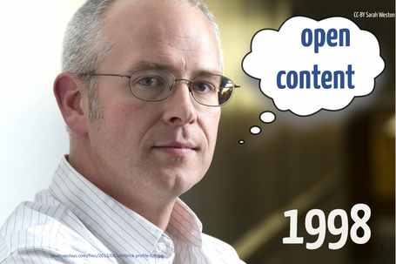
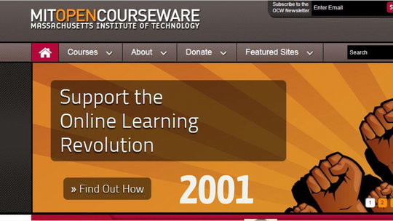
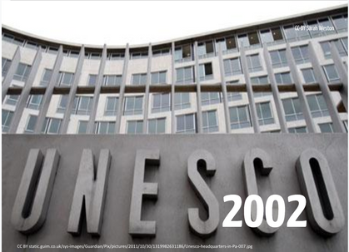
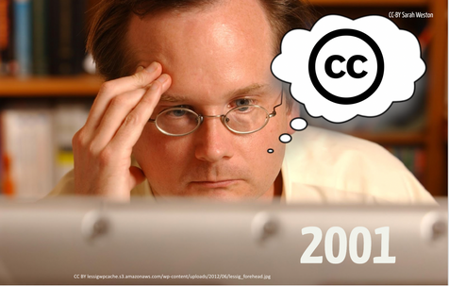
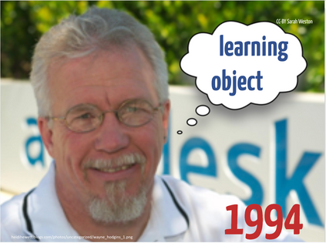
A (Brief) History of OER
CC-BY DeLaina Tonks

Slide 5
Mountain Heights Experiences
Mission: To develop connected and successful learners, opened in 2009
Experimented, evaluated, learned
Identified multiple benefits of OER, including just-in-time instruction and differentiation
Teachers as instructional designers
Schoolwide goal to increase OER impact, by supporting others

Slide 6
Itz’at STEAM Academy: OER Policy
To help meet the mission and vision, the school will:
Design the school’s curriculum such that the use of Open Educational Resources comprises a majority percentage of teaching and learning materials.
Develop materials, especially those for use in teaching and learning at the school, as Open Educational Resources utilizing a permissive license.
Utilize OER to provide ready access to materials and to personalize materials to meet the needs of individual students.
Promote the use and awareness of OER through professional development activities supported by the school.
Promote the creation, use and awareness of OER by students.
Communicate the use of and value of OER with parents, other community members and the education system in Belize.
STEAM Laboratory School. ”Belize STEAM Laboratory School Open Educational Resources Policy”. June 30, 2022.

Slide 7
Key Elements of the Policy
Patterned after Mountain Heights
  Copyright, Attribution
  CC-BY License
  Students
  Teacher Support
As a new school, distinguishing what’s used in the classroom, vs. what (and when) the school publishes the OER

Slide 8
Copyright
The Belize STEAM Laboratory School will hold the copyright of all materials developed for use at the school by its teachers, educators, administrators and other staff.
The Belize STEAM Laboratory School will be the publisher of all materials developed for use at the school by its teachers, educators, administrators and other staff.
A copyright statement may be included with materials published by the Belize STEAM Laboratory School.
The following is an example copyright statement: Copyright © 2022, Belize STEAM Laboratory School.
STEAM Laboratory School. ”Belize STEAM Laboratory School Open Educational Resources Policy”. June 30, 2022.

Slide 9
License
The Belize STEAM Laboratory School will publish and license the materials developed by its teachers, educators, administrator and other staff with a current Creative Commons Attribution license. As of June 2022, all materials will be licensed with a Creative Commons Attribution 4.0 International License.
STEAM Laboratory School. ”Belize STEAM Laboratory School Open Educational Resources Policy”. June 30, 2022.

Slide 10
Attribution & Citation
Attribution
Individuals contributing to the development of materials developed and/or published by the Belize STEAM Laboratory School will have the option of having their name listed along with the Belize STEAM Laboratory School on a material-by-material basis. Contributions by those outside of the school may be included upon request and with consent of the publisher. Contributions will follow generally accepted practice of attribution in academic publications.
Good practice for attribution of the materials described by this policy is to include the title, author, source and license.
Citation
Good practice for citation of materials developed by the school is to follow standard citation guidelines such those published by the American Psychological Association or the Modern Language Association.
STEAM Laboratory School. ”Belize STEAM Laboratory School Open Educational Resources Policy”. June 30, 2022.

Slide 11
Students
Students of the Belize STEAM Laboratory School will hold the copyright of materials they develop during their attendance at the school.
Students may opt out of which materials are used by the school as part of lesson plans and activities. (For example, students will engage in project work and the school may request that some or all of the project materials be included as part of future lesson plans and activities.)
Student materials that are not opted and are used as part of lesson plans and activities will be licensed with a current Creative Commons Attribution license.
STEAM Laboratory School. ”Belize STEAM Laboratory School Open Educational Resources Policy”. June 30, 2022.

Slide 12
Publishing OER
Belize STEAM Laboratory School OER will be published in a publicly available website and/or repository that may include: the school’s website; a Ministry of Education, Culture, Science and Technology website / repository; and one or more international OER repositories (e.g., OER Commons9).
STEAM Laboratory School. ”Belize STEAM Laboratory School Open Educational Resources Policy”. June 30, 2022.

Slide 13
Support for Teachers
The Belize STEAM Laboratory School will support teachers, educators, administrators and other staff in the development and use of OER. This support will take the form of regular professional development and includes support for copyright clearance, finding OER, use of a school style guide, etc.
STEAM Laboratory School. ”Belize STEAM Laboratory School Open Educational Resources Policy”. June 30, 2022.

Slide 14
Implementation Challenges
Brand new school, campus under construction as the school opened
New pedagogical approach of competency-based and project-based learning → teachers learning a new system, becoming curriculum developers
Typical challenges in helping teachers / faculty / instructional designers transition to OER
“Building the airplane as we’re flying it”

Slide 15
Learn More
Itz’at STEAM Academy, https://www.itzat.edu.bz
Mountain Heights Academy, https://mountainheightsacademy.org
  OER → https://mountainheightsoer.org
MIT Open Learning, https://openlearning.mit.edu

